Slide 1
How do we clean up this mess?

Slide 2
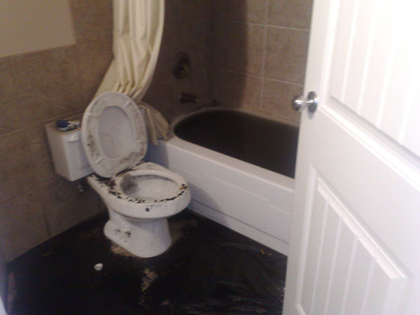
How do we clean up this mess?

Slide 3
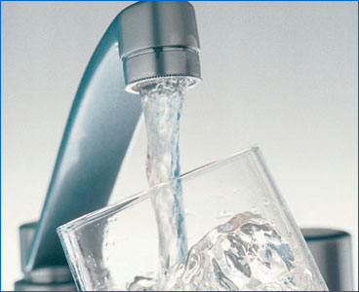
How do we keep our <1% good drinking water safe and clean?
There are many ways we can purify water on earth. For example, you can boil water to help kill harmful bacteria in our drinking water if the sewers overflow into our fresh drinking water supply.
Hydrologists typically use 5 methods for cleaning our water so we can reuse it over and over again. Carefully remove the five objects in the bag. Each represents a different method of water purification.

Slide 4
There are many ways we can purify water on earth.

Slide 5
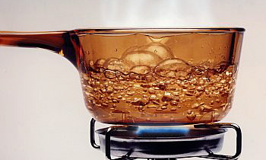
There are many ways we can purify water on earth. For example…

Slide 6
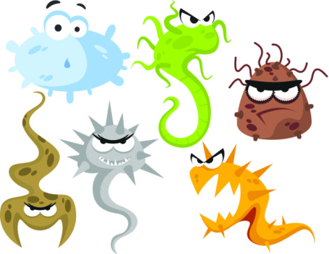
You can boil water to help kill harmful bacteria in our drinking water if the sewers overflow into our fresh drinking water supply.

Slide 7
Hydrologists typically use 5 steps for cleaning our water so we can reuse it over and over again.

Slide 8
Hydrologists typically use 5 steps for cleaning our water so we can reuse it over and over again.

Slide 9
can you put these 5 steps in the right order??????

Slide 10
Carefully remove the five objects in the bag. Each object represents a different method of water purification.

Slide 11
SAND FILTRATION
Just like underground, water’s adhesive abilities help sand trap impurities while the cleaner water flows through slowly and more cleanly.

Slide 12
SAND FILTRATION
Just like underground, water’s adhesive abilities help sand trap impurities while the cleaner water flows through slowly and more cleanly.
The JAR OF SAND represents how water can be filtered by sand.

Slide 13
DECOMPOSING BACTERIA
Millions upon millions of good bacteria are used to gobble up other more deadly microbes in the water. These bacteria are the good guys who are the tiniest soldiers in our water cleaning arsenal.

Slide 14
DECOMPOSING BACTERIA
Millions upon millions of good bacteria are used to gobble up other more deadly microbes in the water. These bacteria are the good guys who are the tiniest soldiers in our water cleaning arsenal.
The ACTIVIA container represents DECOMPOSING BACTERIA!

Slide 15
SETTLING TANKS
A settling tank lets sediments sink to the bottom of a big tank of water. After awhile, the cleaner water left on top is saved and the sludge bottom is disposed.

Slide 16
SETTLING TANKS
A settling tank lets sediments sink to the bottom of a big tank of water. After awhile, the cleaner water left on top is saved and the sludge bottom is disposed.
The GLITTER JAR represents a settling tank.

Slide 17
CHLORINE DISINFECTING
The BLEACH CONTAINER represents the small bit of chlorine that is added to get rid of any living microbial life in the water. Just a bit is added so the water doesn’t taste bad like a swimming pool.

Slide 18
CHLORINE DISINFECTING
The BLEACH CONTAINER represents the small bit of chlorine that is added to get rid of any living microbial life in the water. Just a bit is added so the water doesn’t taste bad like a swimming pool.
The BLEACH CONTAINER represents CHLORINE DISINFECTING.

Slide 19
SCREENING
Water goes through a screen to remove leaves and small pieces from the fresh, but yet to be drinkable water.

Slide 20
SCREENING
Water goes through a screen to remove leaves and small pieces from the fresh, but yet to be drinkable water.
The PIECE OF SCREEN represents SCREENING.

Slide 21
Your job is to order all 5 methods of water treatment in their PROPER order.
Do it in the CORRECT ORDER and your will get candy!

Slide 22
DID YOU GET IT RIGHT?

Slide 23
How cities clean/recycle our fresh water:

Slide 24
How cities clean/recycle our fresh water:
SCREENING (gets the chunks out)

Slide 25
How cities clean/recycle our fresh water:
SCREENING (gets the chunks out)
SETTLING TANK (muddy sludge settles at bottom)

Slide 26
How cities clean/recycle our fresh water:
SCREENING (gets the chunks out)
SETTLING TANK (muddy sludge settles at bottom)
SAND FILTRATION (removes tiniest particles)

Slide 27
How cities clean/recycle our fresh water:
SCREENING (gets the chunks out)
SETTLING TANK (muddy sludge settles at bottom)
SAND FILTRATION (removes tiniest particles)
DECOMPOSING BACTERIA (eat tiniest microbes)

Slide 28
How cities clean/recycle our fresh water:
SCREENING (gets the chunks out)
SETTLING TANK (muddy sludge settles at bottom)
SAND FILTRATION (removes tiniest particles)
DECOMPOSING BACTERIA (eat tiniest microbes)
CHLORINE DISINFECTION (kill anything left)

Slide 30
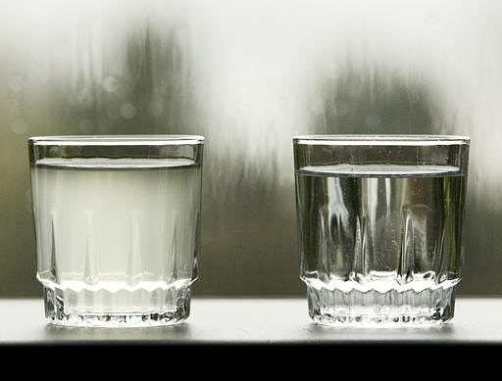
Why is TURBIDITY a sign of harmful drinking water?

Slide 31
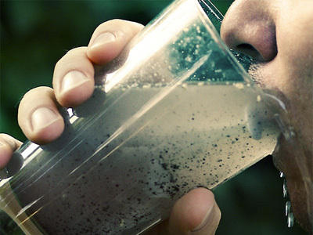
Germs can be hiding in that silt floating in your water!

Slide 32
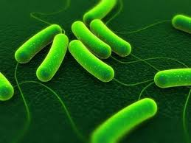
Germs can be hiding in that silt floating in your water!

Slide 33
BESIDES BOILING, how can we possibly keep our own water clean?

Slide 34
Besides boiling, how can we possibly keep our own water clean?
AERATION of tap water (bubbles release toxic gases)
show my sink

Slide 35
How can we possibly keep our own water clean?
AERATION of tap water (bubbles release toxic gases)
FLOCCULATION gets rid of turbidity
show 1st 3:30 of link…
https://www.khanacademy.org/partner-content/mit-k12/mit-k12-materials/v/flocculation

Slide 36
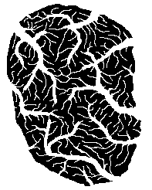
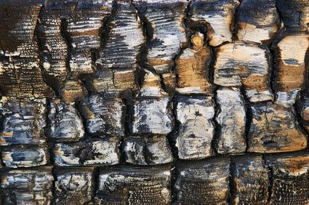
How can we possibly keep our own water clean?
AERATION of tap water (bubbles release toxic gases)
FLOCCULATION gets rid of turbidity
CARBON FILTRATION using CHARCOAL!
Charcoal is made of carbon and has so much micro-surface area, it absorbs a lot of impurities!

