Slide 1
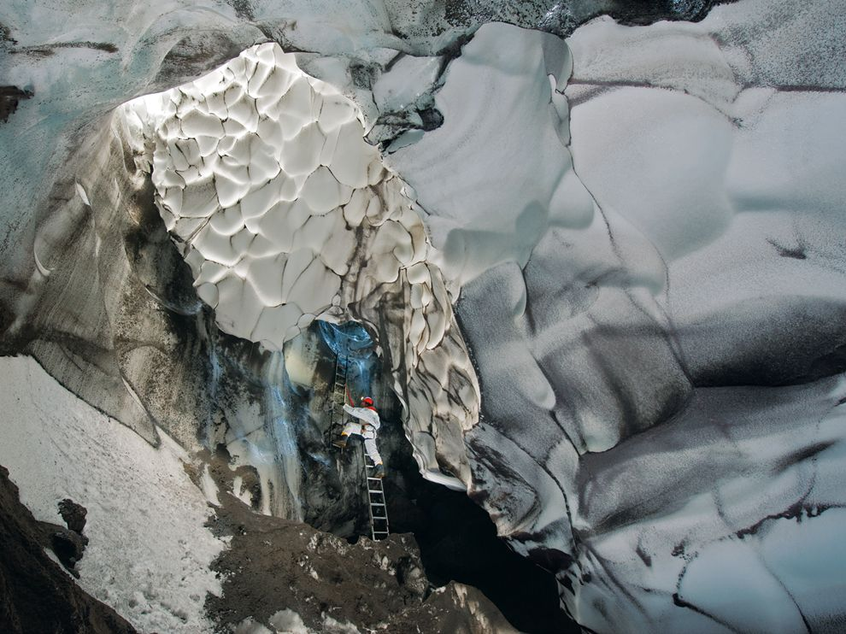
Warm Up, September 29th, 2014
Notes:
A mix of ropes and ladders eases access to Warren Cave, a labyrinth of passages melted from the ice by the volcano's heat. Small currents of air probably cause the scalloping around the cave's entrance.

Slide 2
“Latin and Greek” Derivatives*
Derivative Translation
21) luna moon
22) sol sun
23) hydro water
24) cycle ring
25) atmos air

Slide 3
Looking at a clock?
Absolute
Looking at
sedimentary layers?
Relative
Looking at an index fossil?
Relative
Measuring C-14?
Absolute
5 + 5
Absolute
Notes:
Review of Absolute and Relative Dating (Test ?’s)

Slide 4
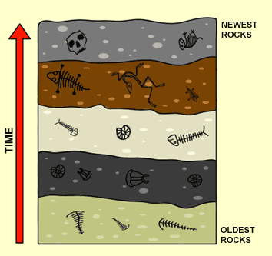

Slide 5
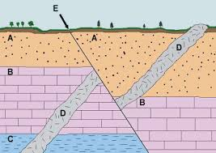

Slide 6
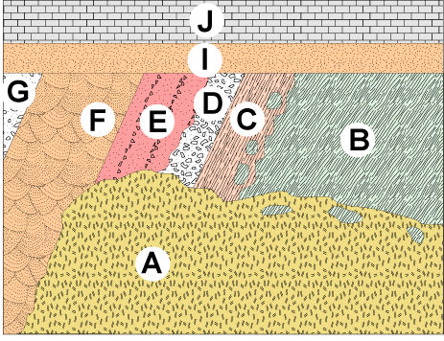

Slide 7
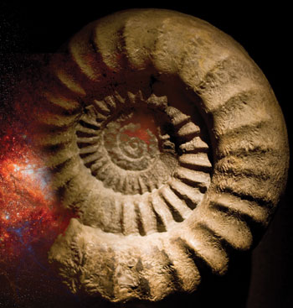
Index Fossil*
- A fossil used to identify the relative age of a specific rock layers and geologic time periods.

Slide 8
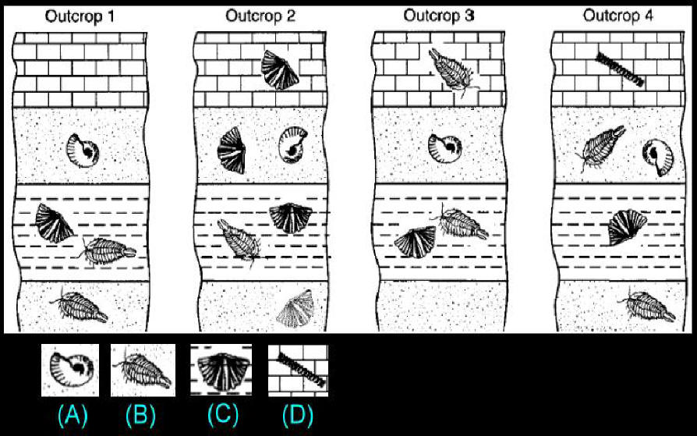

Slide 9
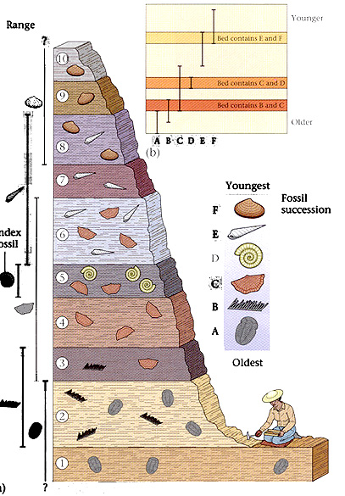

Slide 10
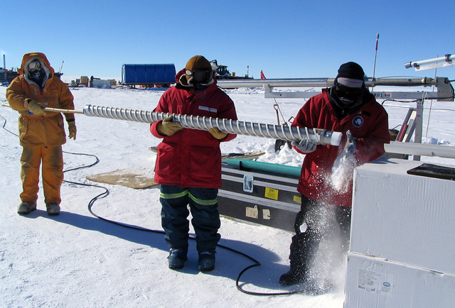
We draw giant cylindrical samples from ice sheets.

Slide 11
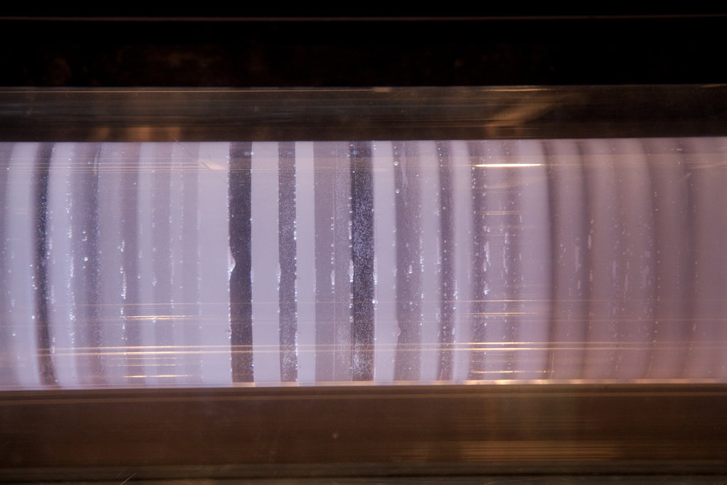
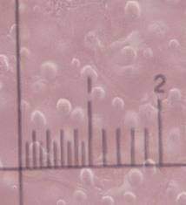
Ice core samples can tell us our geologic & meteorlogic (weather/climate) past…
Ice traps our atmospheric gases and dust; preserving it in time!

Slide 12
Lonnie Thomson Ice Cores Video

Slide 13
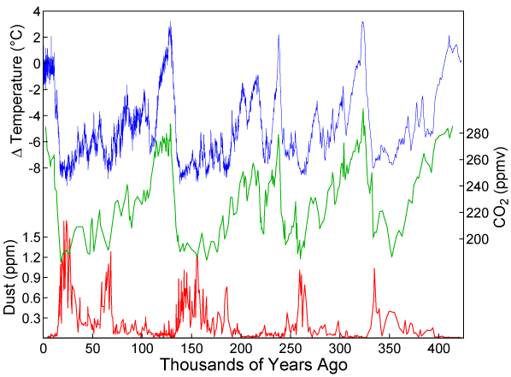
Let’s look at the evidence…
Review the amount of dust and carbon dioxide found deep under ice towards the poles, going back hundreds of thousands of years.

Slide 14
About how often do we have ice ages?

Slide 15
Going back in time, (left to right), do high amounts of dust possibly cool the Earth?

Slide 16
Are rising CO₂ levels (carbon dioxide) in our past connected to warmer or cooler temperatures?

Slide 17
Could our overpopulation be driving global warming today? (Use the evidence below.)
Notes:
Worksheet on Ice Cores weather samples

Slide 18
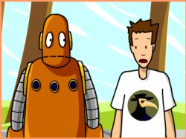
Erosion

