Slide 1
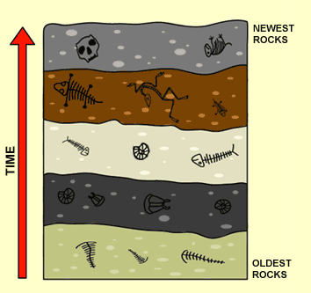

Slide 2
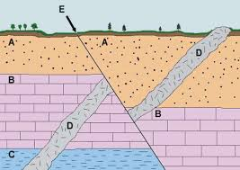

Slide 3
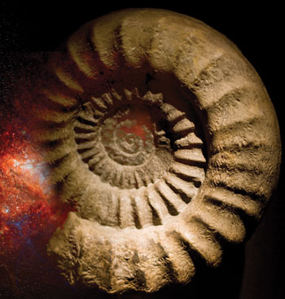
Index Fossil*
- A fossil used to identify the relative age of a specific rock layers and geologic time periods.

Slide 4
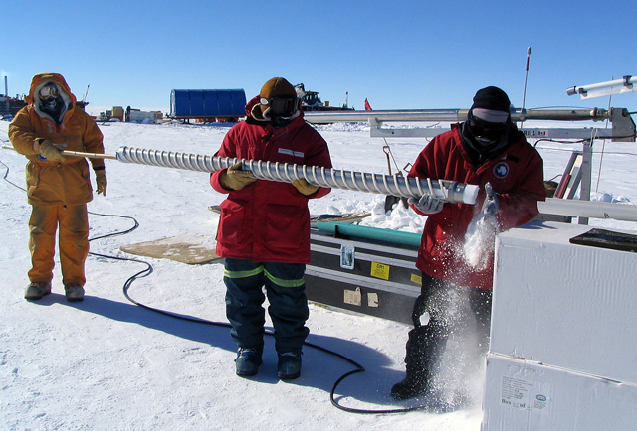
We draw giant cylindrical samples from ice sheets.

Slide 5
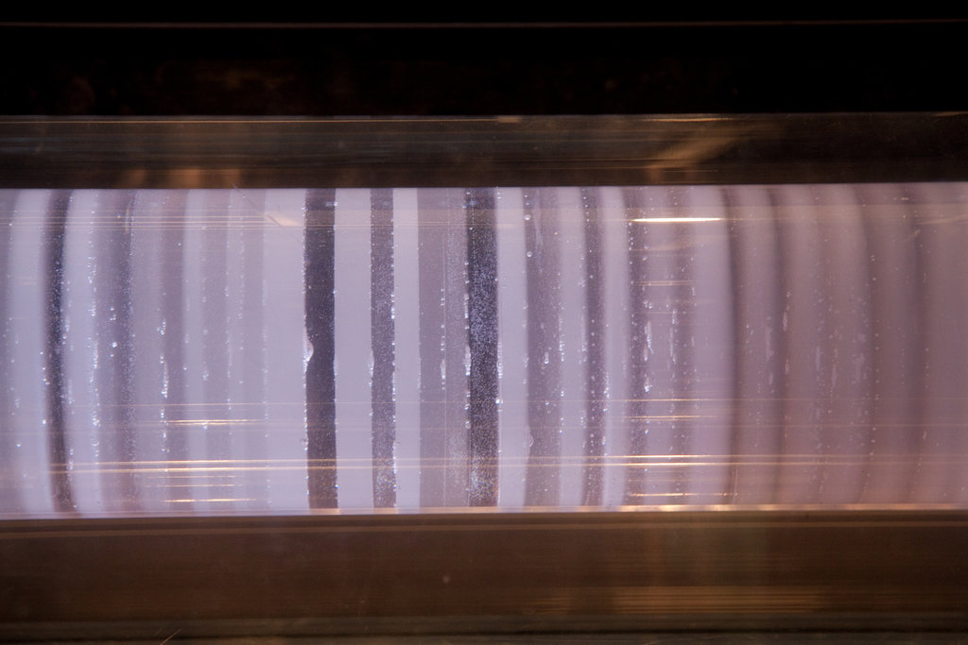
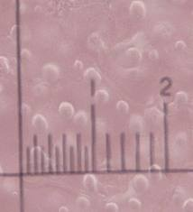
Ice core samples can tell us our geologic & meteorlogic (weather/climate) past…
Ice traps our atmospheric gases and dust; preserving it in time!

Slide 6
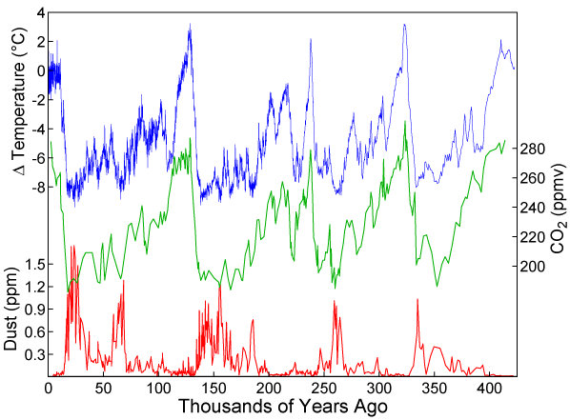
Let’s look at the evidence…
Review the amount of dust and carbon dioxide found deep under ice towards the poles, going back hundreds of thousands of years.

Slide 7
About how often do we have ice ages?

Slide 8
Going back in time, (left to right), do high amounts of dust possibly cool the Earth?

Slide 9
Are rising CO₂ levels (carbon dioxide) in our past connected to warmer or cooler temperatures?

Slide 10
Could our overpopulation be driving global warming today? (Use the evidence below.)
Notes:
Worksheet on Ice Cores weather samples

