Slide 1
What other organisms do MICROBIOLOGISTS study?
OTHER MICROORGANISMS

Slide 2
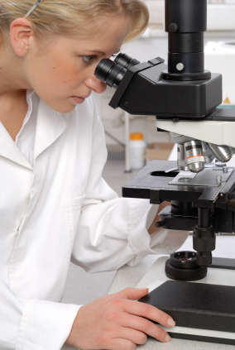
What other organisms do MICROBIOLOGISTS study?

Slide 3
MICRObiology studies…

Slide 4
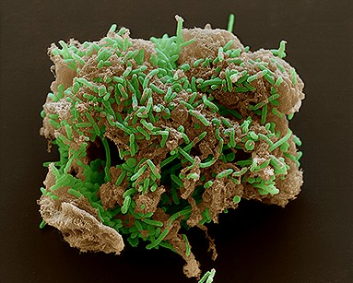
Microbiologists study…
bacteria…

Slide 5
MICRObiology studies…
bacteria…
smallest living thing

Slide 6
MICRObiology studies…
bacteria…
smallest living thing
unicellular prokaryote

Slide 7
MICRObiology studies…
bacteria…
smallest living thing
unicellular prokaryote
reproduces FAST through binary fission

Slide 8
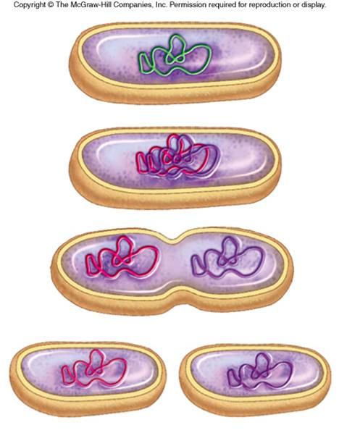
MICRObiology studies…
bacteria…
viruses…
smallest living thing
unicellular prokaryote
reproduces FAST through binary fission
http://www.youtube.com/watch?v=9hzUjx_oD8E

Slide 9
MICRObiology studies…
bacteria…
viruses…
smallest living thing
unicellular prokaryote
reproduces FAST through binary fission
non-living—

Slide 10
MICRObiology studies…
bacteria…
viruses…
smallest living thing
unicellular prokaryote
reproduces FAST through binary fission
non-living—can’t reproduce

Slide 11
MICRObiology studies…
bacteria…
viruses…
smallest living thing
unicellular prokaryote
reproduces FAST through binary fission
non-living—can’t reproduce
needs to reprogram a “host” cell & force it to make viruses

Slide 12
But WAIT! There’s MORE!
Protists and Fungi

Slide 13
Other infectious diseases can be caused by protozoa, fungi, and helminths. Protozoa are single-celled eukaryotes, fungi are multicellular heterotrophs, and helminths are commonly known as parasitic worms. All three of these types of infectious agents can usually survive outside the human body. However, if they establish a presence in a human host, they can take over the body’s systems and cause disease.

Slide 14
Protists are a very diverse group of eukaryotic organisms.
Protists exist in a wide variety of environments and are commonly found in water.
Protists include algae.

Slide 15
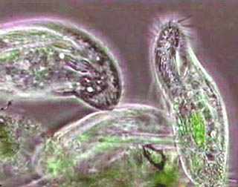
MICRObiology studies…
PROTOZOA –AKA, Protists

Slide 16
Most Protists are Single Cell
Protists include all organisms whose cells have nuclei and are NOT plants, animals, or fungi. Single Celled.
Some protists are PRODUCERS and provide Oxygen
Some protists are parasites that cause disease
Some protists are decomposers

Slide 17
Protists classified by how they get energy ch. 5.4E
Algae-PLANT LIKE PROTIST
Protozoa-ANIMAL LIKE PROTISTS
Capture sunlight-convert it to energy
Have chlorophyll and photosynthesize
Algae are producers
Seaweed, euglenas, diatoms, volvox and Chlamydomonas are Algae
Eat other organisms for energy
Single celled
Most move with cilia or flagella
Some are parasites and cause disease
Paramecia are protozoa

Slide 18
Other protists
Absorb material that contain stored energy
Cellular slime molds
Plasmodial slime molds
Water molds

Slide 19
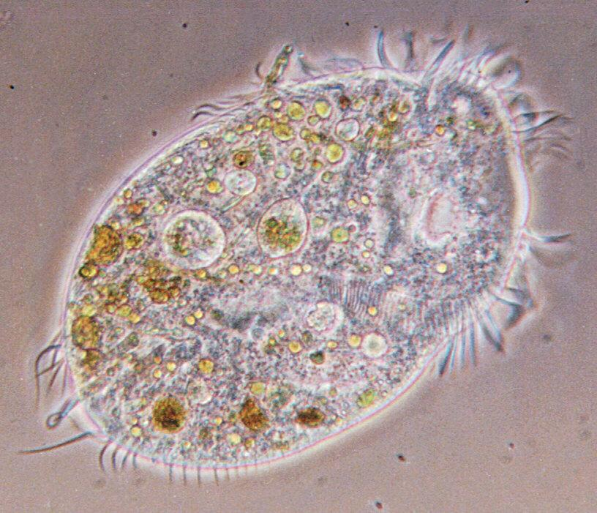
MICRObiology studies…
PROTOZOA
found in natural waters,

Slide 20
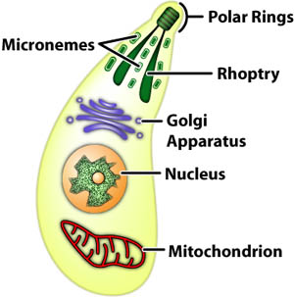
MICRObiology studies…
PROTOZOA
found in natural waters,
unicellular EUKARYOTE!

Slide 21
MICRObiology studies…
PROTOZOA- also known as protists
found in natural waters,
unicellular EUKARYOTE!
can cause some diseases

Slide 23
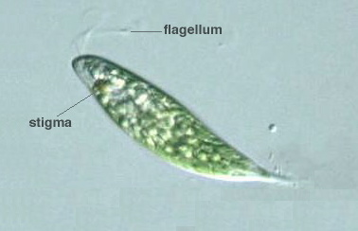
MICRObiology studies…
PROTOZOA
FUNGI
found in natural waters,
unicellular EUKARYOTE!
can cause some diseases

Slide 24
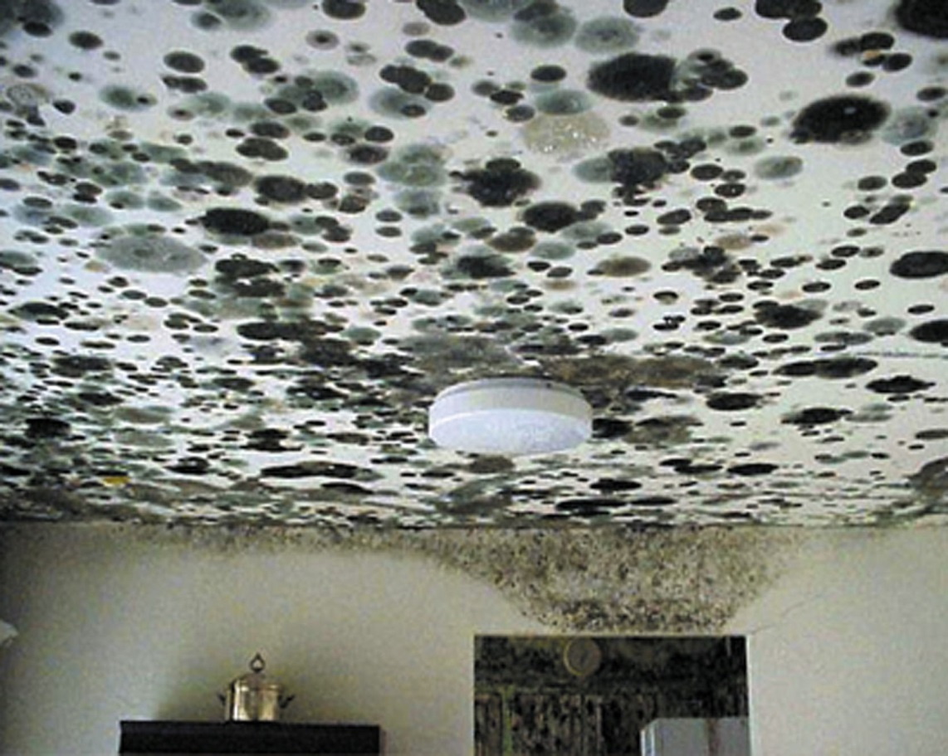
MICRObiology studies…
FUNGI
found in natural waters,
unicellular EUKARYOTE!
can cause some diseases
molds &

Slide 25
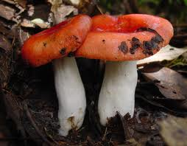
MICRObiology studies…
FUNGI
found in natural waters,
unicellular EUKARYOTE!
can cause some diseases
molds & mushrooms

Slide 26
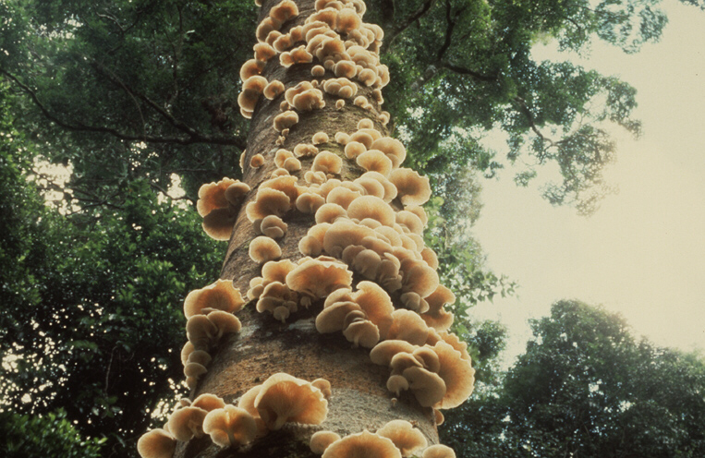
MICRObiology studies…
FUNGI
found in natural waters,
unicellular EUKARYOTE!
can cause some diseases
molds & mushrooms
multicellular, non-photosynthesizing EUKARYOTES

Slide 27
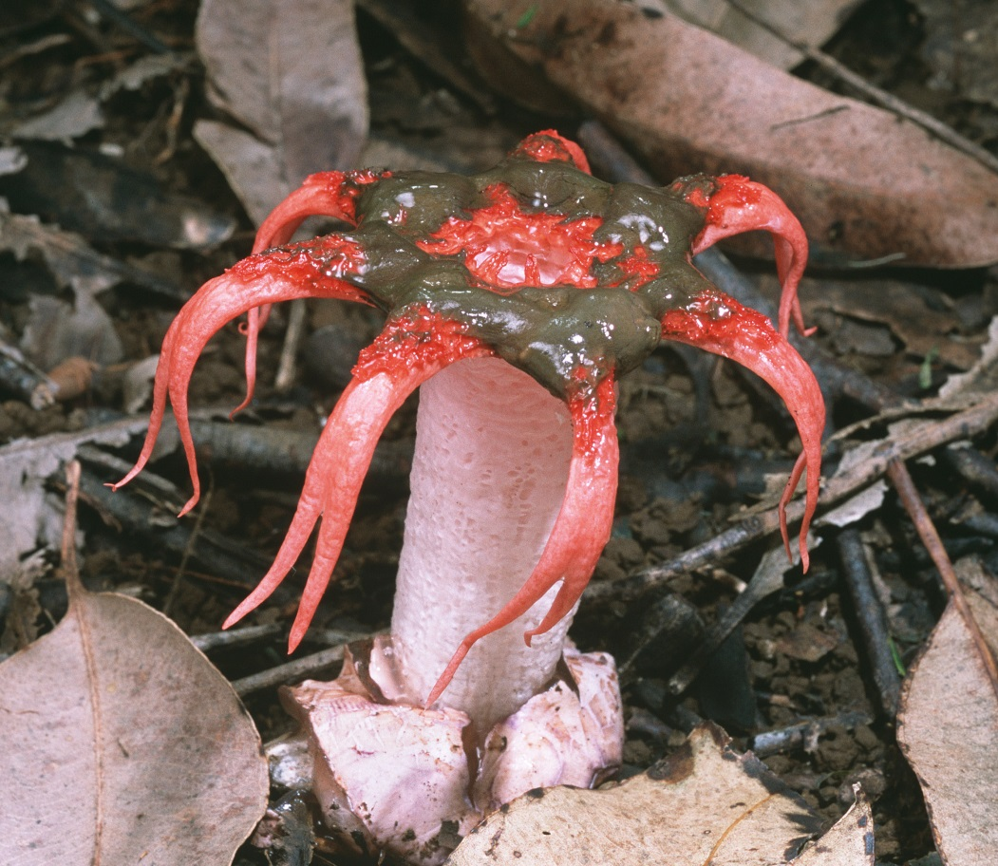
MICRObiology studies…
FUNGI
found in natural waters,
unicellular EUKARYOTE!
can cause some diseases
molds & mushrooms
multicellular, non-photosynthesizing EUKARYOTES

Slide 28
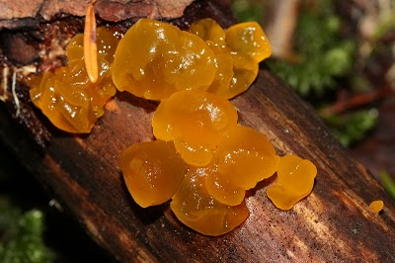
MICRObiology studies…
FUNGI
found in natural waters,
unicellular EUKARYOTE!
can cause some diseases
molds & mushrooms
multicellular, non-photosynthesizing EUKARYOTES

Slide 29
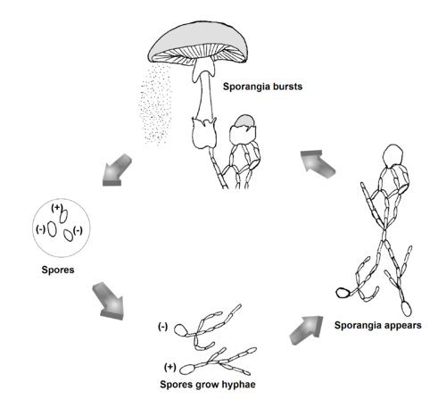
MICRObiology studies…
FUNGI
found in natural waters,
unicellular EUKARYOTE!
can cause some diseases
molds & mushrooms
multicellular, non-photosynthesizing EUKARYOTES
can reproduce asexually (spores) OR

Slide 30
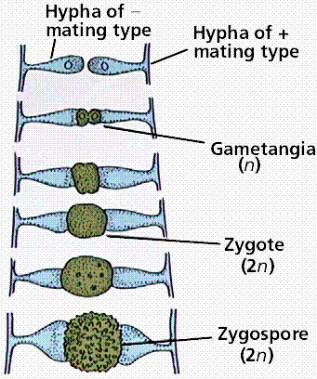
MICRObiology studies…
FUNGI
found in natural waters,
unicellular EUKARYOTE!
can cause some diseases
molds & mushrooms
multicellular, non-photosynthesizing EUKARYOTES
can reproduce asexually (spores) OR sexually (exchanging genetic info with a neighboring fungi)
Yeast – the only unicellular eukaryotic fungi

Slide 31
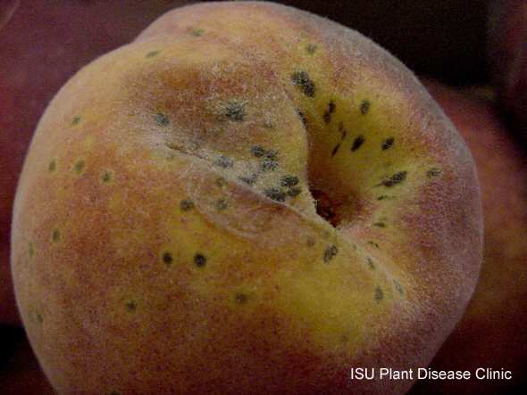
MICRObiology studies…
FUNGI
found in natural waters,
unicellular EUKARYOTE!
can cause some diseases
Sometimes attack living plants and animals, causing disease

Slide 32
Lichen

Slide 34
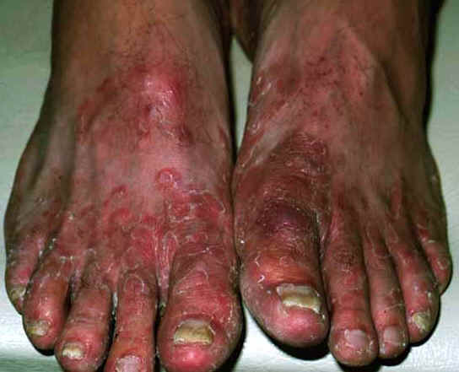
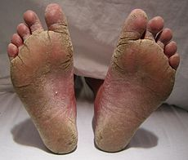
Athletes Foot
Fungal infection in feet that is usually transmitted in moist, communal areas. Also known as ringworm of the foot.

Slide 35
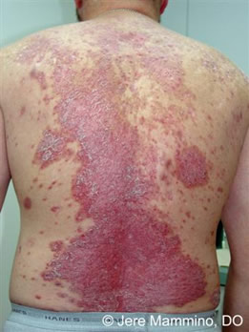
MICRObiology studies…
PROTOZOA
FUNGI
found in natural waters,
unicellular EUKARYOTE!
can cause some diseases
Sometimes attack living tissue, causing disease

Slide 36
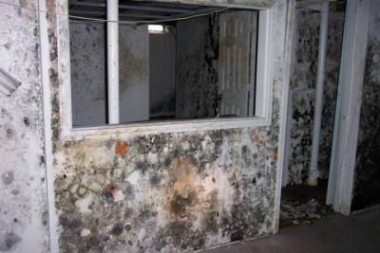
MICRObiology studies…
PROTOZOA
FUNGI
found in natural waters,
unicellular EUKARYOTE!
can cause some diseases
Sometimes attack living tissue, causing disease
Mold spores are released by fungi and cause allergic reactions in humans

Slide 37
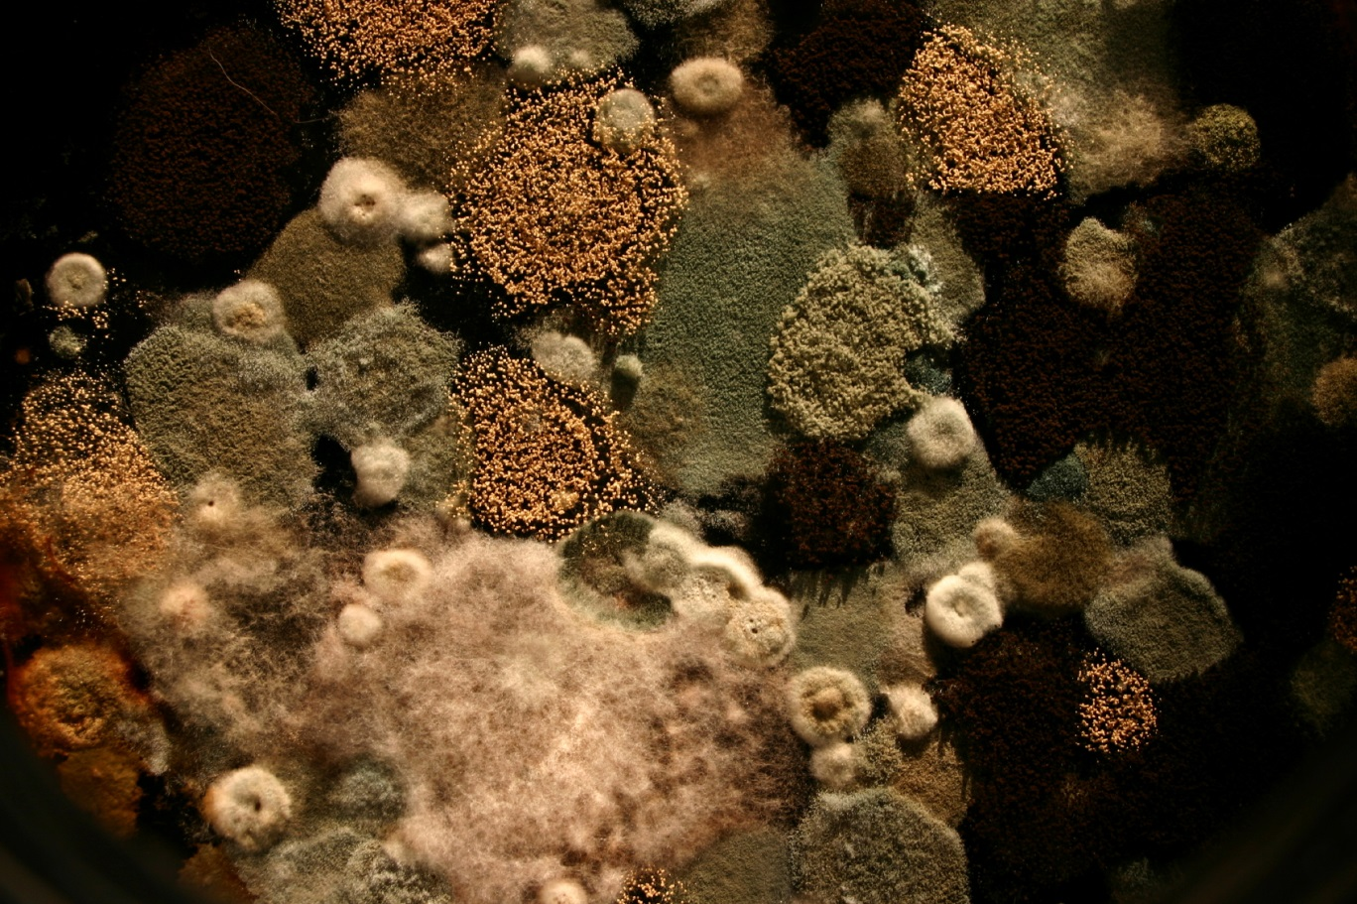
MICRObiology studies…
PROTOZOA
FUNGI
found in natural waters,
unicellular EUKARYOTE!
can cause some diseases
Sometimes attack living tissue, causing disease
Mold spores are released by fungi and cause allergic reactions in humans

Slide 38
MICRObiology studies…
PROTOZOA
FUNGI
found in natural waters,
unicellular EUKARYOTE!
can cause some diseases
Sometimes attack living tissue, causing disease
Mold spores are released by fungi and cause allergic reactions in humans

Slide 39
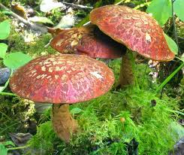
MICRObiology studies…
PROTOZOA
FUNGI
http://www.youtube.com/watch?v=CibGFo0RHIw

Slide 40
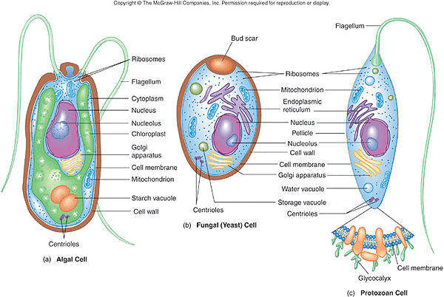

Slide 41
Warm Up 3/10/2016
1. What are three types of Fungi?
2. A mushroom is a(n)
photosynthesizing fungi
multicellular prokaryote
unicellular eukaryote
non-photosynthesizing fungus
3. Which one of the following is true about fungi:
they can reproduce sexually or asexually
some can photosynthesize
their cells can be prokaryotic or eukaryotic
they are mostly unicellular
4. What are the six KINGDOMS scientists have classified all living things. Group them in a chart. (page 62B)

Slide 42
Life Science: Protists and Fungi
What is a fungus and how does it reproduce?
What is symbiosis?
What are lichens and how does the partnership between the lichen organisms help them survive?
What causes malaria and how does it spread?
Explain the relationship between leaf cutter ants and fungus.
What is pfiesteria and what triggers its toxic effects?
What ability of certain molds led to the development of life-saving drugs?

Slide 43
Chapter 4.3 page 152E – 157E
Where do most protists live?
What are algae?
What is seaweed?
What is one way protists can be classified?
Where do algae get energy?
What are plankton?
What are protozoa?
What causes the disease malaria?

Slide 45
1) Title Page :
-Bacteria, Viruses, and Other Microorganisms
-Name, date, and block
-1 Colored picture with a caption
2) Five Tabs
-Title each tab
-5 facts per tab
-1 colored picture with a caption per tab
3) Reflection 1-8
Write and answer each…
Bacteria, viruses, and other microorganisms
Name, Date, Block
Bacteria
Viruses
Fungi
Parasites
Reflection

Slide 46
Bacteria, Viruses and Other… Reflection
Name 2 features that all bacteria share.
What three shapes can bacteria have?
How can bacteria be helpful? How can they be harmful?
How does a virus harm a host cell?
Why are viruses not considered to be living organisms?
What is a parasite?
Analyze: Parasitic bacteria do not usually kill their hosts, at least not quickly. For a parasite, why is it better not to kill the host? EXPLAIN….
Compare and Contrast: What features do viruses and cells have in common? How are they different?

