Slide 1
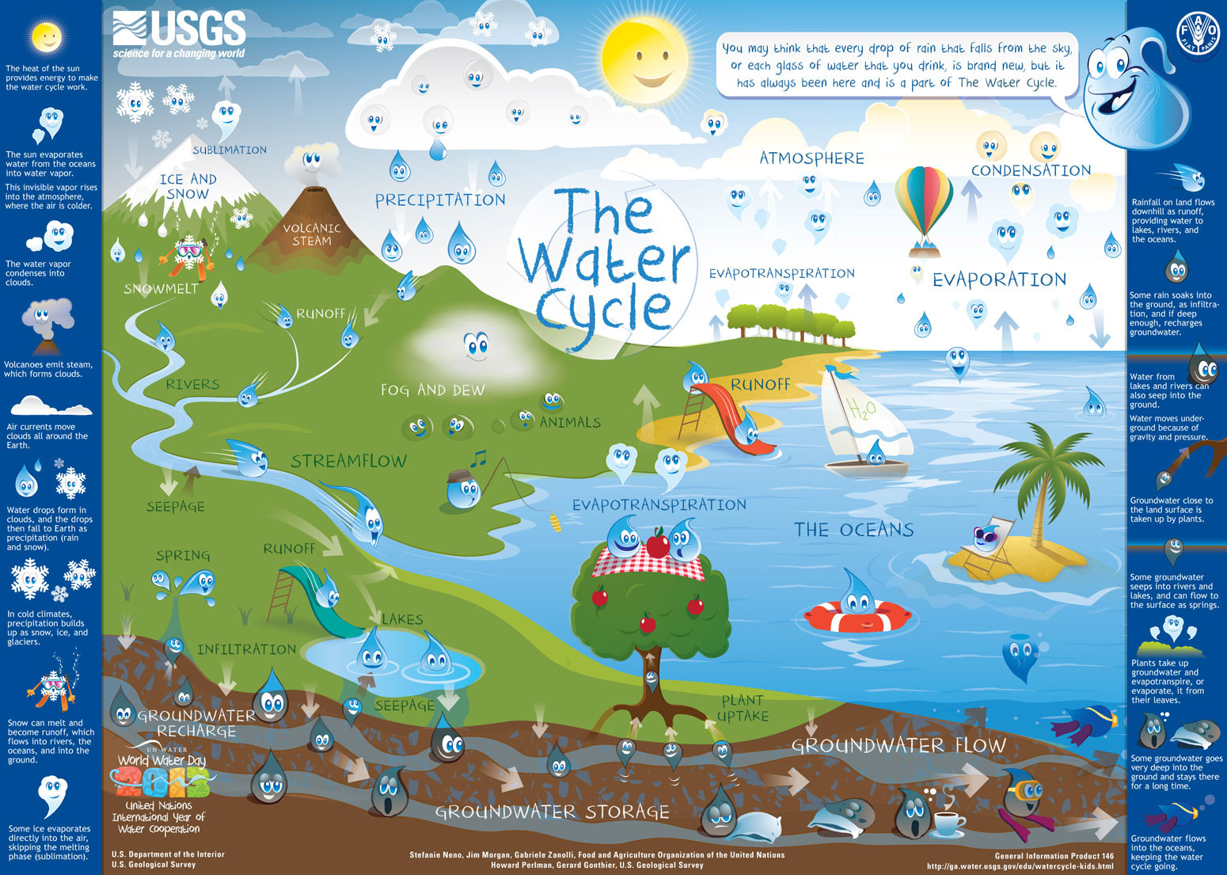
MS_Watersheds_5minuteprep_WN4.ppt

Slide 2
Warm Up, October 16th, 2014
Log in to Chromebook.
Go to Kahoot.it
Wait for PIN Number.
Type your First Name/Last Name only.

Slide 3
What happens when fresh & salt water meet?

Slide 5
Estuary*
When salt water and fresh water mix in a river, delta, or other source.
2 Types:
- Mangrove Forest
- Salt Marsh

Slide 6
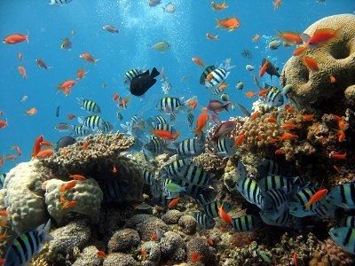
MAYBE A FRESH WATER CROCODILE WANTS A SALTY MEAL IN THE SEA!

Slide 7
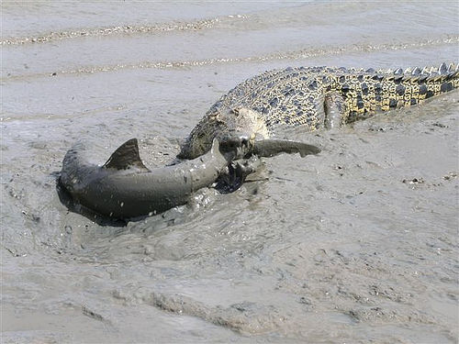
Maybe it wants a shark dinner!

Slide 8
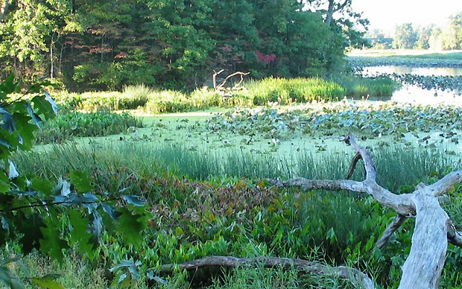
Double the plant life!!!!!

Slide 9
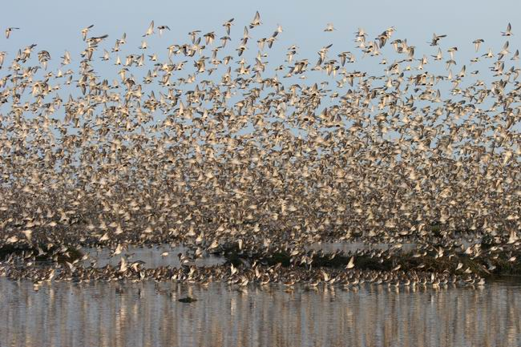
Birds always have something to eat.

Slide 10
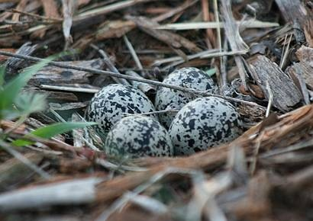
Birds have plenty of nesting sites too!

Slide 11
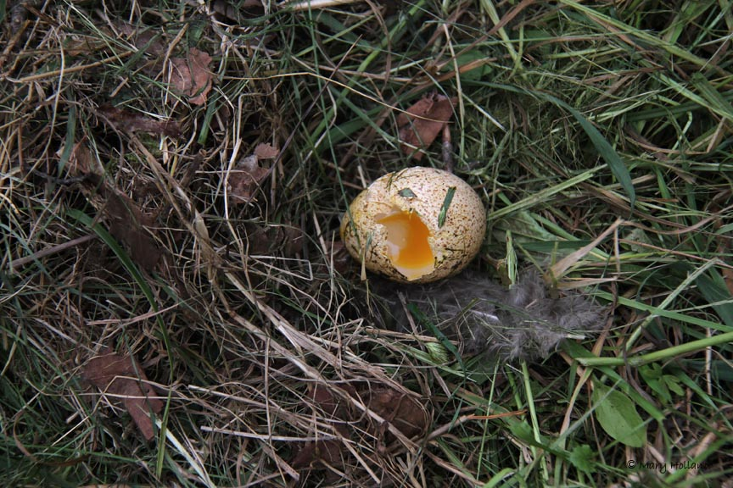
Birds have plenty of nesting sites too!

Slide 12
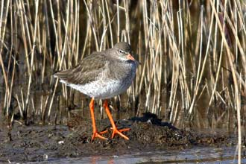
Birds have plenty of nesting sites too!

Slide 13
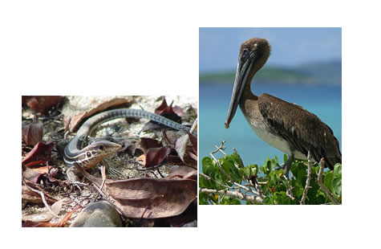
Estuaries have 2x life because 2 ecosystems are colliding!

Slide 14
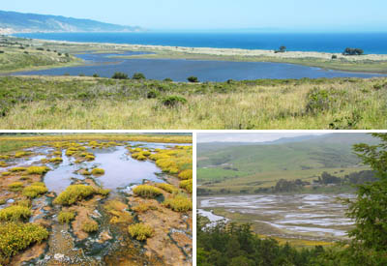
Estuaries have 2x life because 2 ecosystems are colliding!

Slide 15
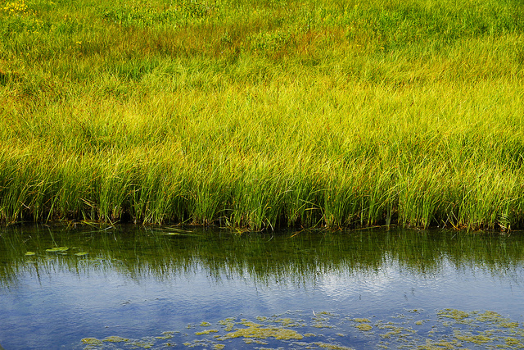
Estuaries: 2 X the breeding & feeding!

Slide 16
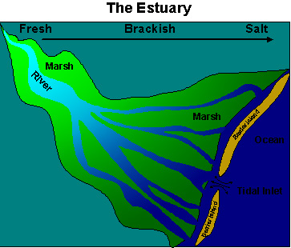
When Fresh rivers run into salty Ocean = estuaries

Slide 17
When fresh river water gets to the ocean, salinity (saltiness) increases

Slide 18
When ocean water pushes up river salinity (saltiness) decreases

Slide 19
salty/fresh mix = brackish
brackish

Slide 20
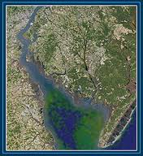
Look how lush & fertile an estuary looks from space!

Slide 21
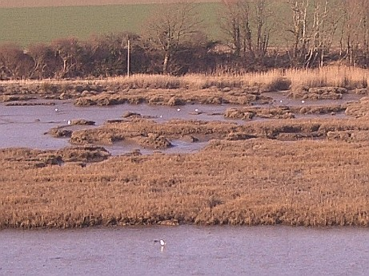
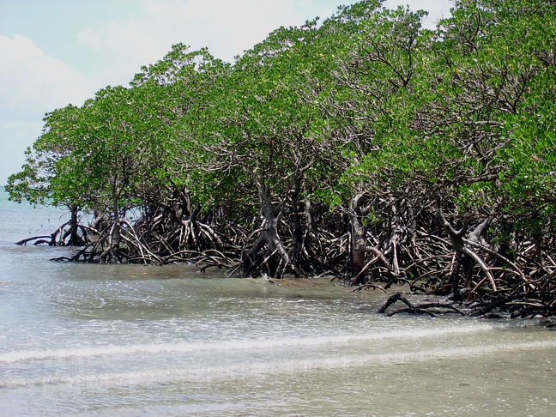
2 types of estuary:
SALT MARSH
Atlantic Carolina coasts
Stinky cord grass
Absorbs tons of moisture
MANGROVES
Louisiana & gulf
Hurricane proof trees
Absorbs tons of moisture
Great breeding grounds--nursery

Slide 22
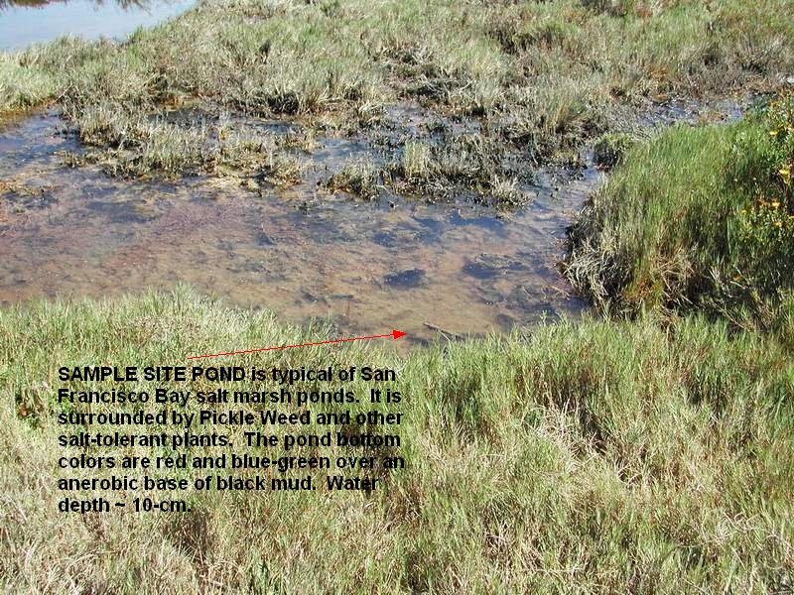
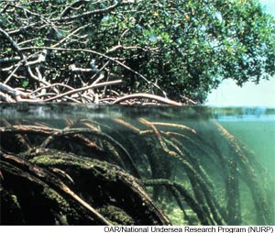
2 types of estuary:
SALT MARSH
Atlantic Carolina coasts
Stinky cord grass
Absorbs tons of moisture
MANGROVES
Louisiana & gulf
Hurricane proof trees
Absorbs tons of moisture
Great breeding grounds--nursery

Slide 23
2 types of estuary: 2X life & nutrients
SALT MARSH
Atlantic Carolina coasts
Stinky cord grass
Absorbs tons of moisture
MANGROVES
Louisiana & gulf
Hurricane proof trees
Absorbs tons of moisture

Slide 24
In both pictures, the water is above the ground for some reason, and we know it is on top of soil. Why isn’t the water sinking if the soil is permeable?

Slide 25
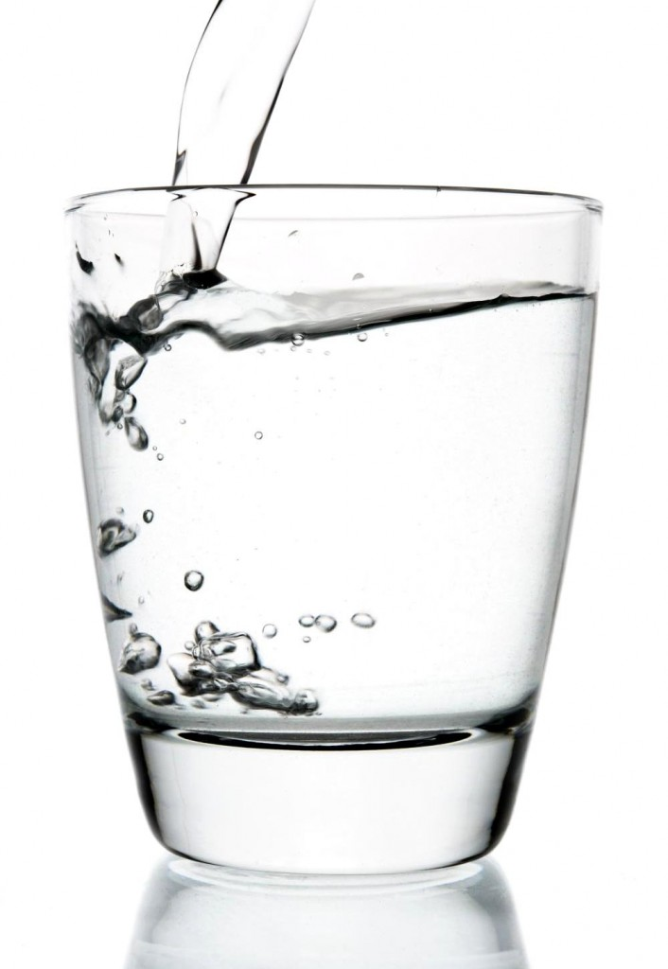
Permeable vs. Impermeable
Great breeding grounds--nursery

Slide 26
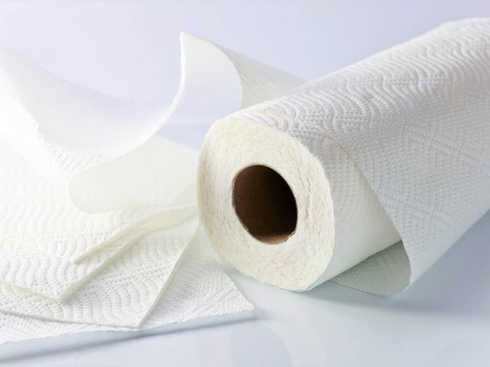
Permeable vs. Impermeable
Great breeding grounds--nursery

Slide 27
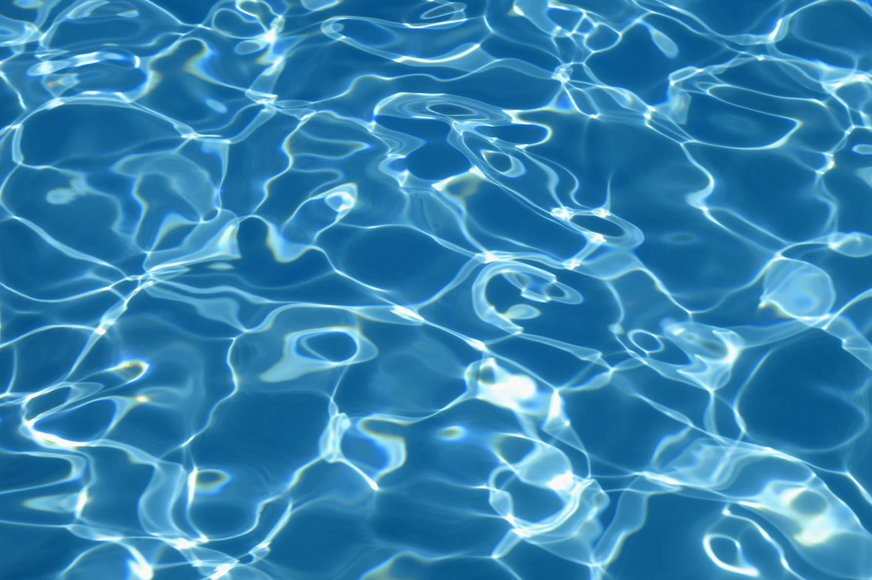
Permeable vs. Impermeable
Great breeding grounds--nursery

Slide 28
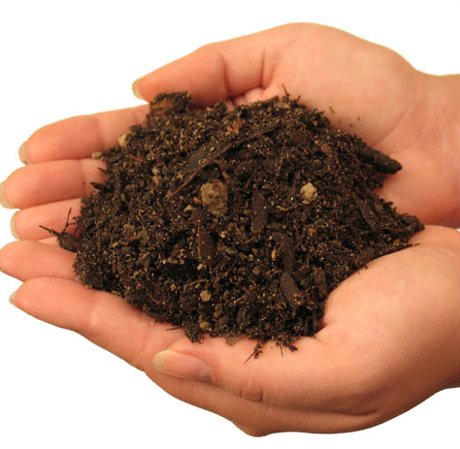
Permeable vs. Impermeable
Great breeding grounds--nursery

Slide 29
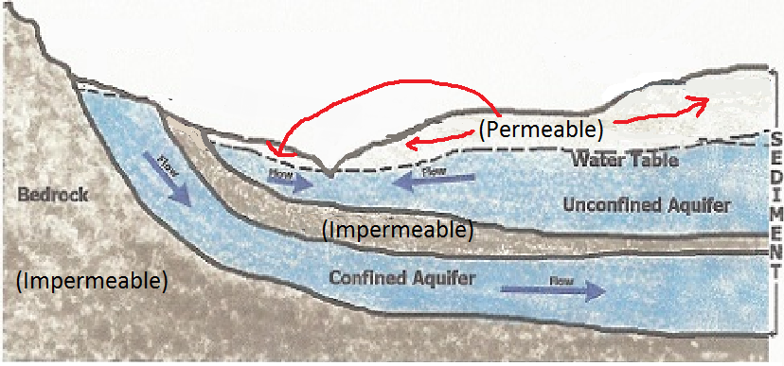
So how does permeable layers affect your groundwater?
Great breeding grounds--nursery

Slide 30
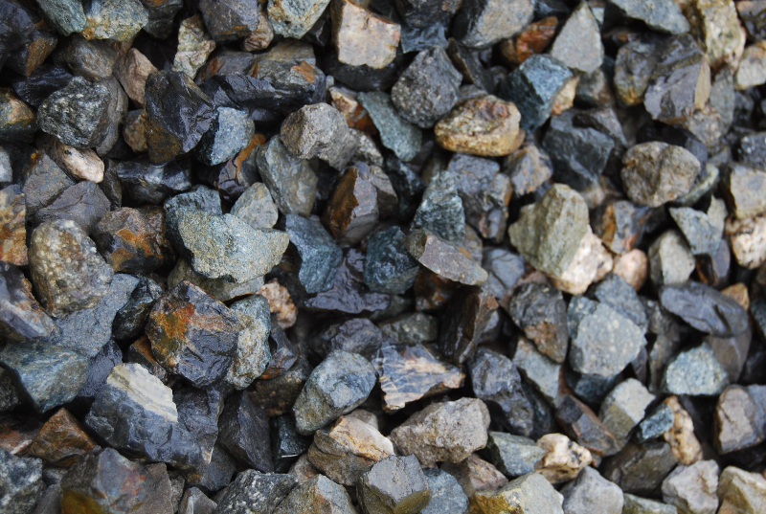
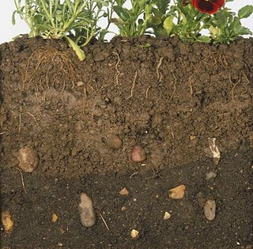
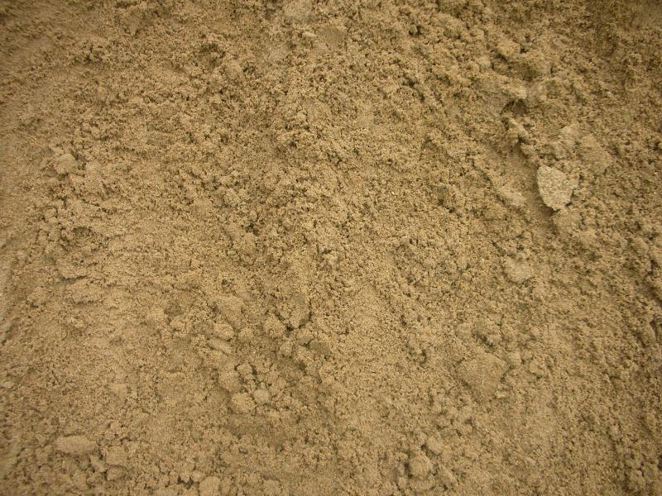
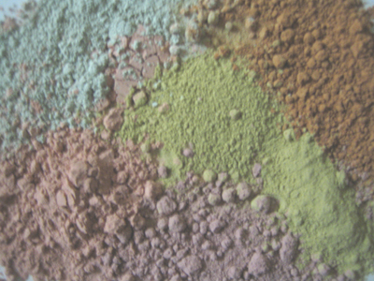
What happens to your water as it goes through different permeable layers?
Gravel
Soil
Sand
Clay
Notes:
Which layer would you want your water to go through first? Which one last? Why?

Slide 32
Water Filtration Lab
three materials to filter out our ‘polluted’ water (food coloring, glitter, salt.
Gravel, sand, sandy soil, clay, tissue
The objective is to filter out all ‘pollution’ in the water.
Hypothesis:
Why?
What Happened? Analyze, be specific.

Slide 33
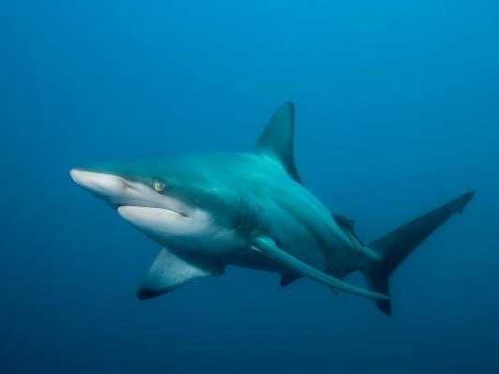
Extra time? Begin Amazon: Blue Planet

