Slide 1
Warm Up April 21, 2017
Who was Charles Darwin?
What do you think the difference is between artificial and natural selection?
Pick a person in this class and name 5 genetic differences between you and them.

Slide 2
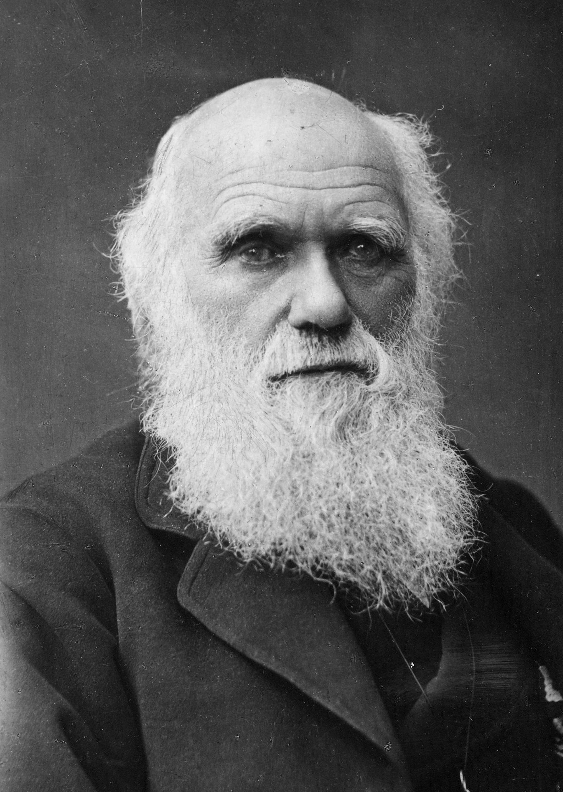
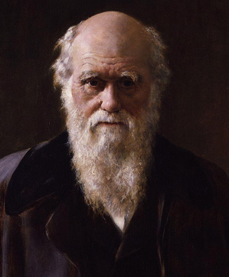
Charles Darwin*
Theorized that species changed over time through a process called 'natural selection'.

Slide 3
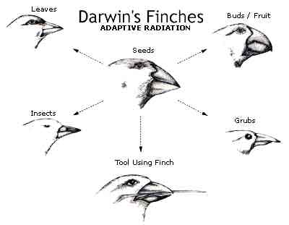

Slide 4
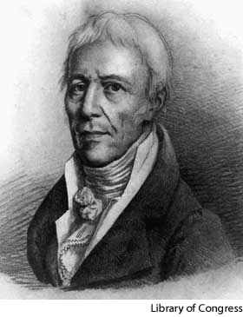
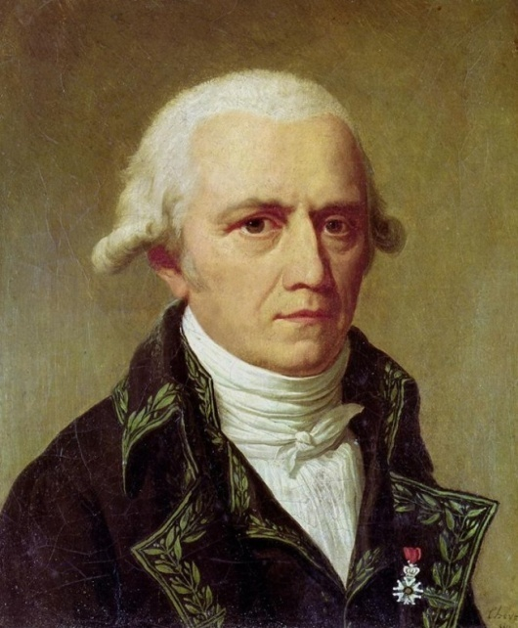
Jean-Baptiste Lamarck
Theorized (incorrectly) that organisms chose which traits were useful and which were not. Also theorized (correctly) that if an organism did change (mutation), it would pass those traits onto its offspring.

Slide 5
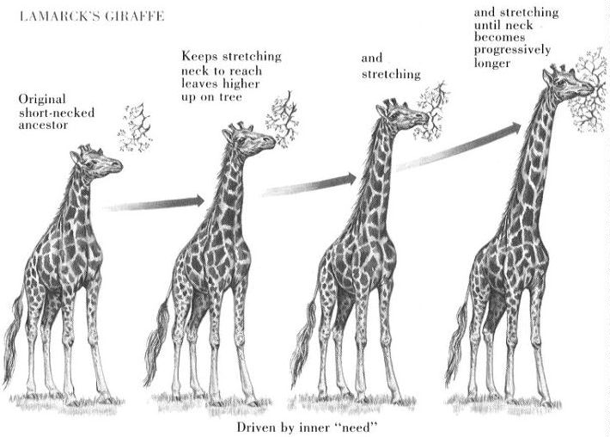

Slide 6
Lamarck vs. Darwin
Jean-Baptiste Lamarck (1744-1829) and Charles Darwin (1809-1882) both thought and had ideas about how life on earth got to be the way it is now.
They had some similar and some very different ideas.

Slide 7
What they agreed on
Unlike most other people at that time, Darwin and Lamarck both thought that life had changed gradually over time and was still changing, that living things change to be better suited and adapted to their environments, and that all organisms are related.
Darwin and Lamarck also agreed that life evolved from fewer, simpler organisms to many, more complex organisms.

Slide 8
What Lamarck believed
Lamarck said that change is made by what the organisms want or need. For example, Lamarck believed that elephants all used to have short trunks. When there was no food or water that they could reach with their short trunks, they stretched their trunks to reach the water and branches, and their offspring inherited long trunks.
Lamarck also said that body parts that are not being used, such as the human appendix and little toes are gradually disappearing. Eventually, people will be born without these parts.
Lamarck also believed that evolution happens according to a predetermined plan and that the results have already been decided.

Slide 9
What Darwin believed
Darwin believed that the desires of animals have nothing to do with how they evolve, and that changes in an organism during its life do not affect the evolution of the species. He said that organisms, even of the same species, are all different and that those which happen to have variations that help them to survive in their environments survive and have more offspring. The offspring are born with their parents' helpful traits, and as they reproduce, individuals with that trait make up more of the population. Other individuals, that are not so well adapted, die off.
Darwin also believed that evolution does not happen according to any sort of plan.

Slide 10
Why Darwin was right
We have seen through many real examples and observations that changes that occur in an animal during life are not passed on to the animal's offspring. Ex. If a dog's ears are cropped short, its puppies are still born with long ears.
We also know that the only way for traits to be passed on is through genes, and that genes can not be affected by the outside world. The only thing that can be affected is which gene sets there are in a population, and this is determined by which individuals die and which ones live.

Slide 11
Natural Selection*
‘Survival of the fittest’
The process by which living things that are better adapted to their environment are more likely to survive and pass on their genes.
Does NOT mean strongest or biggest.

Slide 12
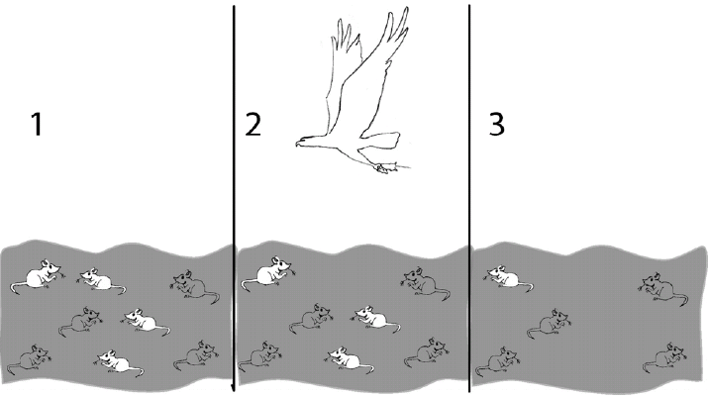
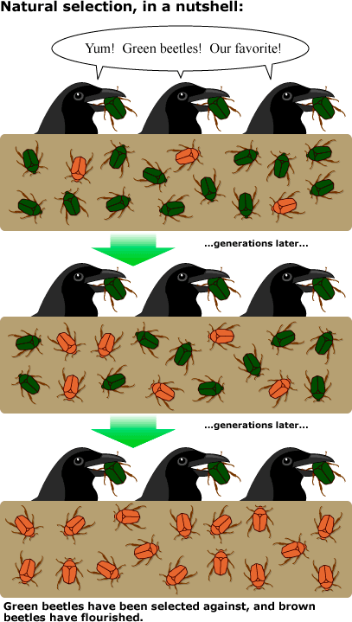
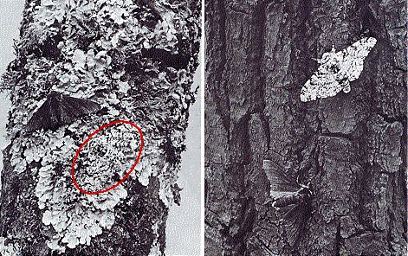

Slide 13
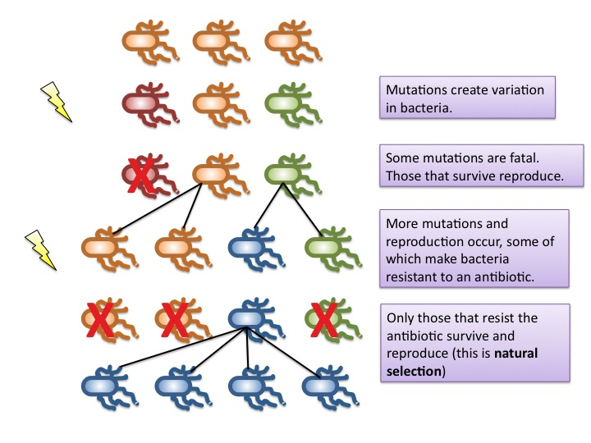

Slide 14
Artificial Selection*
The process by which humans breed plants and animals for specific traits.

Slide 15
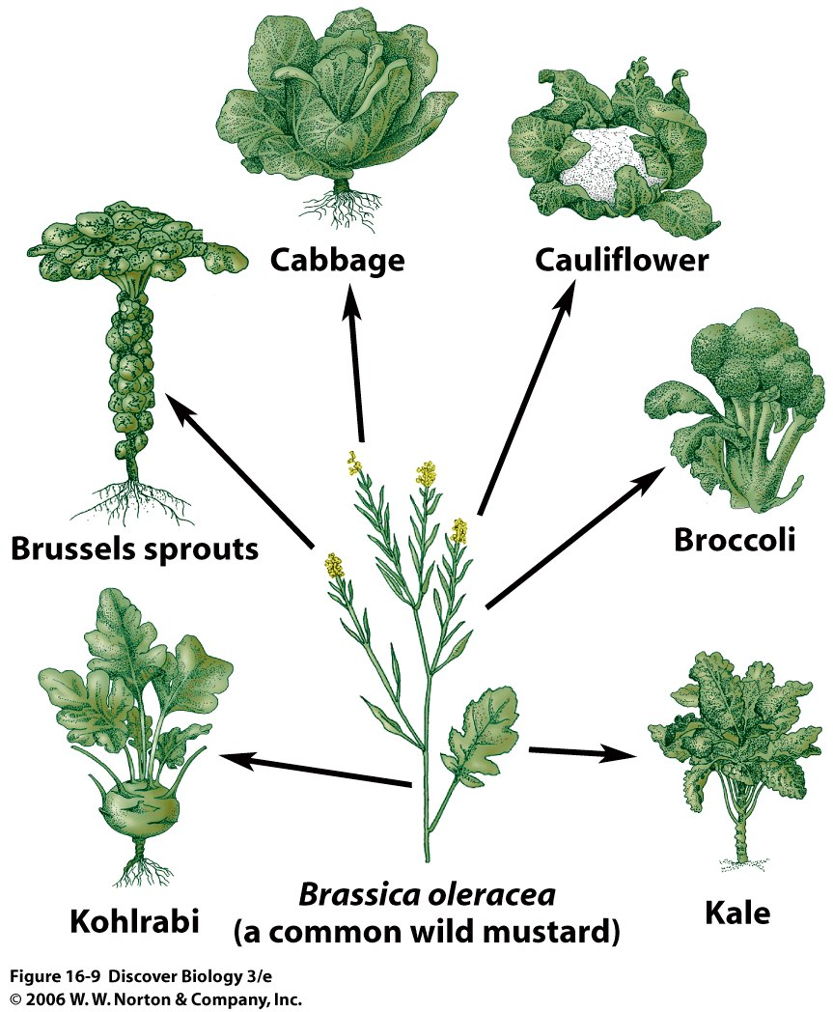
Artificial selection starts
here

