Slide 1
DE Article: Underwater Life
What 4 categories are lake ecosystems divided into?
What’s the difference between zones with sunlight and deeper zones?
How are marine ecosystems categorized? How many zones?
What are the 5 zones and what organisms and plants live in each of them?

Slide 2
Annotate
GREEN Central Idea
RED Unknown words
BLUE Something surprising
YELLOW Something exciting

Slide 3
Our ocean has 3 ecosystems:

Slide 4
Our ocean has 3 ecosystems:
1.
2.
3.

Slide 5
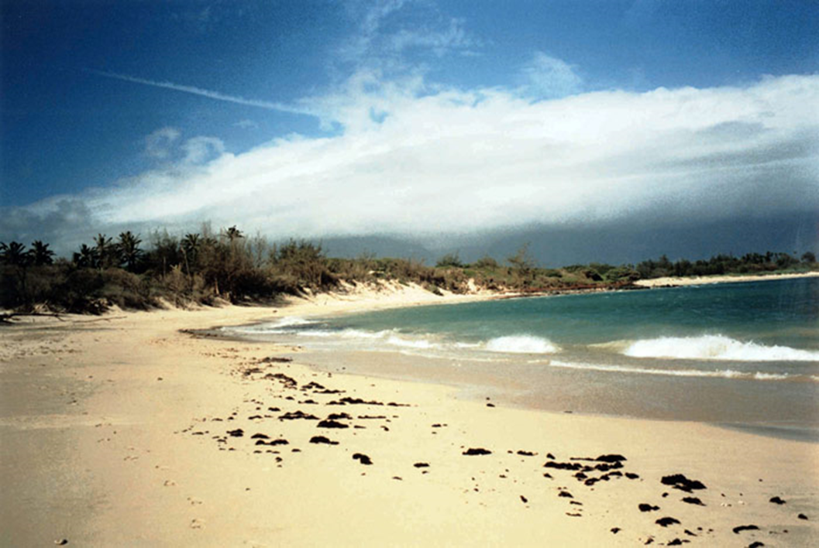
Our ocean has 3 ecosystems:
1. SHORE =
2.
3.

Slide 6
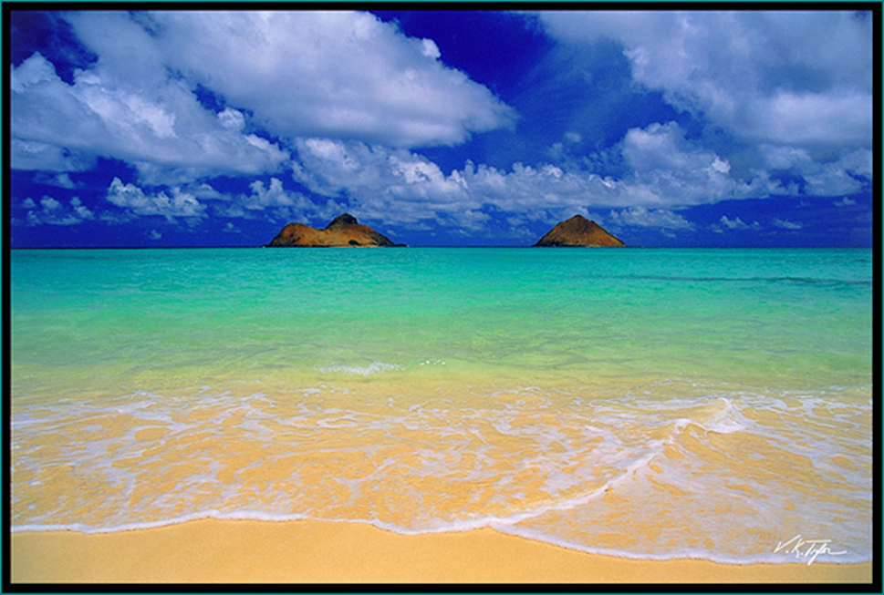
Our ocean has 3 ecosystems:
1. SHORE = INTERTIDAL ZONE
2.
3.

Slide 7
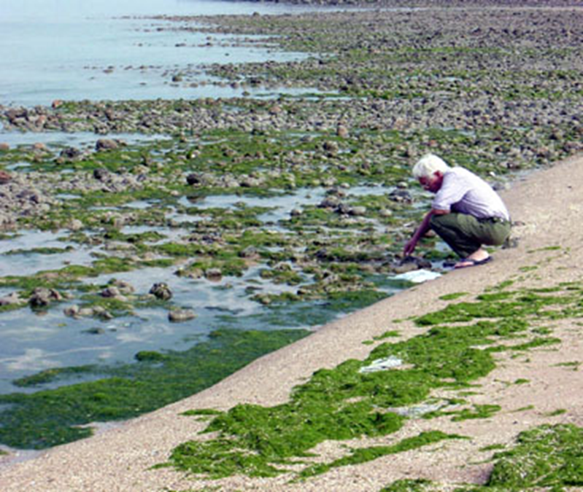
Our ocean has 3 ecosystems:
1. SHORE = INTERTIDAL ZONE
2.
3.

Slide 8
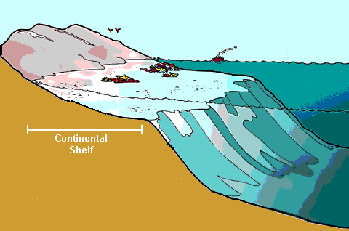
Our ocean has 3 ecosystems:
1. SHORE = INTERTIDAL ZONE
2. CONTINENTAL SHELF
3.

Slide 9
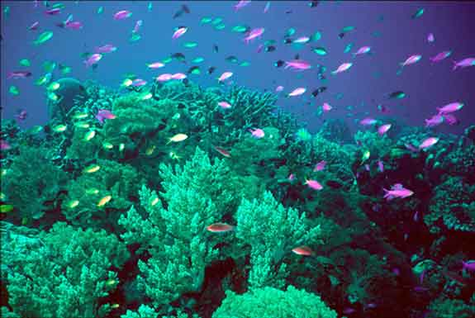
Our ocean has 3 ecosystems:
1. SHORE = INTERTIDAL ZONE
2. CONTINENTAL SHELF = NERITIC ZONE
3.

Slide 10
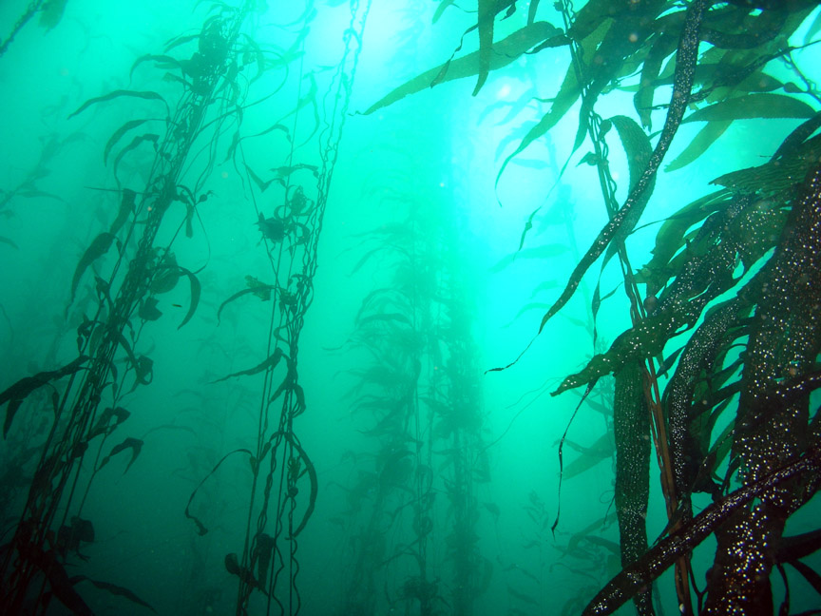
Our ocean has 3 ecosystems:
1. SHORE = INTERTIDAL ZONE
2. CONTINENTAL SHELF = NERITIC ZONE
3.

Slide 11
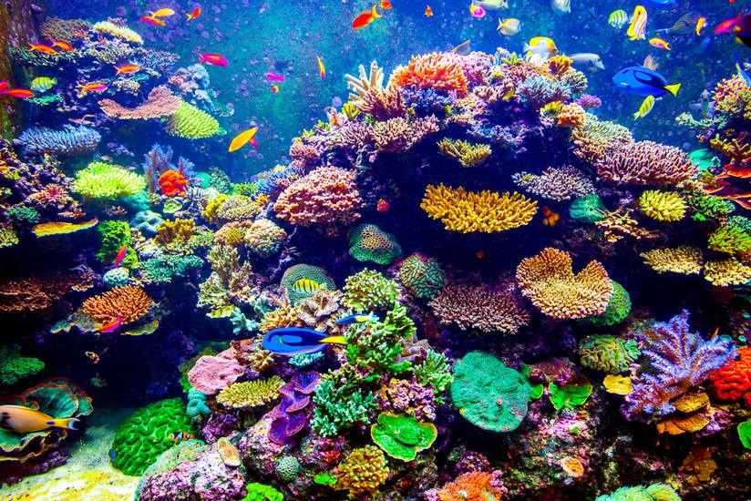
coral reefs

Slide 12
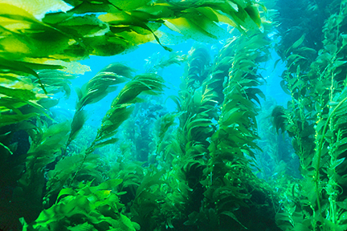
kelp forests
1. SHORE = INTERTIDAL ZONE
2. CONTINENTAL SHELF = NERITIC ZONE
3.

Slide 13
Our ocean has 3 ecosystems:
1. SHORE = INTERTIDAL ZONE
2. CONTINENTAL SHELF = NERITIC ZONE
coral reefs
kelp forests
3.

Slide 14
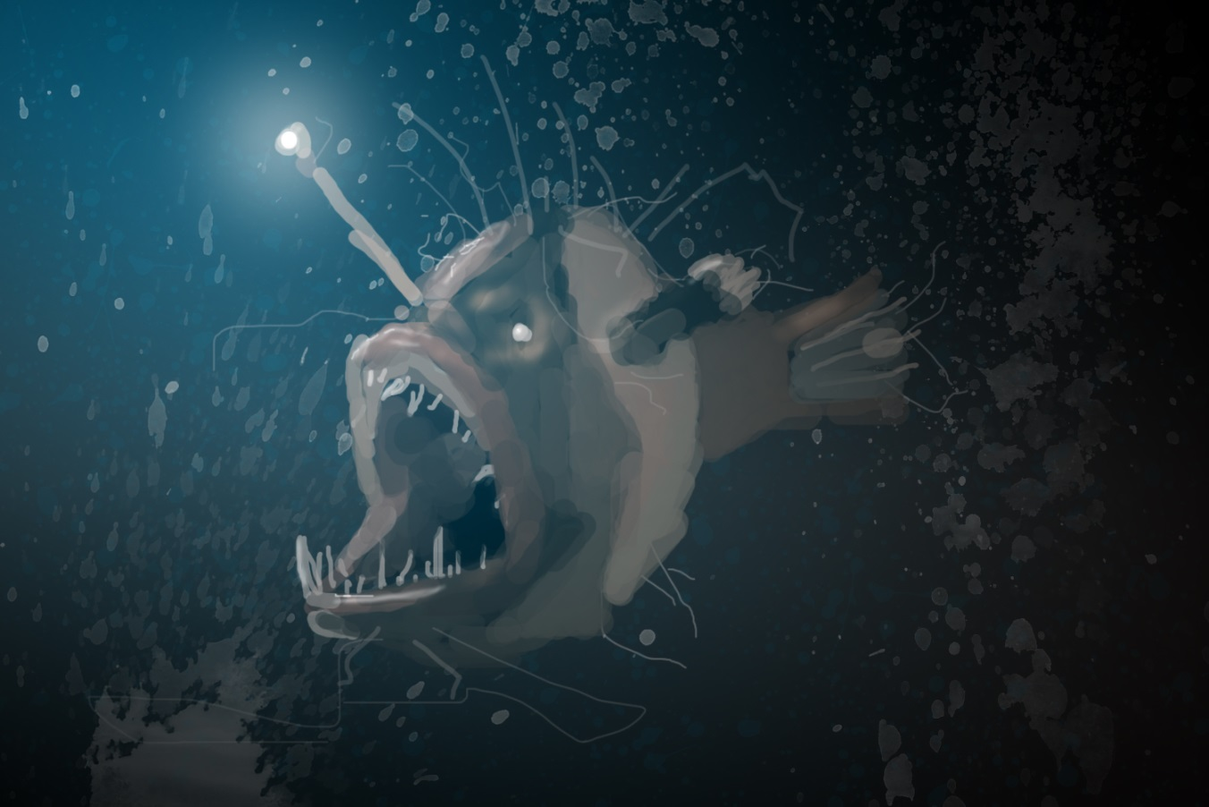
Our ocean has 3 ecosystems:
1. SHORE = INTERTIDAL ZONE
2. CONTINENTAL SHELF = NERITIC ZONE
coral reefs
kelp forests
3. DEEP ZONE =

Slide 15
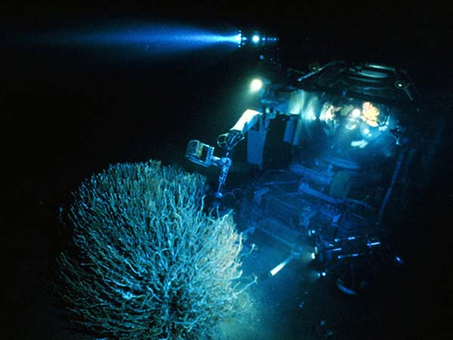
Our ocean has 3 ecosystems:
1. SHORE = INTERTIDAL ZONE
2. CONTINENTAL SHELF = NERITIC ZONE
coral reefs
kelp forests
3. DEEP ZONE = BENTHIC ZONE

Slide 16
Let’s make a SIMPLE table for notes!
Should take up at LEAST a HALF PAGE!
 | LIFE | LIGHT | PRESSURE
INTERTIDAL
NERITIC
BENTHIC

Slide 17
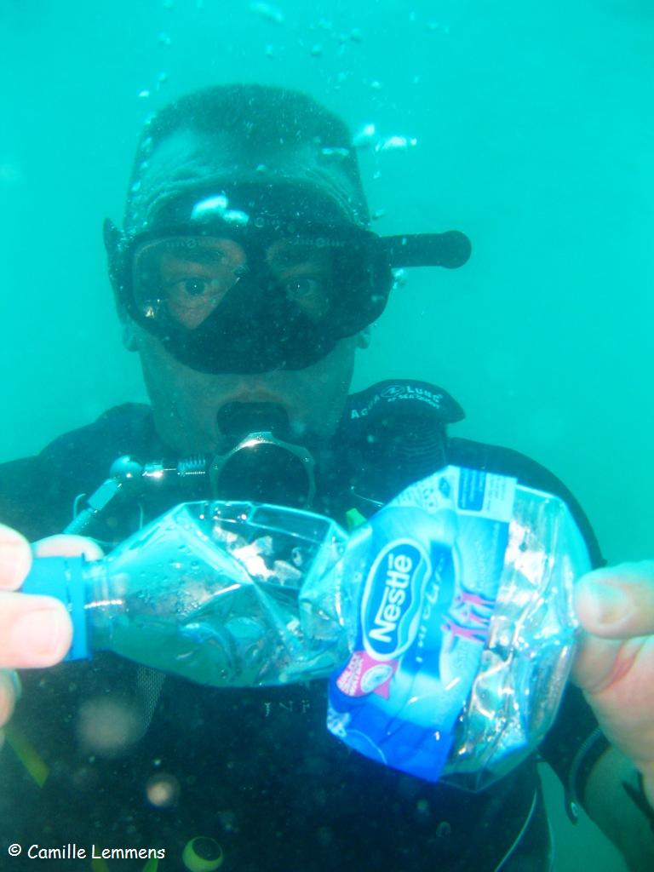
The deeper you go, the ______ the pressure.

Slide 18
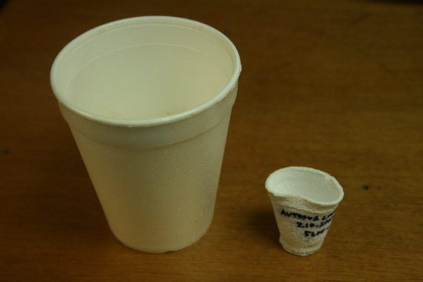
The deeper you go, the more the pressure.

Slide 19
Which zone has the most PRESSURE?
 | LIFE | LIGHT | PRESSURE
INTERTIDAL
NERITIC
BENTHIC |  |  | HIGHEST

Slide 20
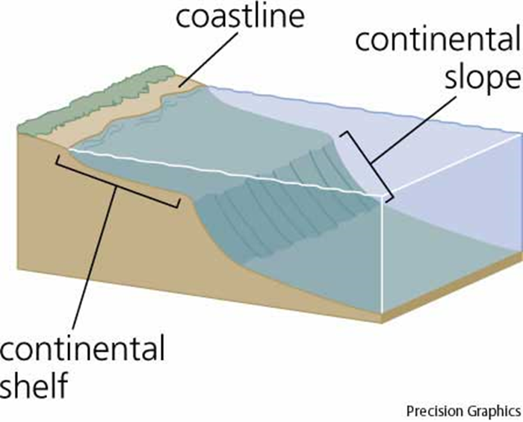
Which zone has the most sunlight?
deep zone

Slide 21
The shoreline has the most sunlight.
deep zone

Slide 22
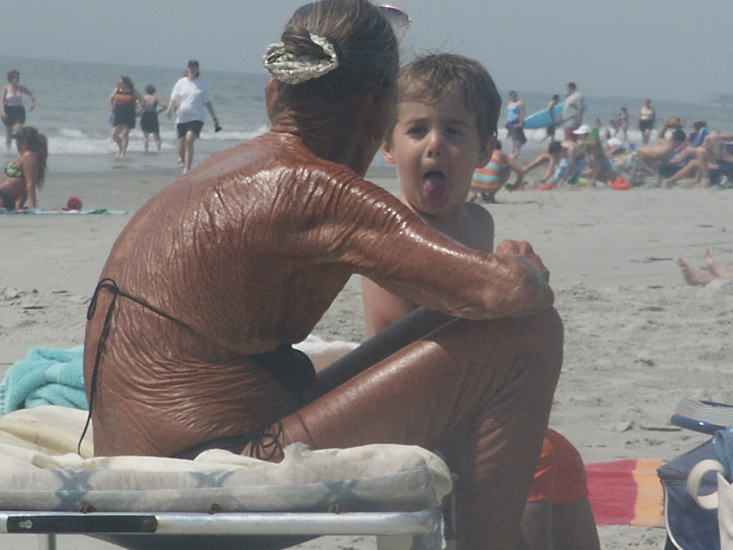
The shoreline has the most sunlight.
Sometimes TOO MUCH sunlight.

Slide 23
Which zone has the most SUNLIGHT?
 | LIFE | LIGHT | PRESSURE
INTERTIDAL |  | HIGHEST | LOW
NERITIC |  | MEDIUM | MEDIUM
BENTHIC |  |  | HIGHEST

Slide 24
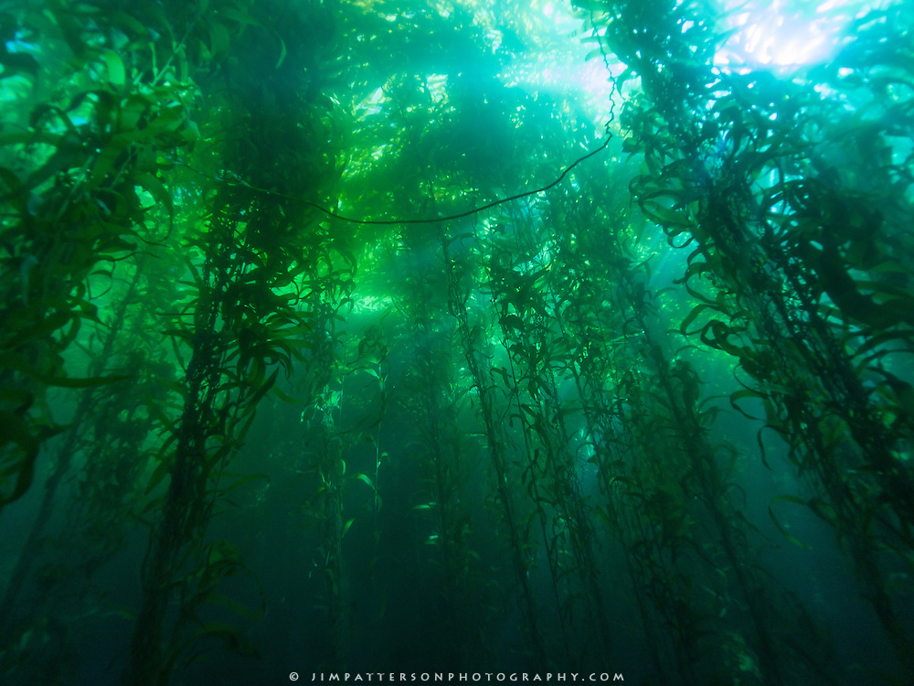
The shelf (neritic zone) gets a right amount of light.

Slide 25
The BENTHIC zone get LITTLE if any SUNLIGHT.
 | LIFE | LIGHT | PRESSURE
INTERTIDAL |  | HIGHEST | LOW
NERITIC |  | MEDIUM | MEDIUM
BENTHIC |  | LOW or NO LIGHT | HIGHEST

Slide 27
Which zone has the highest concentration, highest density of life?

Slide 28
coral reefs

Slide 29
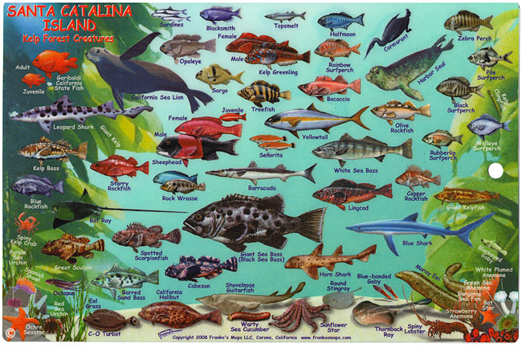
kelp forests
1. SHORE = INTERTIDAL ZONE
2. CONTINENTAL SHELF = NERITIC ZONE
3.

Slide 30
Neritic zone has the highest concentration of sea life …conditions are just right!
 | LIFE | LIGHT | PRESSURE
INTERTIDAL |  | HIGHEST | LOW
NERITIC (CONDITIONS JUST RIGHT) | HIGH DENSITY | MEDIUM | MEDIUM
BENTHIC |  | LOW or NO LIGHT | HIGHEST

Slide 31
Which zone has life suited for wet & dry conditions?

Slide 32
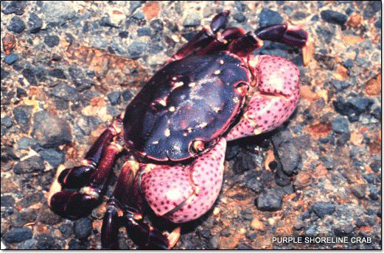
The INTERTIDAL zone has life best suited for wet or dry conditions!

Slide 33
Neritic zone has the highest concentration of sea life …conditions are just right!
 | LIFE | LIGHT | PRESSURE
INTERTIDAL | WET & DRY conditions | HIGHEST | LOW
NERITIC (CONDITIONS JUST RIGHT) | HIGH DENSITY | MEDIUM | MEDIUM
BENTHIC |  | LOW or NO LIGHT | HIGHEST

Slide 34
Which zone has the most diverse array of life?
diverse= different types

Slide 35
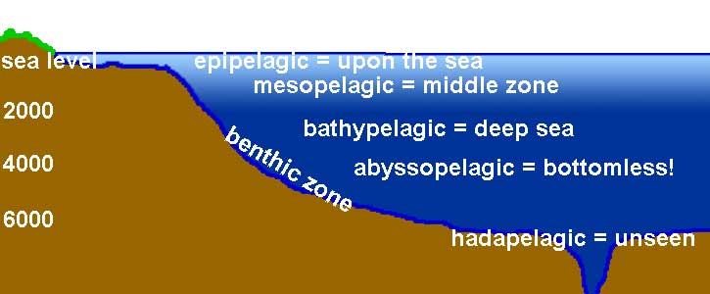
Surprisingly, the BENTHIC zone has the greatest VARIETY of living things anywhere on Earth!
It’s the LARGEST part of our Oceans!

Slide 36
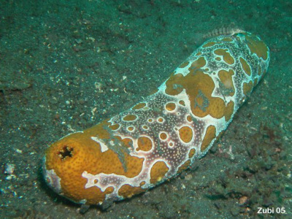
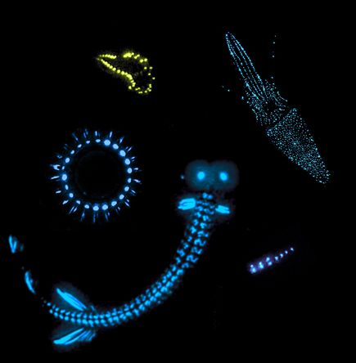
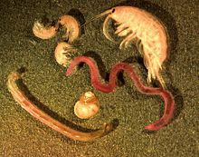
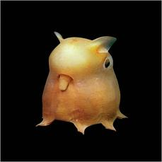
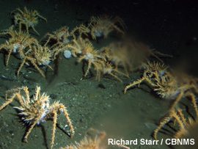
Surprisingly, the BENTHIC zone has the greatest VARIETY of living things anywhere on Earth!
It’s the LARGEST part of our Oceans!

Slide 37
Neritic zone has the highest concentration of sea life …conditions are just right!
 | LIFE | LIGHT | PRESSURE
INTERTIDAL | WET & DRY conditions | HIGHEST | LOW
NERITIC (CONDITIONS JUST RIGHT) | HIGH DENSITY | MEDIUM | MEDIUM
BENTHIC | low density high variety | LOW or NO LIGHT | HIGHEST

