Slide 1
Finding the Age of Rocks Through Rock Dating

Slide 2
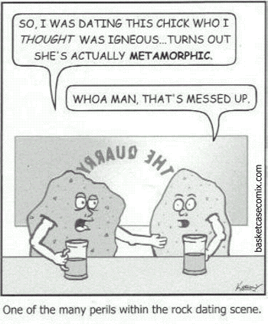
D
A
T
I
N
G
R
O
C
K

Slide 3
Activator: Student Line Up
I need 7 volunteers
What is the exact position of _______ in the line?
What is an estimate of _______ in the line?
What is the difference between exact and estimate?

Slide 4
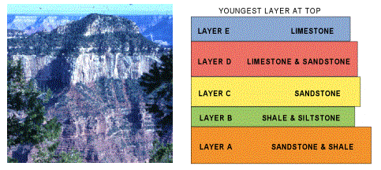
Ages of Rocks
The relative age of a rock is its age compared to other rocks. Use words like: “older or younger”
The absolute age of a rock is the number of years since the rock was formed.
Ex: 358-360 mya

Slide 5
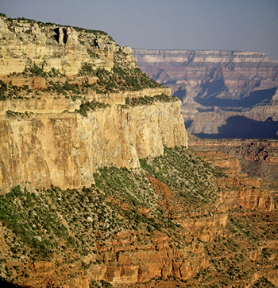
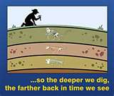
Law of Superposition

Slide 6
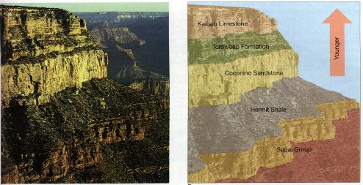
The Position of Rock Layers
It can be difficult to determine a rocks absolute age. So… scientists use the law of superposition.
According to the law of superposition, in horizontal sedimentary rock layers the oldest layer is at the bottom. Each higher layer is younger than the layers below it.

Slide 7
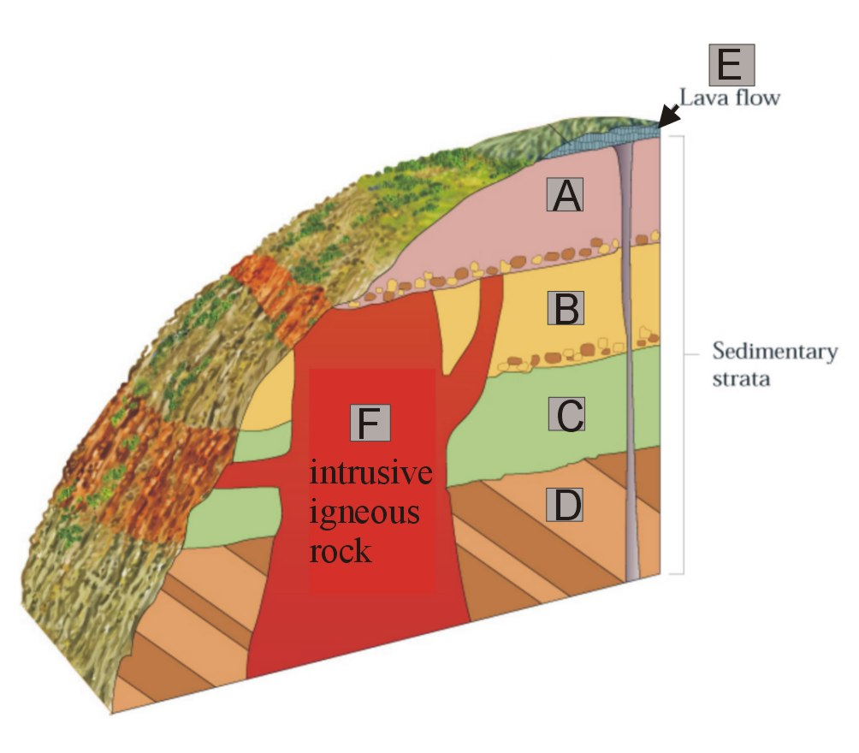
Other Clues to Relative Age
Clues From Igneous Rock
Lava that cools at the surface is called an extrusion. Rock below an extrusion is always older.
Magma that cools beneath the surface is called an intrusion. An intrusion is always younger than the rock layers around an beneath it.

Slide 8
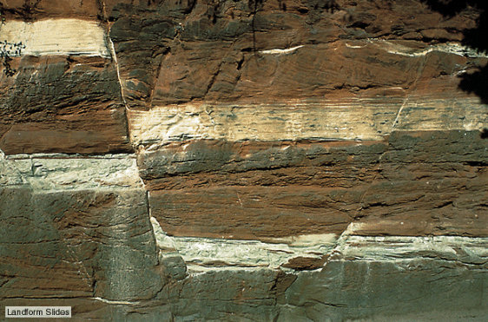
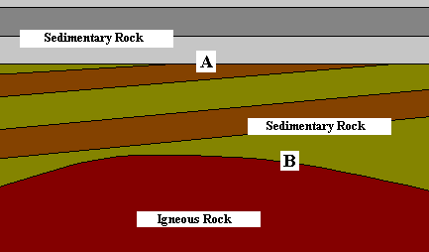
Other Clues to Relative Age
Faults (a break in the rock) are always younger than the rock it cuts through!
Unconformities: An unconformity is a gap in the geological record that can occur when erosion wears away rock layers and other rock layers form on top of the eroded surface.

Slide 9
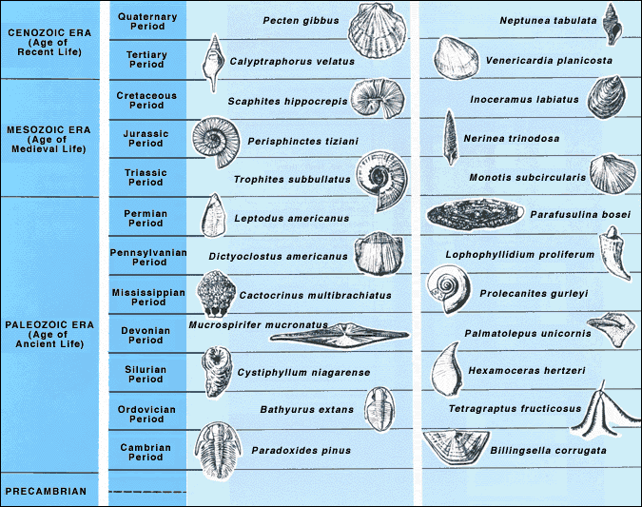
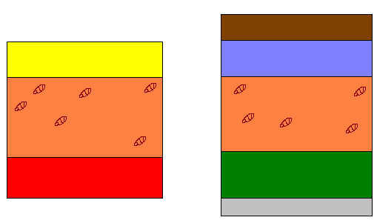
Using Fossils to Date Rocks!
Scientists use index fossils to match rock layers.
An index fossil must be widely distributed and represent a type of organism that existed only briefly.
They are useful because they tell the relative ages of the rock layers they are found in.

Slide 10
The Trilobite
One example of an index fossil is a trilobite.
Trilobites were a group of hard-shelled animals whose bodies had three distinct parts.
They evolved in shallow seas more than 500 million years ago.

