Slide 1
Objectives: 8.L.4.1 -TSWU evolution as it pertains to the change in land formations including the theory of plate tectonics and the law of superposition. Essential question: -how does the geologic timescale represent evolution in earth's history?
Introduction to Evolution

Slide 2
Literacy Warm Up: Day 1 evolution
Learning to Fly: DE article
What characteristics were found in Archaeopteryx that are shared with modern birds?
Were these feathered species able to fly?
What were their feathers used for?
Comparative anatomy is the study of…..
What was the evolutionary advantage of flight?
Using biomechanics, scientists now believe what about Archaeopteryx?
Summarize the main idea of this article.

Slide 3
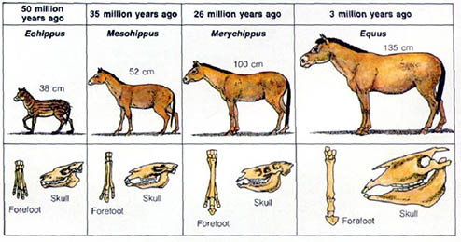
What is evolution?
How does this illustration portray the evolution of a horse?
How have bacteria evolved?

Slide 4
Additional warm up 4-12
Define the Law of Superposition.
Define the Theory of Continental Drift.
Define the Theory of Plate Tectonics.
Now, explain what any of these have to do with biological evolution?

Slide 5
What is evolution?
Humans evolved from monkeys?
If you and your wife are muscle builders, your child will be muscular?
Giraffes have really long necks because they stretched to reach the tallest leaves making their necks longer?
Humans are no longer evolving.
Evolution is random

Slide 6
What is evolution?
Humans evolved from monkeys?
If you and your wife are muscle builders, your child will be muscular?
Giraffes have really long necks because they stretched to reach the tallest leaves making their necks longer?
Humans are no longer evolving.
Evolution occurs as a response to the environment.

Slide 7
Evolution*
The process by which different kinds of living organisms have developed and diversified from earlier forms throughout the history of the earth.
CHANGE OVER TIME!

Slide 8
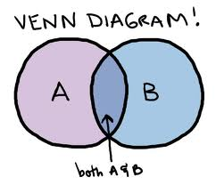
Literacy Activity
Writing Prompt (create a timeline during the video for one)
Evolution of Dance or
Evolution of technology
Evolution of Earth
6-8 facts about Earth’s past
Create a Venn Diagram
Compare and contrast the
evolution of earth to the evolution
of dance.
Comparison Essay
Write a 3 paragraph essay comparing and contrasting the evolution of dance to the evolution of the Earth.
Each paragraph must be a minimum of 5-8 sentences each.
You must include an introduction paragraph, a body, and a conclusion.

Slide 9
Evolution Writing Prompts
Choose ONE of the following topics and write a 3 paragraph essay to answer ALL of the bullets for that article. Be sure to provide a short introduction and conclusion to your essay. Be sure to use information from the video clips as well as information from our class discussion when writing your essay.
Evolution of Dance
Explain how each of the dancing styles have evolved over time. (movement, music, clothing). Explain why each these dance styles may have been popular during their time.
Explain why these types of dance styles may have been replaced with new styles of dance.
Evolution of Technology
Explain how technology has evolved over time (from your childhood, your parents childhood, maybe even your grandparents childhood). Explain how each of you may have had to adapt to changes with technology.
Some questions you might want to answer include but are not limited to: What are some ways technology has changed education? How has communication changed? How has travel become easier?

Slide 10
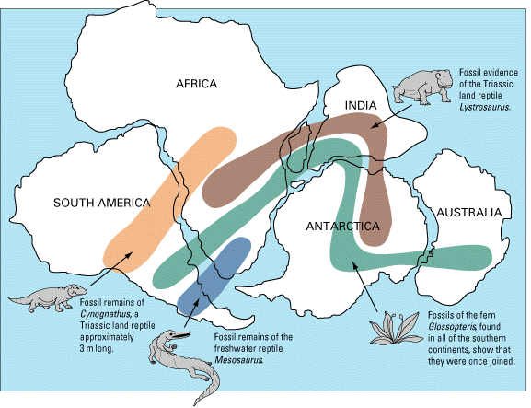
So evolution, how do we prove it?
Not only due to organisms changing over time, but also because land changes over time, forcing those organisms to adapt!

Slide 11
Which brings us back to a certain law we learned back in September…

Slide 12
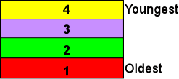
The Law of Superposition*
Each rock layer is older than the layer above it.

Slide 13
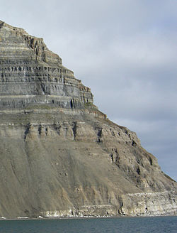
The Law of Superposition*
Each rock layer is older than the layer above it.

Slide 14
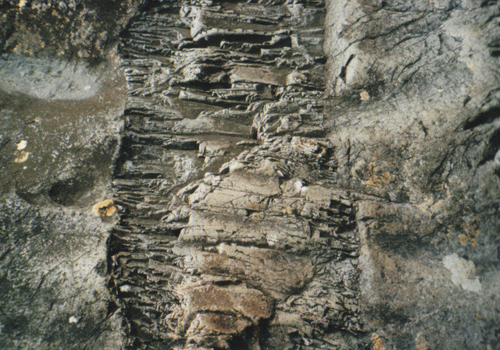
Youngest Top, Oldest Bottom!
Unless something happens….

Slide 15
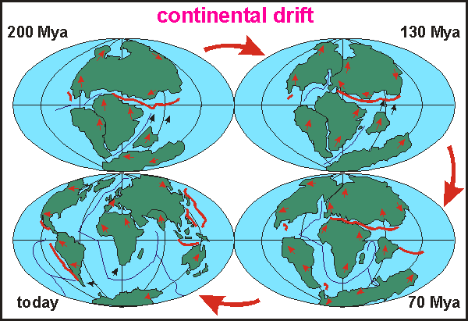
The Theory of Continental Drift*
All the continents originated from one super-continent, and then drifted apart.

Slide 16
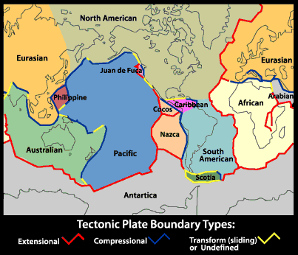
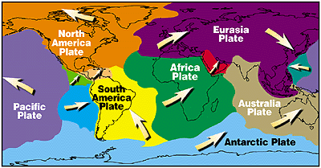
The Theory of Plate Tectonics*
There are large plates under the Earth’s surface that move around because of heat from the core (convection).

Slide 17
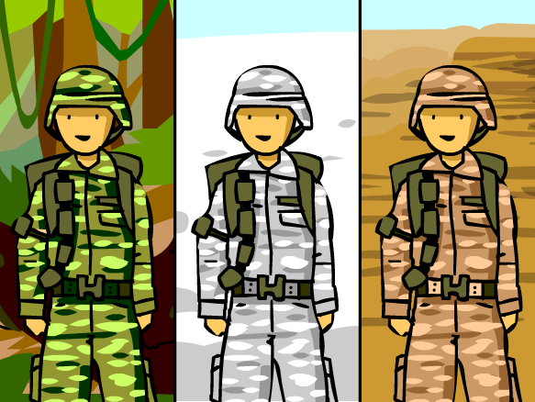
Brain Pop - Mutations

