Slide 1
Warm Up Dec. ^{th}, 2014
Atomic Number: 15
1) List # of electrons, protons, neutrons, shells, valence electrons, atomic mass, chemical symbol (and name if you know it); then draw a model of that atom and a Lewis Dot Structure.
2) What’s special about this element?

Slide 2
Warm Up/Spiral Dec. 8th
Use pages 111D-113D to review these terms. Answer the questions in complete sentences.
1. What is the difference between a solute and a solvent?
2. What does it mean if something is insoluble?
3. What is solubility???

Slide 3
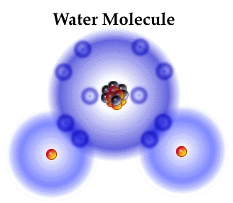
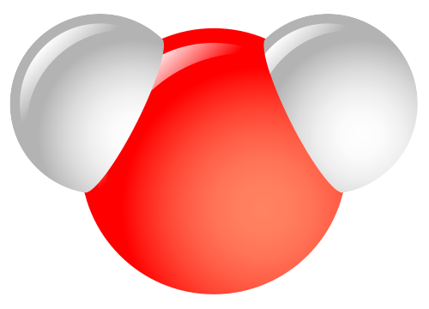
Molecule*
Two or more atoms bonded
together. Molecules can also be compounds.
O
H
H

Slide 4
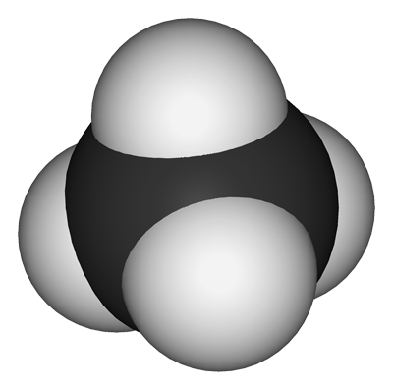
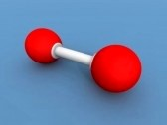
Molecule*
Two or more atoms bonded
together. Some molecules are not compounds.
H
O
C
H
O
H
H

Slide 5
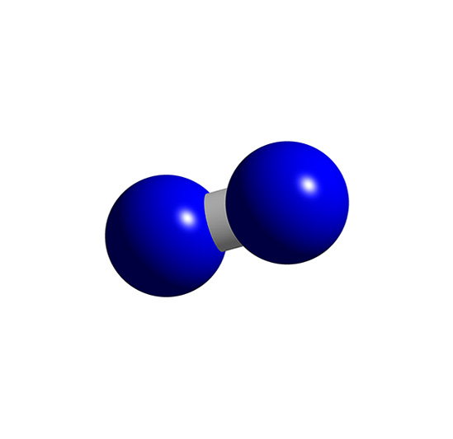
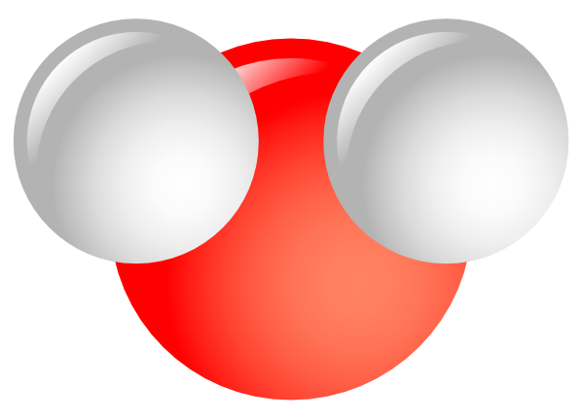
Compound*
A substance consisting of two or more different types of atoms. Compounds can be molecules.

Slide 6
From Elements to Compounds
Sodium is an element.
Chlorine is an element.
When sodium and chlorine bond they make the compound sodium chloride, commonly known as table salt.
Octet Rule – after bonding, both atoms have 8 valence electrons
▪Compounds have different properties than the elements that make them up.
▪Table salt has different properties than sodium, an explosive metal, and chlorine, a poisonous gas.

Slide 7
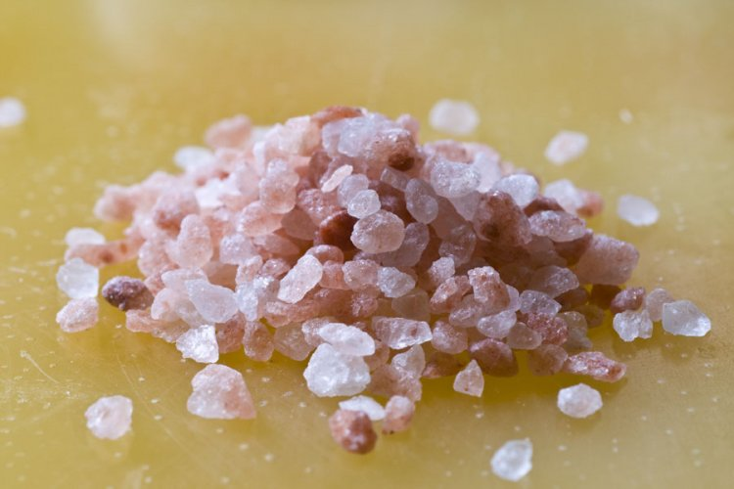
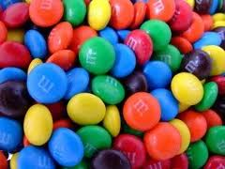
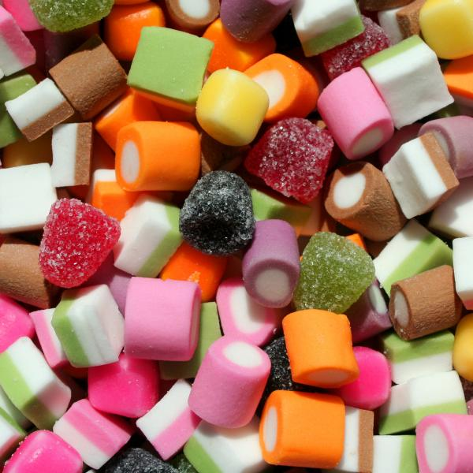
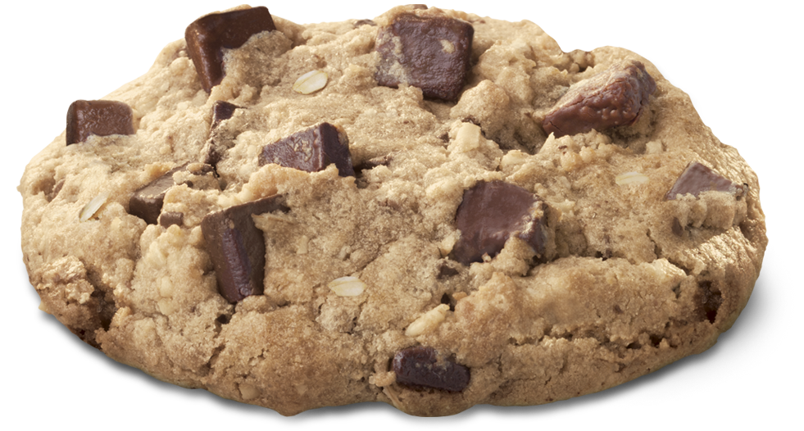
Mixture*
When two or more different substances are mixed, but not chemically combined.

Slide 8
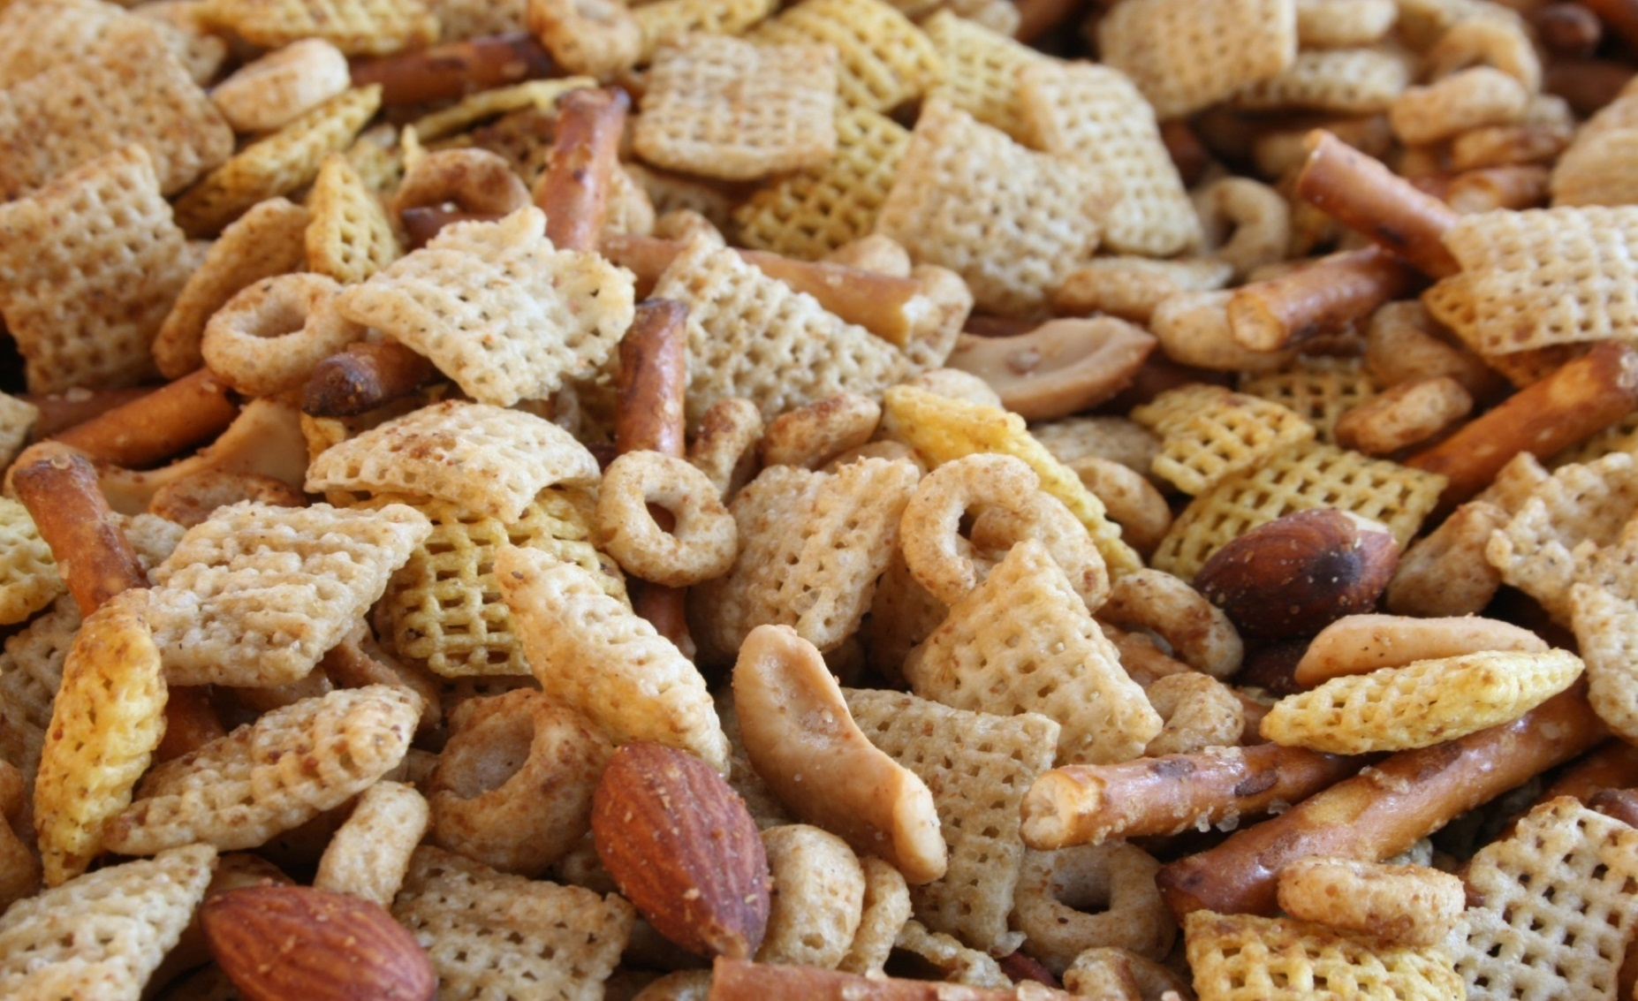
How would you separate the following? That’s called physical.

Slide 9
How would you separate the
following?

Slide 10
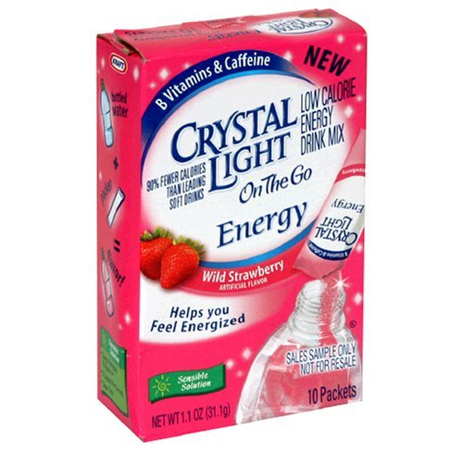
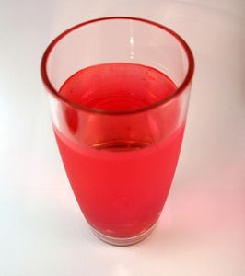
How would you separate the following?

Slide 11
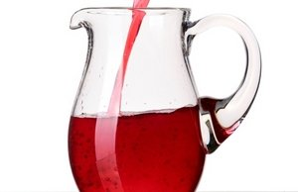
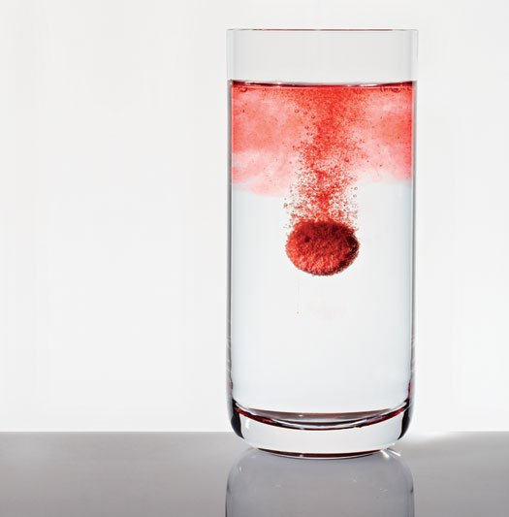
Solution*
A mixture where one part of the solution (solute) is dissolved into the other part of the solution (solvent).

Slide 12
Homogeneous* – A mixture in which the components are uniformly distributed.
Heterogeneous* – A mixture in which the components are not uniformly distributed.

Slide 13
So which is homogenous and
which is heterogeneous?

Slide 14
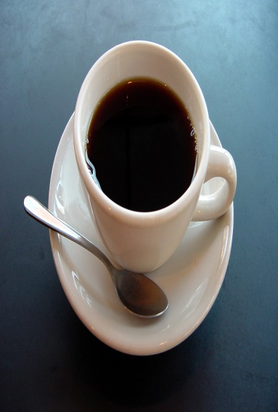
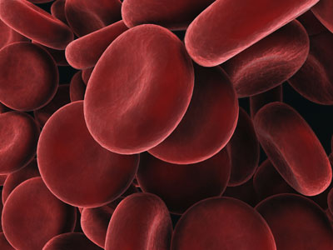
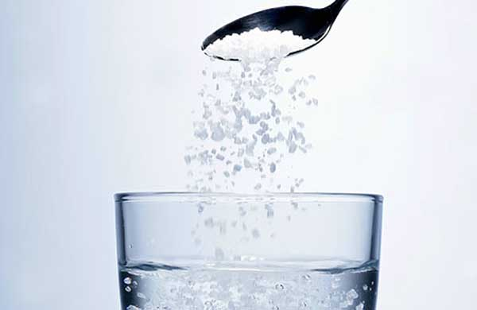
Then what is homogenous???

Slide 15
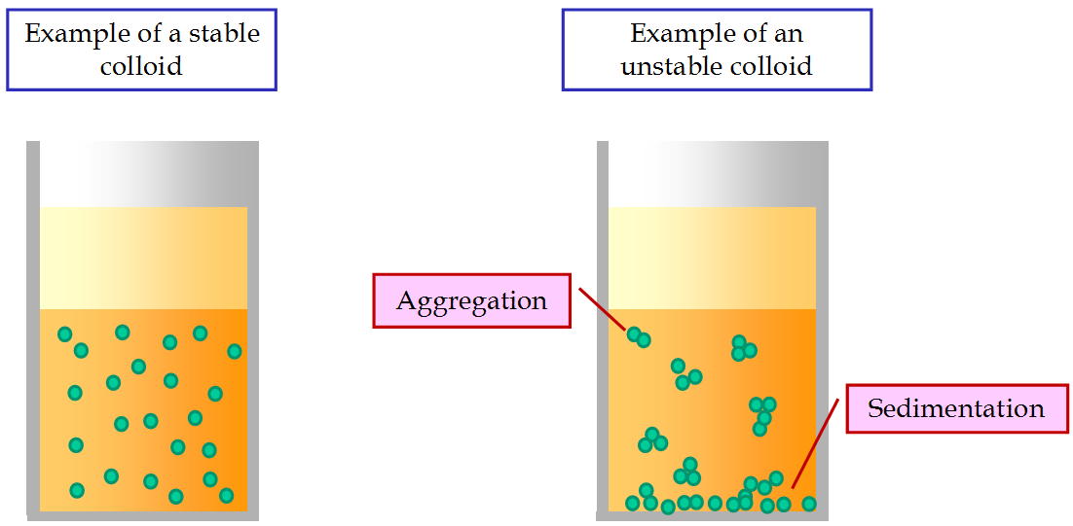
Suspensions and colloids:

Slide 16
Suspension: Heterogeneous mixture in which some particles settle out.

Slide 17
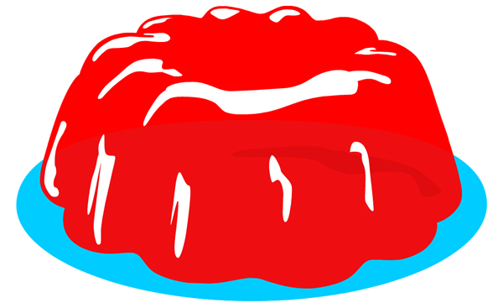
Colloid: mixture in which particles are mixed but not dissolved.

Slide 18
Brain Pop: Compounds

Slide 19
Compound Molecule Worksheet

