Slide 1
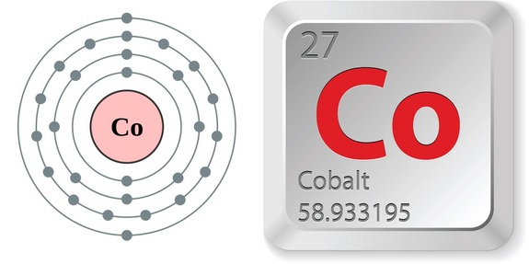
Warm Up, December 1, 2015
1) How many protons, neutrons, and electrons are in this element?
2) What are the rows
of the periodic table
called? What are the
columns called?
3) How is the periodic table arranged (left to right)? What does the Atomic # represent? What does the Atomic Mass represent?

Slide 2
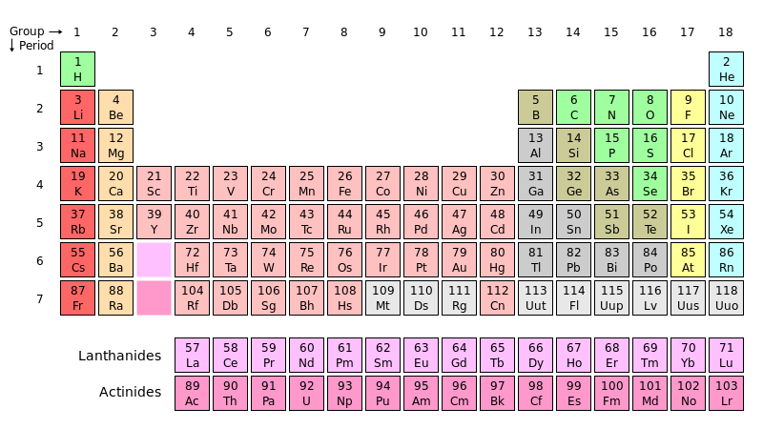
Element*
A pure substance consisting of one type of atom.

Slide 3
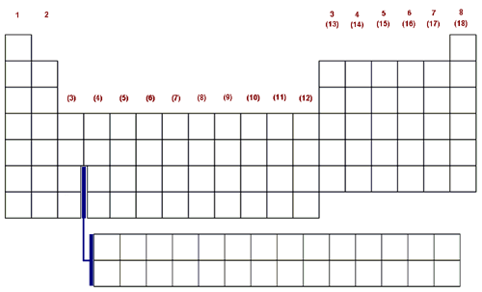
Periodic Table Geography You will need : three colored pencils and handout
Group or Family Similar chemical properties
Non-Metals
Period
Atoms decrease in size from left to right
Metalloids
Metals

Slide 4
Group*
A vertical column in the Periodic Table.

Slide 5
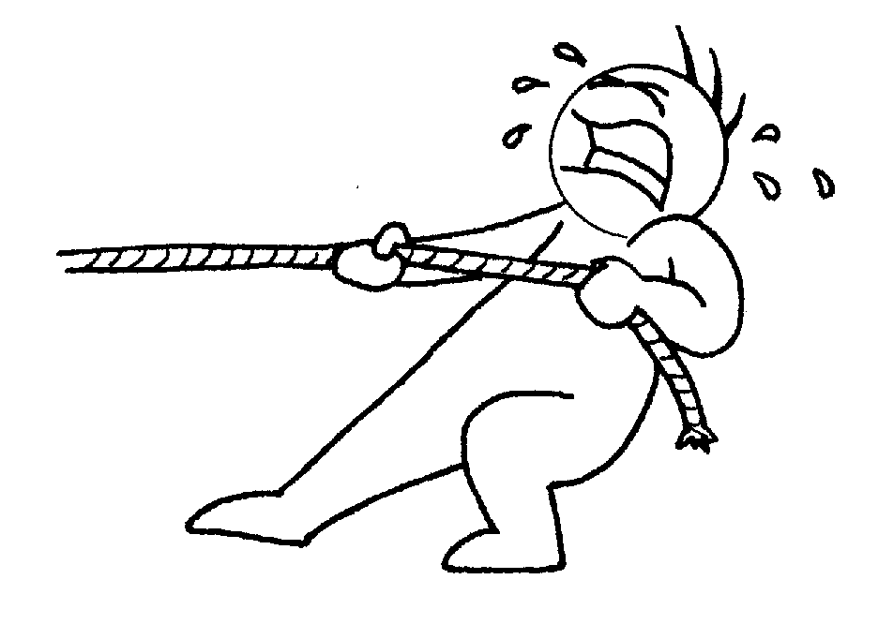
Period*
A horizontal row in the Periodic Table.

Slide 6
Noble Gas
This family is the least reactive family of elements
Alkali Metals Family
This family is the most reactive family of elements
PBS Hunting the Elements Video on You Tube

Slide 7
Noble Gas
This family is the least reactive family of elements
Alkali Metals Family
This family is the most reactive family of elements
Alkaline Earth Metals
PBS Hunting the Elements Video on You Tube

Slide 8
Noble Gas
This family is the least reactive family of elements
Alkali Metals Family
This family is the most reactive family of elements
Alkaline Earth Metals
Halogens, means salt producing. Used as disinfectant
PBS Hunting the Elements Video on You Tube

Slide 9
Periodic Table Geography You will need : three colored pencils and handout
Group or Family Similar chemical properties
Non-Metals
Period
Atoms decrease in size from left to right
Metalloids
Metals

Slide 10
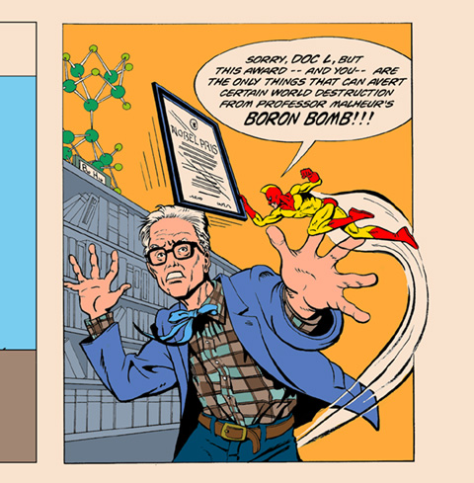
Periodic Table
Periodic Table
spiral:
Use your Periodic Table from last class, textbook p.20D, or your planner p. R13
Most of the elements are metals. Name 3 metals from the Periodic Table.
Many elements are non-metals. Name 3 non-metals from the Periodic Table.
Some of the elements are metalloids. Name 3 metalloids from the Periodic Table.
Metals, non-metals, alkaline, metals, non-metals, metalloids notes
Homework: Periodic table of elements sheet
Page 135
Page 136

Slide 11
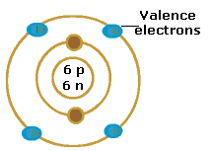
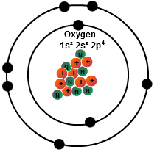
Valence Electrons*
The electrons that make up the outermost shell of an atom.
Elements in the first 3 periods have shell capacities of 2, 8, and 8.

Slide 12
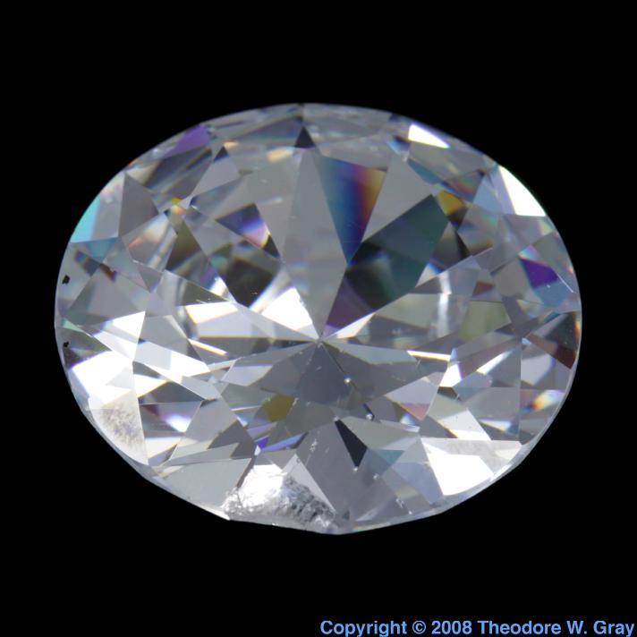
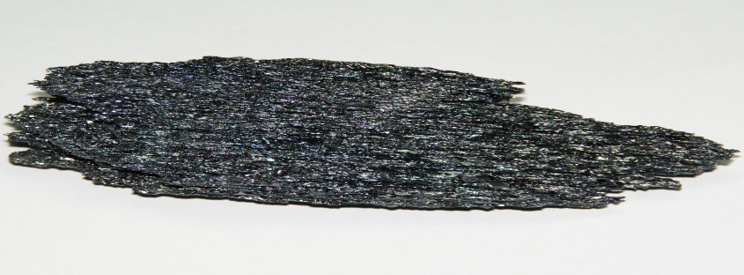
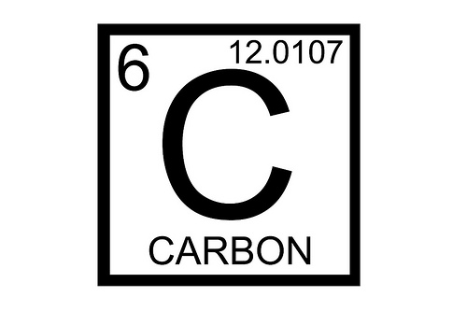
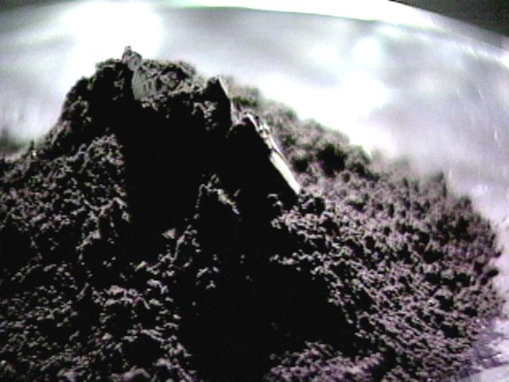
So what is an element?
Well, this is Carbon.

Slide 13
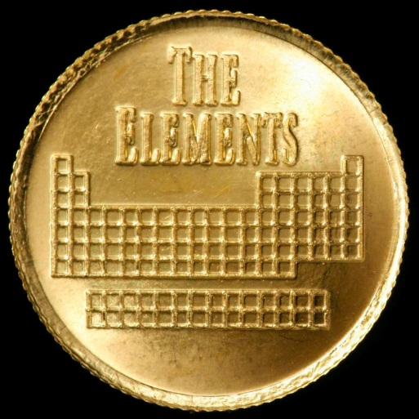
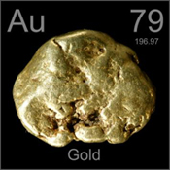
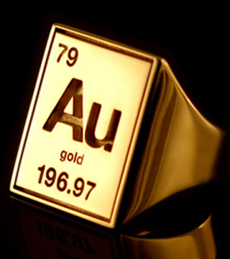
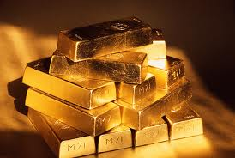
So what is an element?
Here’s Gold!

Slide 14
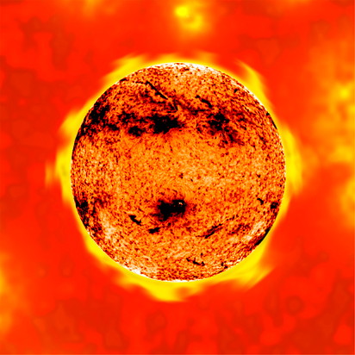
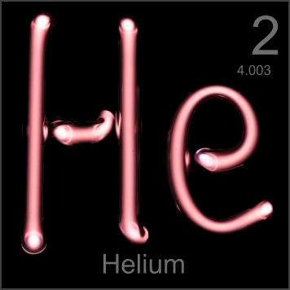
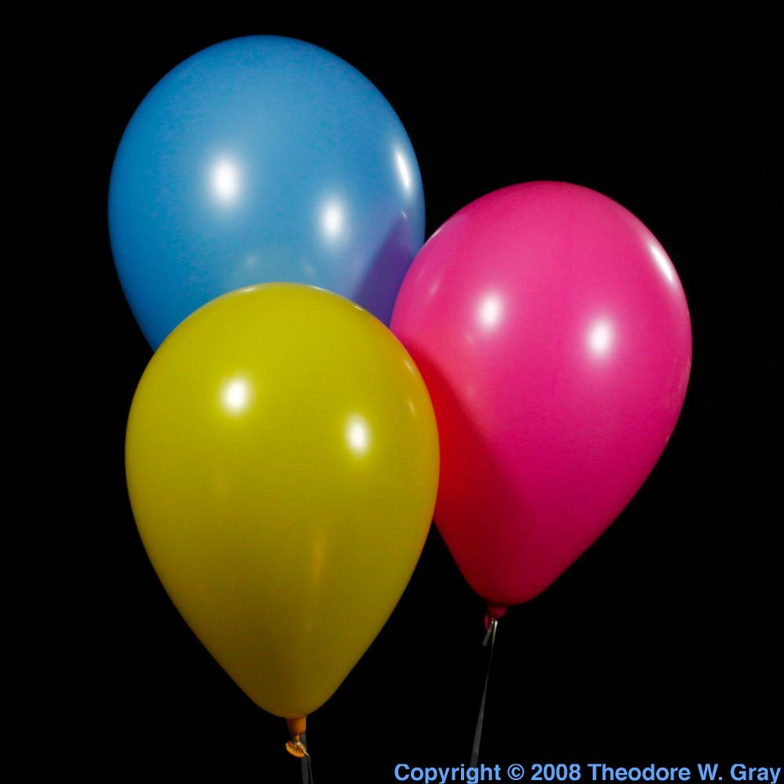
So what is an element?
And Helium!

Slide 15
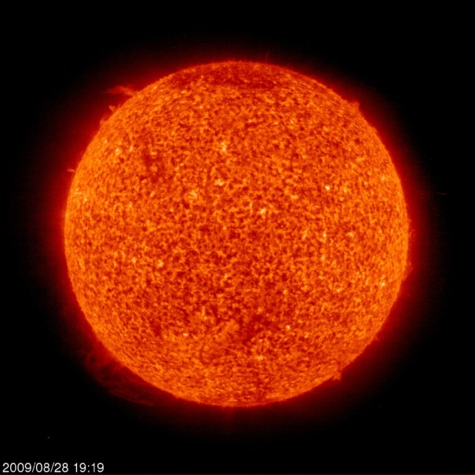
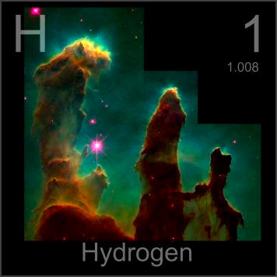
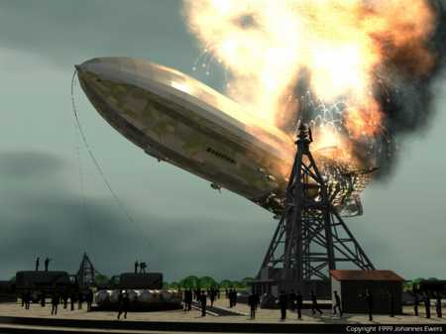
So what is an element?
What about Hydrogen?
Notes:
"Pillars of Creation" is a photograph taken by the Hubble Telescope of elephant trunks of interstellar gas and dust in the Eagle Nebula, some 7,000 light years from Earth

Slide 16
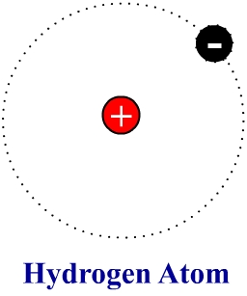
So what is an element?
Hydrogen’s atomic structure
Hydrogen:
1 Proton
1 Electron
0 Neutrons

Slide 17
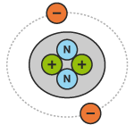
So what is an element?
Helium’s atomic structure
Helium:
2 Protons
2 Electrons
2 Neutrons

Slide 18
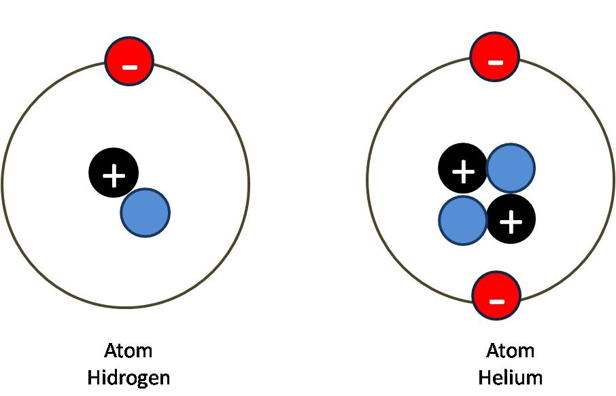
Hydrogen
Helium

Slide 19
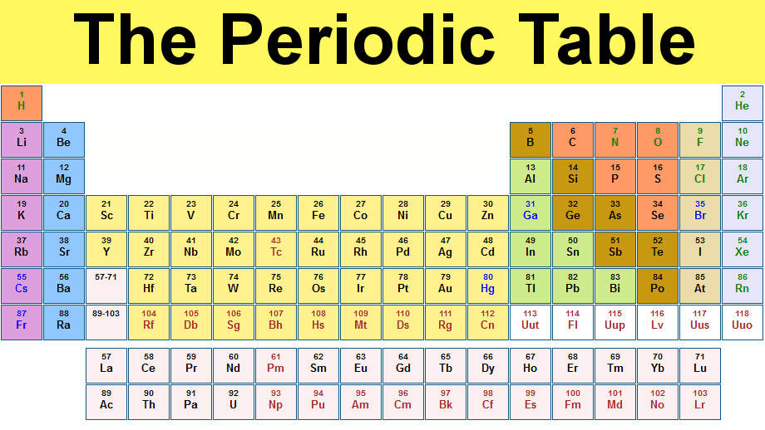
So why is it shaped this way (weird)?

Slide 20
So each Period of the Periodic Table represents a shell of electrons…
1
2
3
4
5
6
7

Slide 21
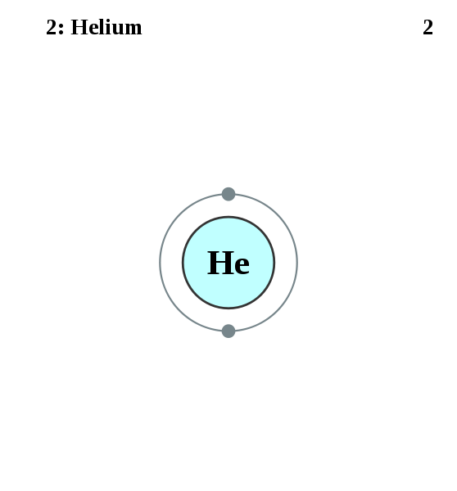
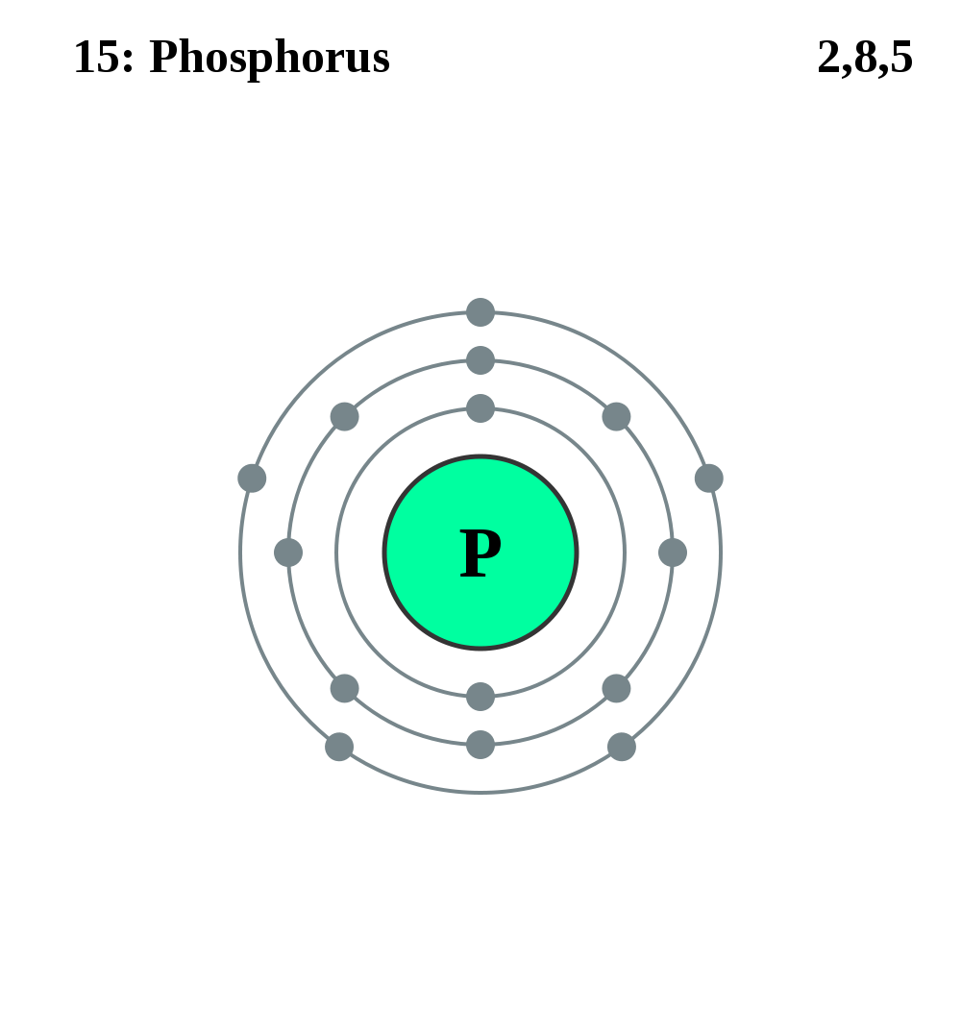
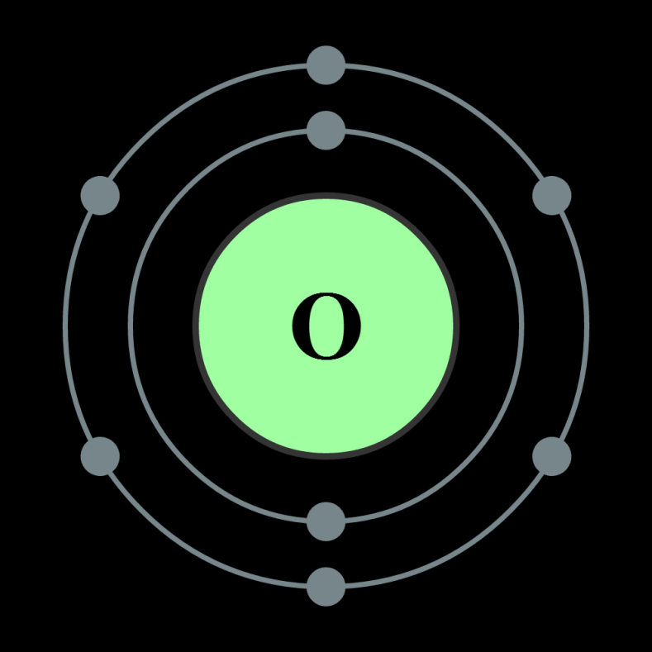
Look at your Periodic Table! Which Period is each of these elements in?

Slide 22
Periodic Table Geography You will need : three colored pencils and handout
Group or Family Similar chemical properties
Non-Metals
Period
Atoms increase in size from left to right
Metalloids
Metals

Slide 23
Noble Gas
This family is the least reactive family of elements
Alkali Metals Family
This family is the most reactive family of elements
PBS Hunting the Elements Video on You Tube

Slide 24
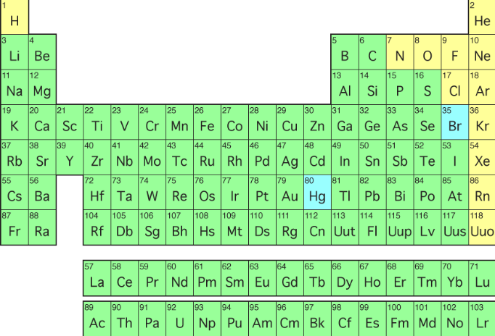
Families of Elements on the Periodic Table – Part 1

Slide 25
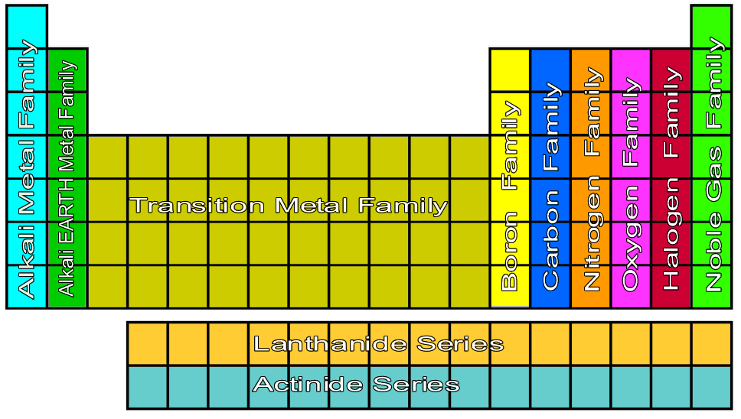
Families of Elements on the Periodic Table – Part 3

Slide 26
Metals: GOOD conduct electricity, heat. Shiny appearance. Malleable. Ex. Al, Au, Cu
Metalloids: Properties of both metals and non-metals. Ex. B, Si
Non-metals: Properties opposite of metals. Dull. Not conductive. Brittle. Ex. Br, Cl, S

Slide 27
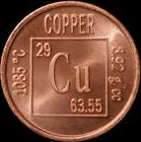
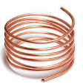
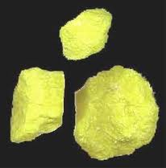
Properties of Elements Brochure
Metals
Non-metals
Metalloids
Most are solids
Can be shaped & pulled into wires
Shiny / lustrous
Good conductors of electricity/heat
Ex. Copper is used for wires
Most are gases
Solid non-metals are brittle (breaks into pieces)
Not shiny, but dull
Poor conductors of electricity and heat
Good insulator of electricity and heat
Most are Solids
Can be shiny or dull
Can be shaped & pulled into wires
Conducts better than nonmetals but not as well as metals
Ex. Silicon used in computers

