Slide 1
  Intro to Chemistry and Atoms
What is Chemistry ?
My Unit Goals
1. ______________________________________
2. ______________________________________
______________________________________
Matter – anything with has mass and takes up space
Atoms – All matter is made of atoms
M A T T E R
…just like all words are made of letters.

Slide 2
The Atoms Family
The Atoms Family was created by Kathleen Crawford, 1994
Presentation developed by Tracy Trimpe, 2006, http://sciencespot.net/

Slide 3

Is air matter?
Well what does matter have to have?
Notes:
Ask students what is needed for matter to be matter.

Slide 4

Have mass and take up space!
You all have mass and certainly take up space (right?)
Notes:
Joke.

Slide 5
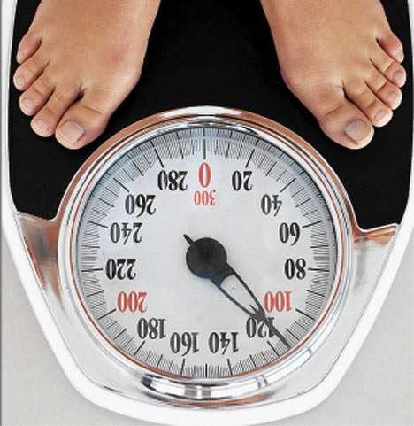
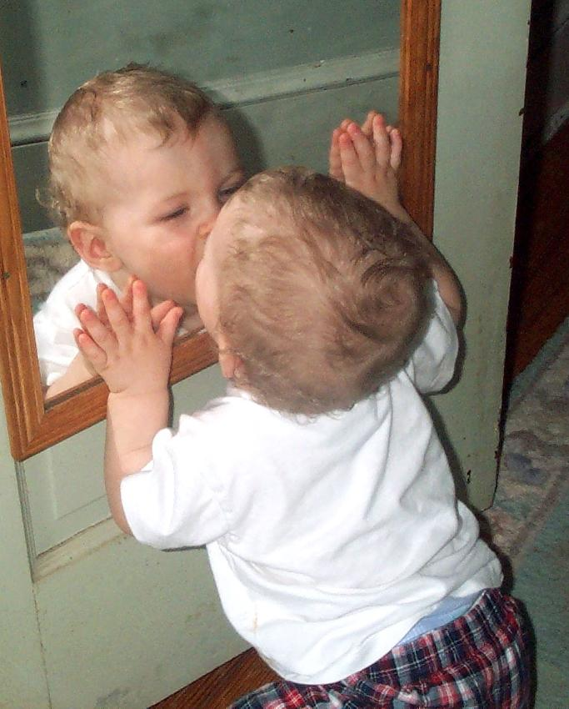
How could we check if you have mass?
How could we check if you take up space?
Notes:
Talk about weight. Make mirror joke.

Slide 6

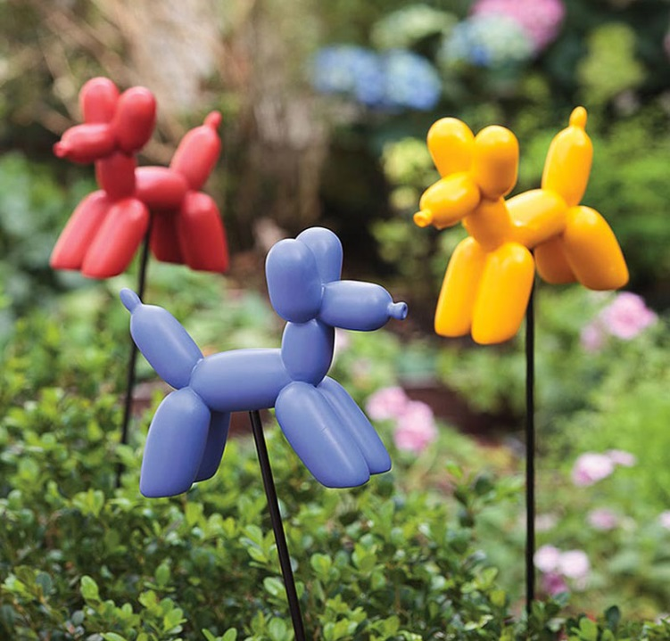

So, is air matter?
Does it really to take up space?…Have Volume?
https://www.youtube.com/watch?v=o5LT_wfI98w
Perhaps if we measured its mass…
Notes:
Demonstrate a balloon being inflated and taking up space. Then measure mass of balloon on a scale. Confirm air is matter. Pop Balloon.

Slide 7
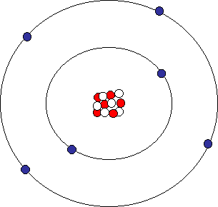
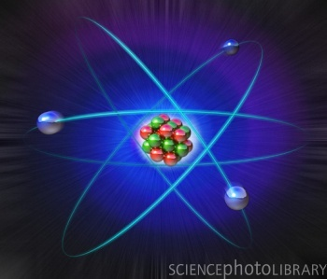
Atom*
- Atoms are the building blocks of the entire universe. All matter is made up of atoms.

Slide 8
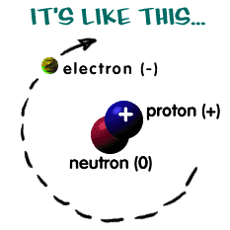
Atomic Structure*
The atomic
structure is the
way atoms are
ordered. All atoms
are similar in terms
of organization.

Slide 9

Proton +*
Positively charged, sub-atomic
particles that are located in the
nucleus.

Slide 10
Neutron*
Non-charged, sub-atomic particles that are located in the nucleus.

Slide 11
Electron -*
Negatively charged, sub-atomic particles
that are located in the electron cloud,
orbiting the
nucleus.

Slide 12
Atoms
  Atoms
Warm up:
Protons are positive / neutral / negative.
Protons are inside / outside the nucleus.
Neutrons are positive / neutral / negative.
Neutrons are inside / outside the nucleus.
Electrons are inside / outside the nucleus.
The overall charge of the nucleus is positive / neutral / negative.
7. Electrons are smaller / larger than protons.
Atom – The building block of matter
- Units of elements
- The smallest part of matter that has all of the chemical properties of that element
Subatomic Particles –parts of atoms
Nucleus Electron Cloud (rings)
Proton Electrons
Neutrons
Parts of an Atom :
Electron Cloud
Homework:
Models of Atoms for Elements 3 - 10
Nucleus
Item #

Slide 13
Connection to the Periodic Table of Elements (p. 20 D)
Atomic Number – Number of Protons
- This is how elements are arranged on the periodic table
Neutral Atom
# of Protons = # of Electrons
Atomic Weight (Mass) = Average Number of Protons + Neutrons (of all isotopes)
Mass Number = The total mass of the nucleus (protons + neutrons)
6
C
Carbon
12.001
Atomic Number = # of Protons / Electrons
Symbol = 1st letter always capital
Atomic Weight = Avg. of Protons + Neutrons

Slide 14
Reading Atoms on the Periodic Table
16
S
Sulfur
32.066
13
Al
Aluminum
26.982
11
Na
Sodium
22.990
Protons:
Neutrons:
Electrons:
Protons:
Neutrons:
Electrons:
Protons:
Neutrons:
Electrons:
Item #

Slide 15
Atomic Structure Notes Continued
Bohr Model - model that shows where particles are located in atoms.
Valence electrons – outermost energy level (ring)
Carbon:
6 Protons How many valence electrons?
6 Neutrons
6 Electrons

Slide 16
Bohr Model Practice: Use the information to make a Bohr model
Carbon:
6 Protons
6 Neutrons
6 Electrons
Valence Electrons___
Nitrogen:
7 Protons
7 Neutrons
7 Electrons
Valence Electrons___
Oxygen:
8 Protons
8 Neutrons
8 Electrons
Valence Electrons___

