Slide 1
BIOTECHNOLOGY EOG QUICK REVIEW

Slide 3
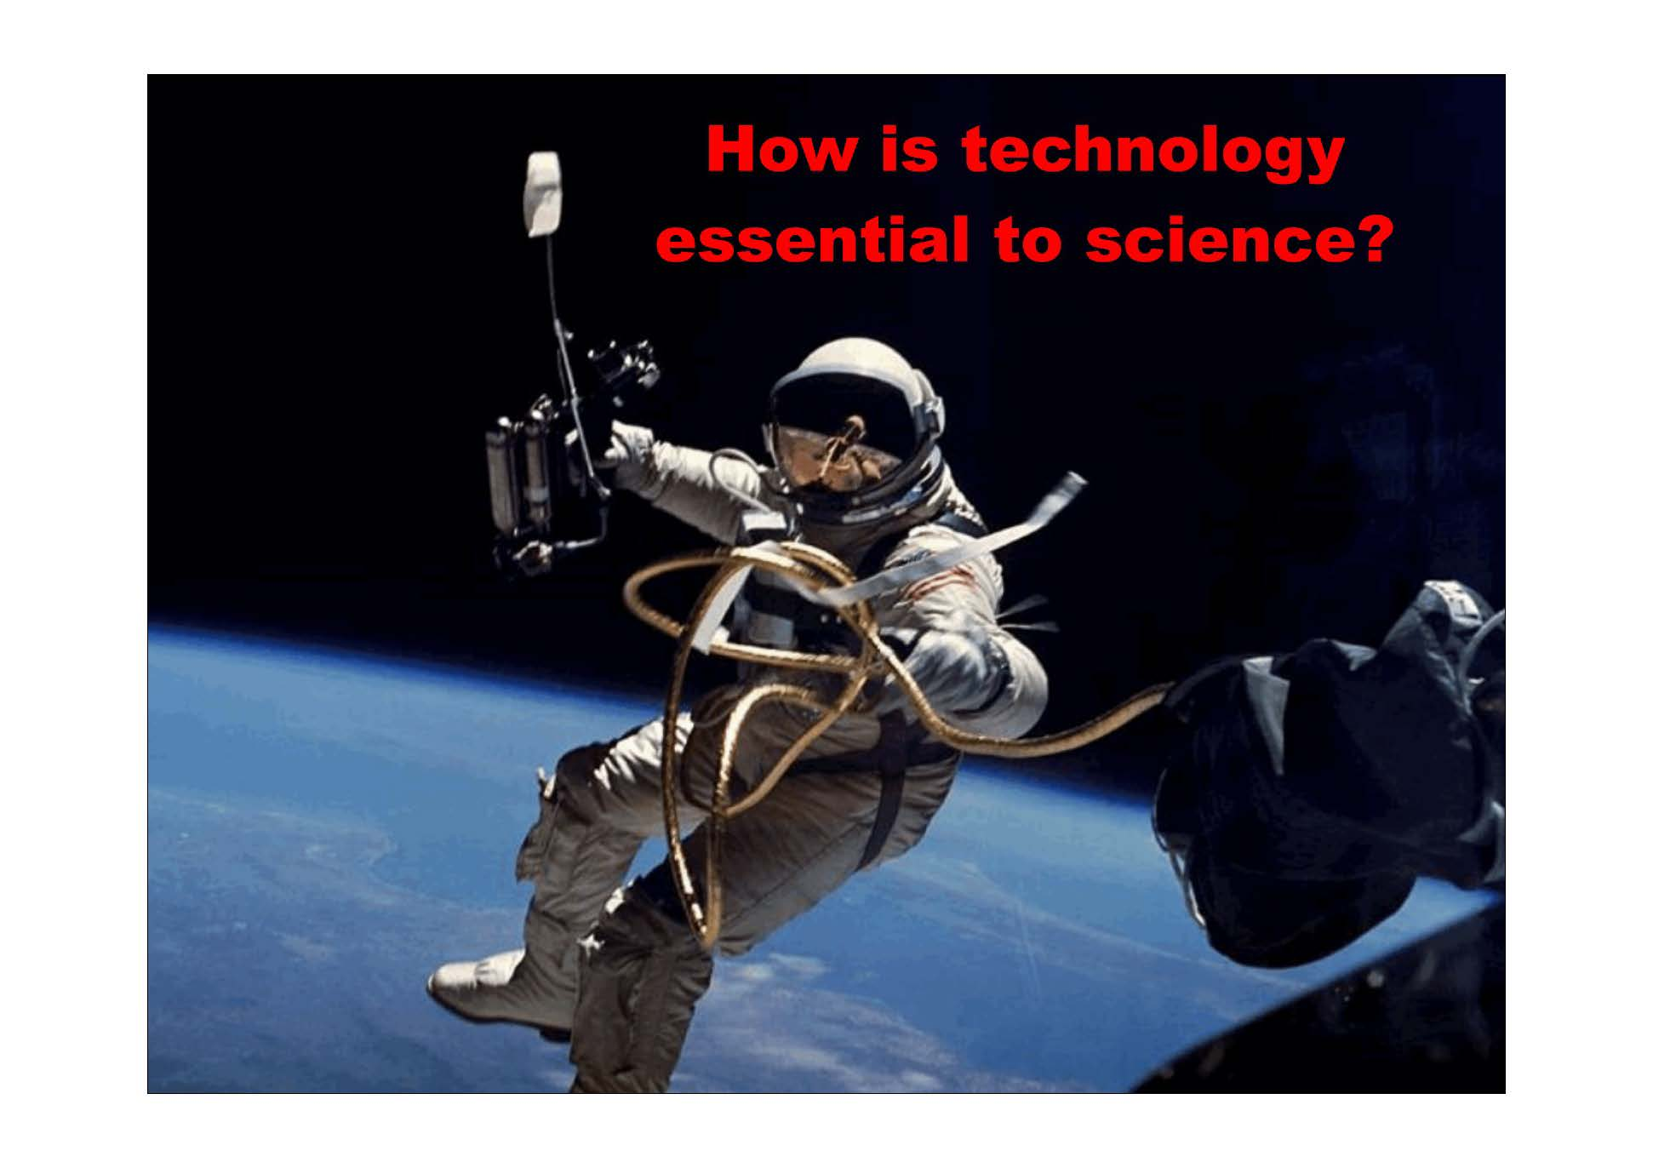

Slide 4
1. How is technology essential to science?

Slide 10
2. What is traditional biotechnology?

Slide 12
3. Fill in the chart on the next page by determining if the type of biotechnology listed would be considered “traditional” or “modern” and then provide a reason this technology might be beneficial to a previous society, our society, or society in the future.

Slide 14
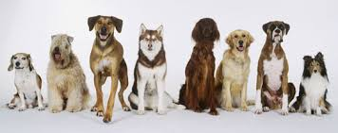

Slide 15
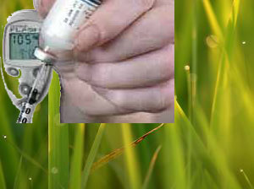

Slide 16
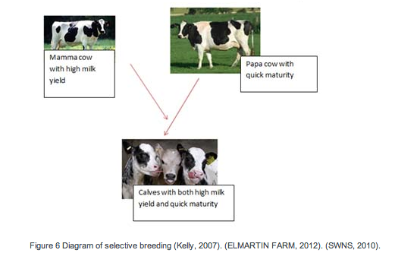

Slide 20
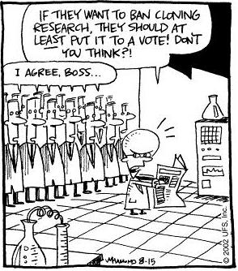
4. Provide at least two reasons why some people might find the scientist in this cartoon unethical.
http://www.skewsme.com/cloning.html#axzz2pv45rYHp

Slide 22
5. Identify what biotechnology tools the scientist probably has used by completing the chart.
BIOTECHNOLOGY TOOL USED | YES or NO
Working with Cells
Working with Proteins
Working with Genes
http://www.skewsme.com/cloning.html#axzz2pv45rYHp

Slide 24
6. Read the following scenario:
Your mother and father wanted a baby (YOU!) very much and wanted to be prepared just in case you were ever in a situation where you might need an organ transplant. They allowed the doctor to take some of your cells while in utero and create a clone of you. The clone was carried in a surrogate mom and born a couple of months after you. Your clone was raised and loved by adoptive parents in northern Alaska. You and your parents live in sunny Florida. Your clone’s father was a smoker, but you were never exposed to any second hand smoke growing up.

Slide 25
Use your knowledge of genes and the environment to support one of the following claims you believe is correct.
CLAIM 1: My clone would have the exact same DNA as me and look identical to me.
CLAIM 2: My clone would have the exact same DNA as me, but looks a little different than me.

Slide 26
I support CLAIM # ______
Provide evidence from the scenario that supports your claim.
What is the scientific reason that proves your evidence is correct?

Slide 27
7. List 3 ways in which industries might use biotechnology.

Slide 30
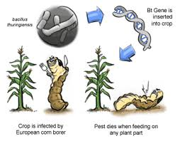
8. Label the transgenic organism in the picture.

Slide 32
9. Why does society need to be well informed about biotechnology?

Slide 34
10. List at least 2 reasons why biotechnology is important in North Carolina.

