Slide 1
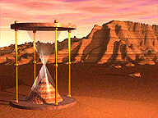
A Trip Through Geologic Time

Slide 2
What is a fossil?
A fossil is the preserved remains of a once-living organisms. .
What do fossils tell us?
Fossils give clues about organisms that lived long ago. They help to show that evolution has occurred.
They also provide evidence about how Earth’s surface has changed over time.
Fossils help scientists understand what past environments may have been like.

Slide 3
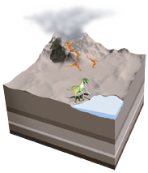
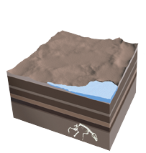
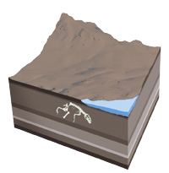
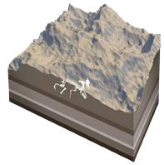
HOW IS A FOSSIL FORMED?
1. Sediment
An animal is buried by sediment, such as volcanic ash or silt, shortly after it dies. Its bones are protected from rotting by the layer of sediment.
2. Layers
More sediment layers accumulate above the animal’s remains, and minerals, such as silica (a compound of silicon and oxygen), slowly replace the calcium phosphate in the bones.
3. Movement
Movement of tectonic plates, or giant rock slabs that make up Earth’s surface, lifts up the sediments and pushes the fossil closer to the surface.
4. Erosion
Erosion from rain, rivers, and wind wears away the remaining rock layers. Eventually, erosion or people digging for fossils will expose the preserved remains.

Slide 4
How is a Fossil Formed?
An animal is buried by sediment
Layers of sediment build up on the animal
Movement of tectonic plates force the fossil to the surface
Erosion by wind and water expose the fossil

Slide 5
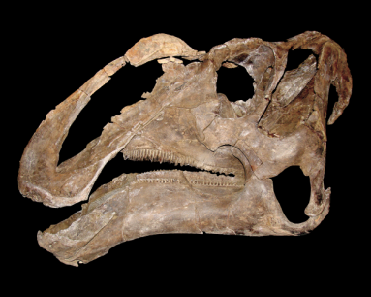
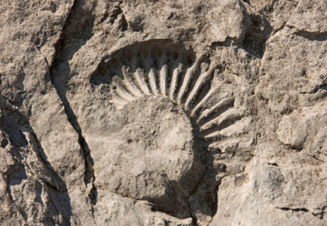
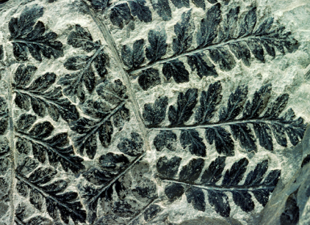
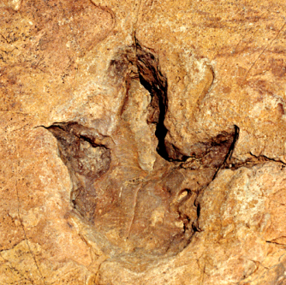
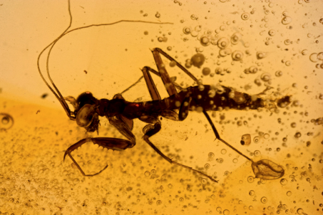
FIVE MAIN TYPES OF FOSSILS
Petrified
Fossils
Molds and
Casts
Carbon Films
Trace
Fossils
Preserved
Remains

Slide 6
Fossils
Fossils are preserved remains or traces of living things.
Most fossils form when living things die and are buried by sediments.
The sediments slowly harden into rock and preserve the shape of the organisms.
Scientists who study fossils are paleontologists.

Slide 7
Fossils
Fossils are usually found in sedimentary rocks.
When an organism dies, its soft parts often decay quickly leaving only the hard parts to fossilize.
Ex. Bones, Shells, Teeth, or Seeds

Slide 8
Kinds of Fossils
Petrified Fossils: fossils in which minerals replace all or part of the organism. Ex: petrified wood
When the object is buried by sediment, water rich in minerals seeps into the cells. After the water evaporates, hardened minerals are left behind.

Slide 9
Kinds of Fossils
Molds and Casts
A mold is a hollow area in sediment in the shape of an organism or part of an organism.
A cast is a copy of the shape of an organism.

Slide 10
Kinds of Fossils
Carbon Films: an extremely thin coating of carbon on rock that forms when materials that make up an organism become gases and escape leaving only carbon behind.
Trace Fossils provide evidence of the activities of ancient organisms. Ex: footprints, animal trails, or animal burrows.

Slide 11
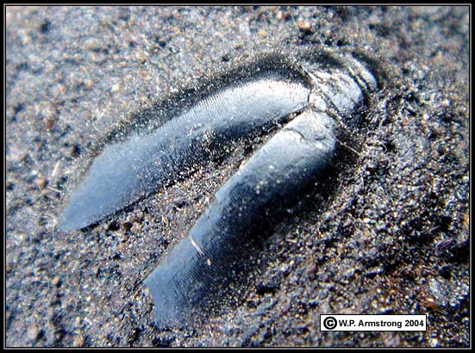
Kinds of Fossils
Preserved Remains are formed when an organism is preserved with little or no change.
For example when organisms become preserved in tar, amber (tree sap), and freezing.

Slide 12
Why Study Fossils?
Scientists study fossils to learn what past life forms were like.
Paleontologists classify organisms in the order in which they lived.
All the information scientists have gathered is called the fossil record.

Slide 13
Fossil Record
The fossil record provides evidence about the history of life on Earth.
The fossil record also shows how different groups of organisms have changed over time.
It also provides evidence to support the theory of evolution.

