Slide 1
Chemistry 8.P.1
8.P.1.1 Classify matter as elements, compounds, or mixtures based on how the atoms are packed together in arrangements.
8.P.1.2 Explain how the physical properties of elements and their reactivity have been used to produce the current model of the Periodic Table of elements.
8.P.1.3 Compare physical changes such as size, shape and state to chemical changes that are the result of a chemical reaction to include changes in temperature, color, formation of a gas or precipitate.

Slide 2
8.P.1.1 Classifying Matter
1. Which of the following best describes an element?
A pure substance used to describe matter
A substance that cannot be changed easily into another substance
A substance that can only be found in mixtures
A substance that is chemically combined

Slide 3
Which of the following represents a mixture?
A piece of copper wire
Air in the atmosphere
Sugar
A gold coin

Slide 4
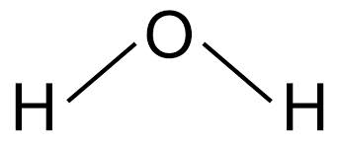
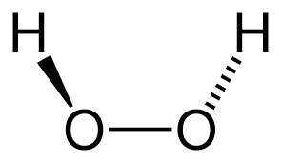
3. H2O and H2O2 are two compounds that are formed by bonding hydrogen and oxygen. These compounds demonstrate that
Elements combine in many different ways to make compounds
Elements combine randomly
Both compounds are gases
Hydrogen peroxide has more elements in it

Slide 5
4. You are trying to separate a mixture of water, sand and iron that are frozen together. The mixture is relatively easy to separate because
The substances are chemically combined
The substances are physically combined
The mixture is a homogenous mixture
The mixture is a solution

Slide 6
5. Which of the following is the BEST example of a homogenous mixture? Choose the best answer and explain why you chose that answer.
Soil
Cement
Salt water
Chicken noodle soup

Slide 7
8.P.1.2 Periodic Table
What do elements in the same family have in common?
Number of protons
Masses of their atoms
Similar chemical properties
State of matter

Slide 8
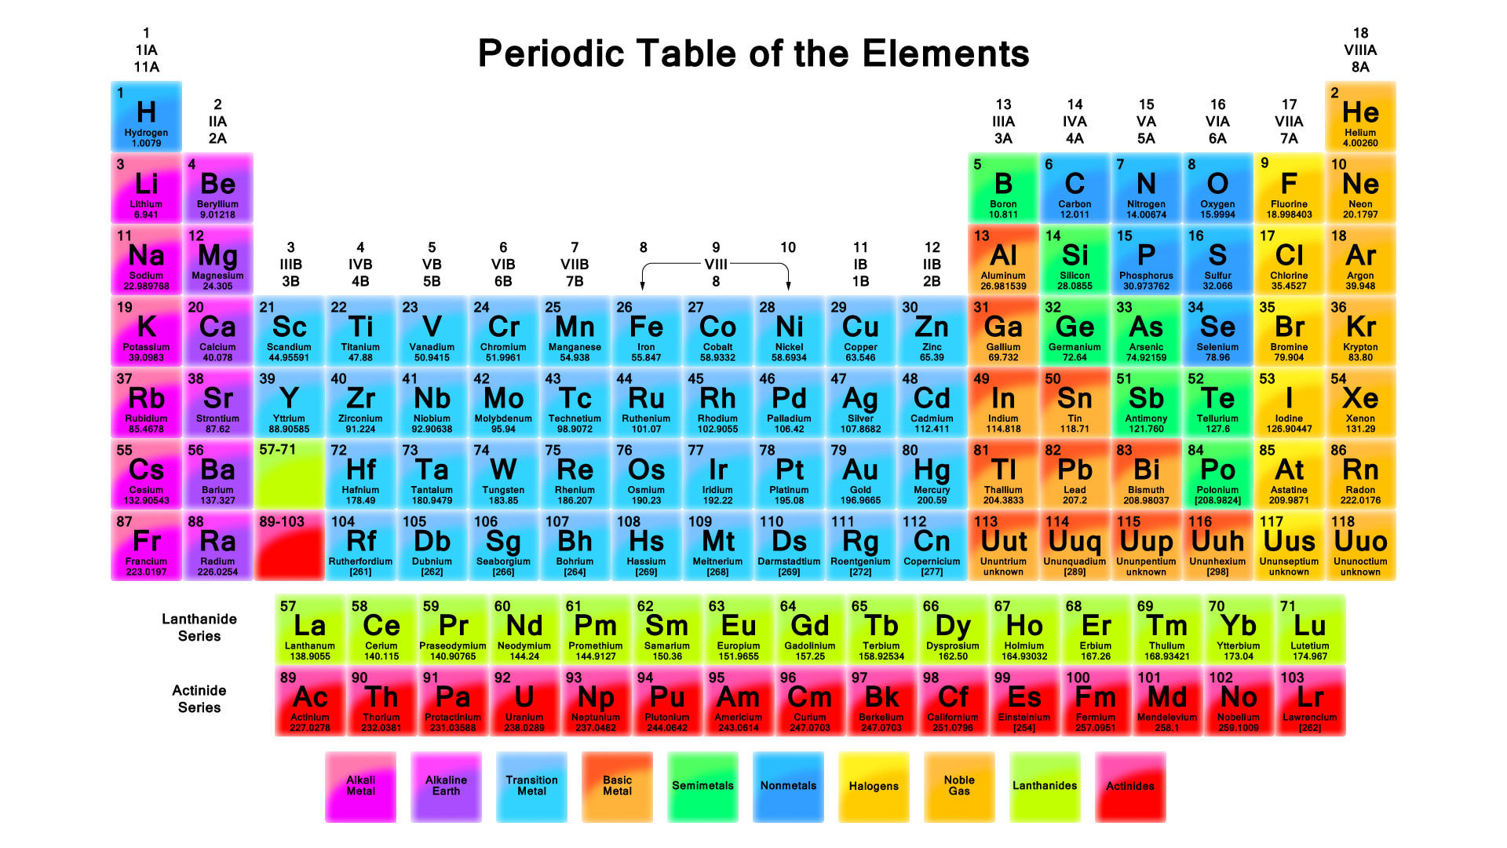
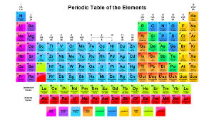
Which of the elements listed below has properties most like helium?
Fluorine
Gallium
Xenon
Mercury

Slide 9
The Noble gases are found in family 18 of the periodic table. Which statement about the Noble gases is correct?
They consist of solids, liquids and gases
They are highly reactive with other elements
They have a full shell of valence electrons and are unreactive
They form compounds easily

Slide 10
According to the periodic table, most nonmetals are
Liquids
Poor conductors of heat and electricity
Easy to hammer and shape
Shiny in appearance

Slide 11
In order to find carbon in the periodic table, what group and period must you use?
Period 14, group 2
Period 16, group 6
Period 15, group 3
Period 2, group 14

Slide 12
6. Explain the organization of the modern periodic table.

Slide 13
8.P.1.3 Physical and Chemical Reactions
1. Which of the following is a chemical property of matter?
Luster
State of matter
Malleability
Flammability

Slide 14
Which of the following may happen during a physical change?
New substances are created
Reactants form products
Phase changes may occur due to a change in temperature
A precipitate may form

Slide 15
3. A student plans to build an electric motor for his science fair project. He decides to test how well different materials conduct electricity from the batteries to the motor. Which of the following materials will be the best conductor for the motor?
A rubber band
A copper wire
A glass rod
A plastic rod

Slide 16
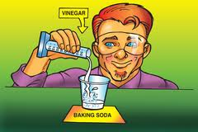
4. When baking soda and vinegar are combined, what evidence suggests that a chemical change has occurred?
The baking soda dissolves in the vinegar
A gas is produced
Light is given off
The state of matter changes

Slide 17
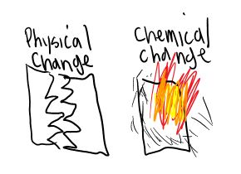
5. Observe the picture to the right. Explain in your
own words the difference between a physical and a
chemical change in matter.
Describe 4 indicators of a chemical reaction.
_________________________
_________________________
_________________________
_________________________

Slide 18
If 94 grams of a product (WX) are produced from a chemical reaction that started with 44 grams of X, how many grams of W went into the chemical reaction?
Give an example of each of the following:
Element
Compound
Solution
Heterogeneous Mixture

Slide 19
9. Which of the following statements refers to a physical property of a substance?
Carbon combines with oxygen to produce carbon dioxide
The density of copper is 8.93 g/cm3
Acids are corrosive
Zinc metal reacts with an acid to produce hydrogen gas

Slide 20
What physical properties make metals suitable for use in electrical wiring?
Malleability and ductility
Conductivity and ductility
Solubility and malleability
Magnetism and ductility

Slide 21
Describe the picture of the duck as if you were talking to a person who was blindfolded.
Think about the physical properties of the duck as you describe it.

Slide 22
Energy 8.P.2
8.P.2.1 Explain the environmental consequences of the various methods of obtaining, transforming, and distributing energy.
8.P.2.2 Explain the implications of the depletion of renewable and nonrenewable energy resources and the importance of conservation.

Slide 23
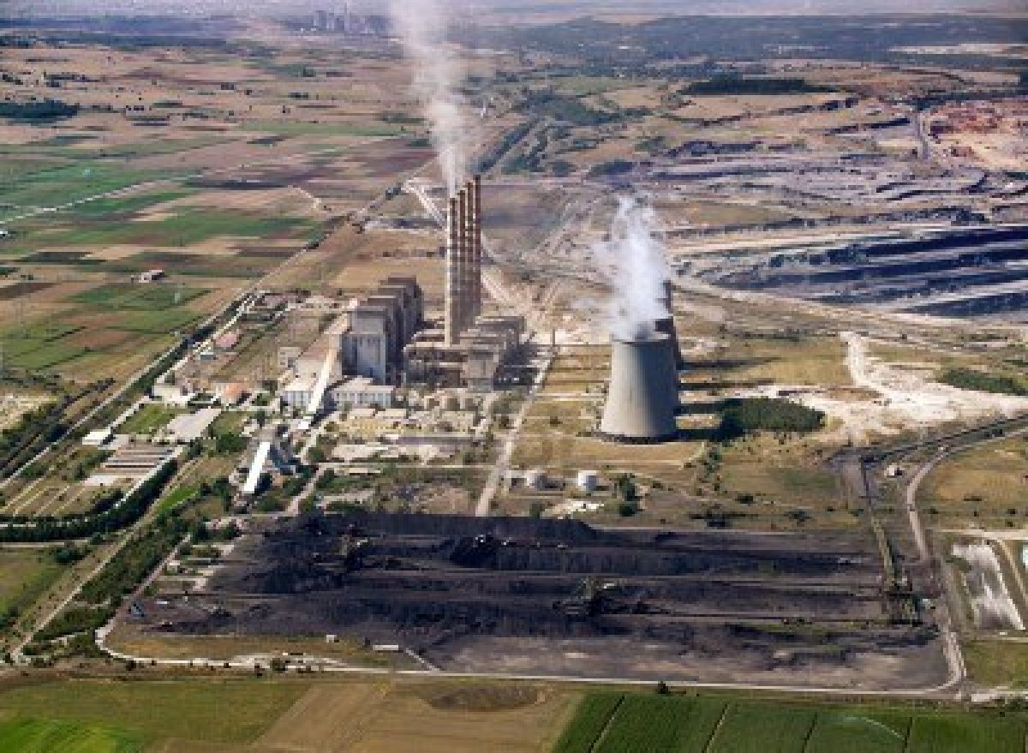
8.P.2.1 Environmental Consequences of Obtaining Energy
People object to the burning of fossil fuels because
They are cheap
They produce a lot of energy
They release polluting gases
They are renewable

Slide 24
2. Opponents of hydraulic fracturing would most likely agree with which of the following statements?
Fracking is good for the economy and land
Natural gas is a good renewable energy source
Fracking is environmentally safe
Fracking could lead to an increase in natural gas/methane in water sources

Slide 25
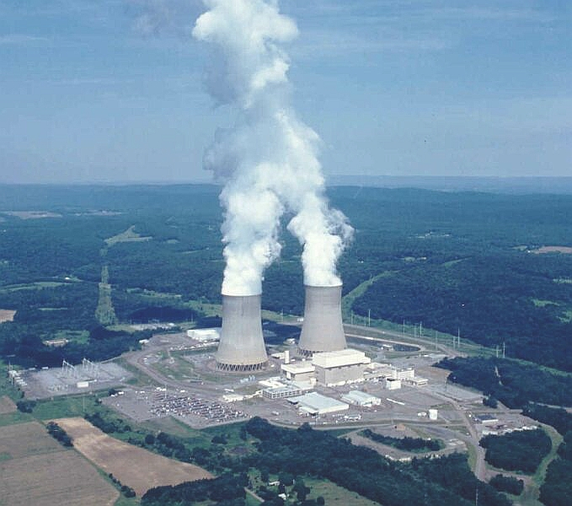
3. A negative effect of nuclear energy is
Too much energy
Radioactive waste
Clean energy
All are negative effects

Slide 26
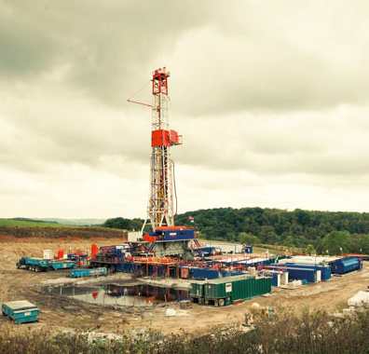
4. Positive impacts of drilling for natural gas in the US include all of the following except
An increase in jobs
Less reliance on importing natural gas from other countries
Cleaner burning energy source
An increase in traffic and construction

Slide 27
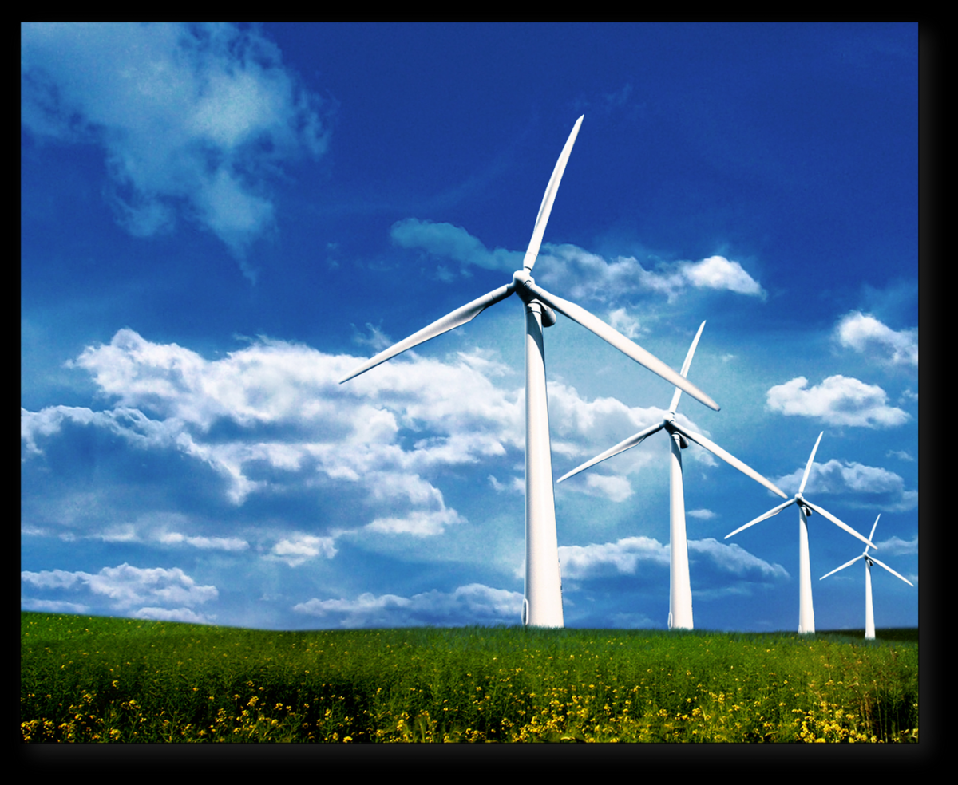
Which of the following is NOT true of wind energy?
Wind energy is reliable
Wind energy will not produce any waste or greenhouse gases
Wind energy uses no fuel to run the turbines
Wind energy is renewable

Slide 28
8.P.2.2 Renewable and Nonrenewable Energy
Which of the following statements can be used to describe renewable energy?
It will run out
Most renewable energy resources do not need to be burned
It pollutes the environment
They all use the power of the sun

Slide 29
2. A non-renewable energy source
Can be plugged in and charged
Will eventually run out
Will not work for new appliances
Can be used over and over again

Slide 30
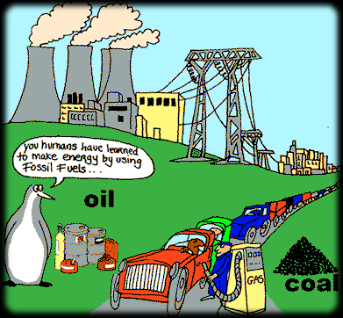
Which of the following best describes why fossil fuel supplies are limited?
Only small amounts of fossil fuels ever formed and early humans used most of the supply
Fossil fuels exist in large quantities, but they are difficult for scientists to locate
Fossil fuels formed over millions of years and they are being used more rapidly than they can be replaced
People are not allowed to use large amounts of fossil fuels

Slide 31
4. Which of the following is NOT a biomass energy source?
Wood
Crops
Petroleum
Animal waste

Slide 32
5. Predict what will happen to non-renewable energy sources as the US population increases and energy consumption increases.
Our resources will run out faster
Our resources will last longer
There will be no change in the amount of resources used
Renewable resources will also run out

Slide 33
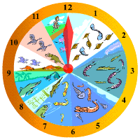
8.E.2 Earth History
8.E.2.1 Infer the age of Earth and relative age of rocks and fossils from index fossils and ordering of rock layers (relative dating and radioactive dating).
8.E.2.2 Explain the use of fossils, ice cores, composition of sedimentary rocks, faults, and igneous rock formations found in rock layers as evidence of the history of the Earth and its changing life forms.

Slide 34
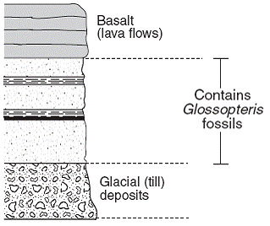
8.E.2.1 Age of Earth, Rocks and Fossils
The diagram shows a cross section of land that
has not been overturned and contains fossils. Which
event occurred last at this location?
Shale was deposited
Glacial till was deposited
Basaltic lava flows became solid
Glossopteris thrived and then became extinct

Slide 35
2. A scientist wants to find the absolute age of a rock. Which of these is the scientist most likely to use?
Radioactive dating
Law of Superposition
Geologic Time Scale
Ice cores

Slide 36
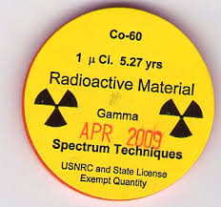
3. Cobalt-60 has a half-life of 5 years. How many years will it take for 100 grams of Cobalt-60 to be reduced to 6.25 grams?
5 years
10 years
15 years
20 years

Slide 37
4. An unstable isotope has a half-life of 10 years. If there were 60 grams of the isotope to begin with, how many grams of it would remain after 40 years?
15 grams
7.5 grams
3.75 grams
30 grams

Slide 38
5. Which life form is most likely to be found in the lowest level of sedimentary rock?
Dinosaurs
Early humans
Simple marine organisms
Sabre toothed tigers

Slide 39
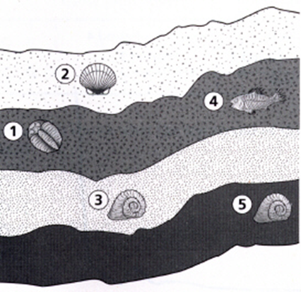
According to the diagram, which statement
is true about the fossils in the rock layers?
Fossil 1 is older than fossil 4
Fossil 1 is younger than fossil 2
Fossil 3 is younger than fossil 5
Fossil 3 is the same age as fossil 5

Slide 40
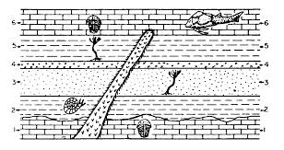
7. According to the diagram, what can
you infer about the age of the igneous
intrusion compared to the other layers
of rock. Explain your reasoning.

Slide 41
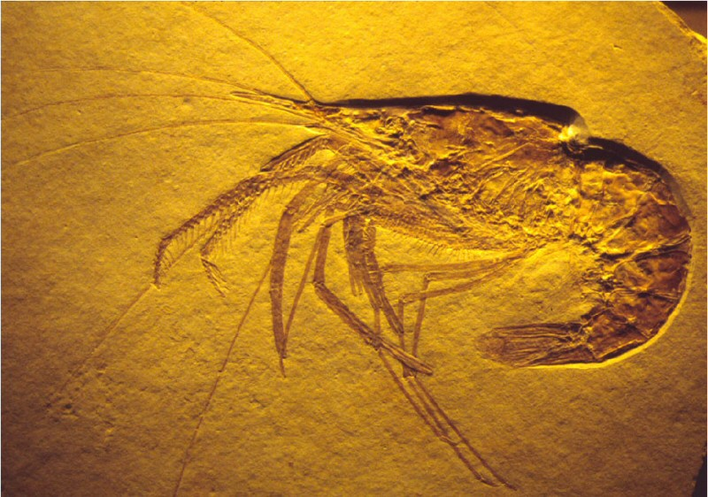
8.E.2.2 Fossils, ice cores and rocks as evidence of Earth’s history
Fossils are useful to develop
A timeline of future species
A history of the stability of life
Predictions about the future
A history of the Earth

Slide 42
2. A scientist finds fossils from the same organism in India and Africa. What is a possible explanation for the presence of these fossils on two different continents?
Adaptation
Continental drift
Climate change
Law of superposition

Slide 43
3. When scientists analyze the fossil record, they find organisms that are similar to some organisms of today with noticeable changes. How does this help scientists to interpret the past?
It doesn’t help them at all
It allows them to see how organisms have changed over time
It allows them to see how organism have remained the same over time
It allows them to see that there is no relationship between the past and today

Slide 44
4. How can fossils tell us about Earth’s past?
Fossils give clues about environmental changes where organisms lived
Fossils can be used to date the time period of rocks and rock layers when the organism lived
Fossils can give clues of changes in the organism body structure over time
All of the above

Slide 45
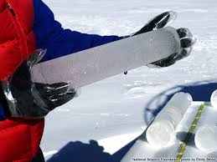
5. Ice cores provide evidence of Earth’s
Rock layers
Atmosphere and climate change
Ocean composition
Index fossils

Slide 46
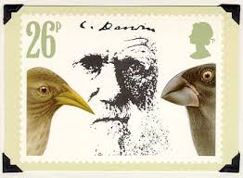
8.L 4 Evolution and Genetics
8.L.4.1 Summarize the use of evidence drawn from geology, fossils, and comparative anatomy to form the basis for biological classification systems and the theory of evolution.
8.L.4.2 Explain the relationship between genetic variation and an organism’s ability to adapt to its environment.

Slide 47
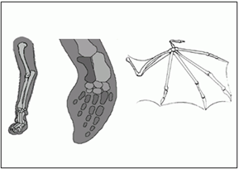
8.L.4.1 Biological Classification Systems and the Theory of Evolution
The front leg of a cat, the front flipper of a dolphin,
and the wing of a bat have the same structure and order
of bones. These structures do not look alike and do
not have the same function, but their bones are similar.
What might scientists say about the cat, dolphin and bat based on this evidence?
a. They are homologous structures and indicate a common ancestor b. they are analogous structures and indicate different ancestors c. they all live in an aquatic environment d. they all have the ability to fly

Slide 48
2. Which of the following is not an example of a vestigial structure?
Appendix in humans
Leg bones in whales
Wings of bats
Wisdom teeth in humans

Slide 49
3. Which is a basis for biological classification?
Sharing similarities in behavior
Sharing the same ecosystem
Sharing a common ancestor
Sharing similar places in the food web

Slide 50
8.L.4.2 Genetic Variation and Adaptation
1. How does a species survive a climate change over thousands of years?
It reproduces more rapidly
It hibernates and waits for better climate conditions
It makes no changes
It adapts to the changing climate

Slide 51
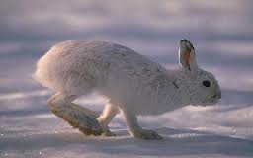
2. The snowshoe hare has the ability to change its coat color. It is brown during the spring, summer and early fall but changes to white as winter approaches. What adaptation does the snowshoe hare have that allows it to hide from predators?
Symbiosis
Commensalism
Camouflage
All of the above

Slide 52
3. Which of the following, over time, is most likely to lead to speciation?
Geographic isolation
A forest fire
An earthquake
Falling sea levels

Slide 53
4. Which of the following plant adaptations would not protect the plant from being eaten by herbivores?
Leaves that are covered by tiny, sharp spines
Leaves that have a very bitter taste
Leaves that contain a poisonous chemical
Leaves that store large amounts of water

Slide 54
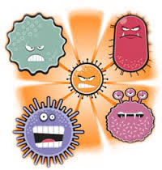
8.L.1 Structure and Function of Living Organisms
8.L.1.1 Summarize the basic characteristics of viruses, bacteria, fungi and parasites relating to the spread, treatment and prevention of disease.
8.L.1.2 Explain the difference between epidemic and pandemic as it relates to the spread, treatment and prevention of disease.

Slide 55
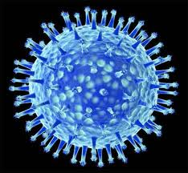
8.L.1.1 Microbes and Disease
1. Which best explains how a virus affects other organisms?
Viruses increase the survival of other organisms
Viruses immediately destroy all cells they come in contact with
Viruses live and reproduce in between the cells of other organisms
Viruses invade the cells of other organisms, using them to reproduce

Slide 56
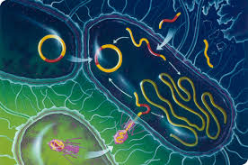
2. Which of the following structures are not found in a bacterial cell?
Cytoplasm
Nucleus
Ribosomes
Cell membrane

Slide 57
3. Which would be the least effective in treating an illness caused by a virus?
Drinking plenty of fluids
Widespread vaccinations
Getting extra sleep
Daily treatment with antibiotics

Slide 58
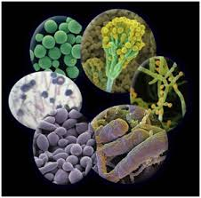
4. Which kind of organisms are disease causing yeasts and molds?
Bacteria
Fungi
Parasites
viruses

Slide 59
8.L.1.2 Pandemic and Epidemic
1. Which of these is best described as a pandemic?
A student catches the flu from her younger brother
Three members of a soccer team come down with the flu
Dozens of people in two neighboring towns have flu at the same time
Tens of millions of people worldwide are infected with the flu in the same year

Slide 60
2. Which of the following is an example of an epidemic?
Dengue fever in an African village
Smallpox outbreak on several continents
Swine flu cases reported in multiple countries
Many people affected by tuberculosis worldwide

Slide 61
3. Which poses the greatest challenge for researchers when attempting to locate the source of a nationwide food based salmonella outbreak?
Cost of the study
Number of food producers involved
Time needed for the study
Number of people infected

Slide 62
4. Which best explains why researchers are working to improve antimicrobial drugs?
Microbes are becoming more resistant to current drugs
Microbes are learning to detect current drugs
Microbes are growing too large to be stopped by current drugs
Microbes are being wiped out by antimicrobial drugs

Slide 63
8.L.5 Molecular Biology
8.L.5.1 Summarize how food provides the energy and the molecules required for building materials, growth and survival of all organisms (to include plants).
8.L.5.2 Explain the relationship among a healthy diet, exercise, and the general health of the body (emphasis on the relationship between respiration and digestion).

