Slide 1
PURE SUBSTANCE
A pure substance is a type of matter with a fixed makeup of atoms. Elements are always a pure substance. H2O and NaCl, is a pure substance, it is always the same. But NOT when mixed together in a solution!
Substances can be either elements or compounds.

Slide 2
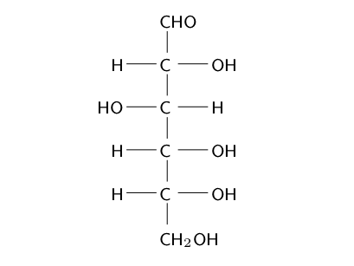
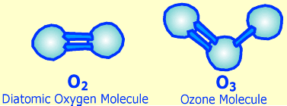
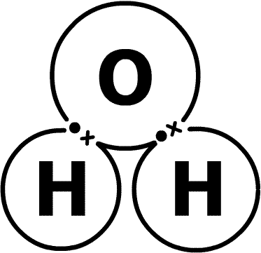
Counting atoms/elements
C₆H₁₂O₆
O₂
H₂O

Slide 3
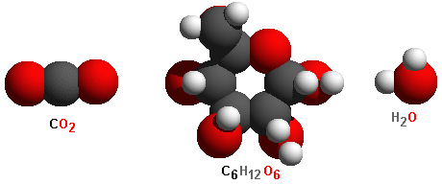
What are these molecule’s formulas?
Grey = Carbon Red = Oxygen White = Hydrogen

Slide 4
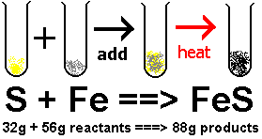
Law of Conservation of Mass*
Matter can neither be created nor destroyed, it can only change form.

Slide 5
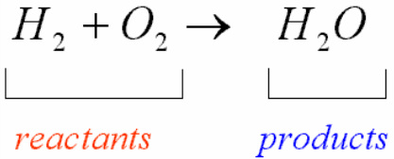
Balanced Chemical Equation

Slide 6
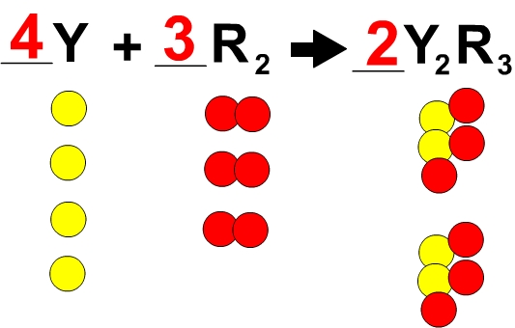
Balanced Chemical Equations

Slide 7
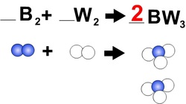
Balanced Chemical Equation

Slide 8
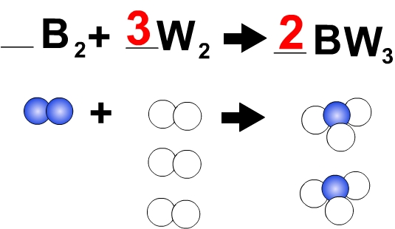
Balanced Chemical Equation

Slide 9
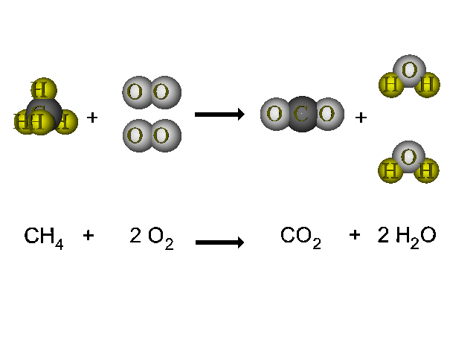
Balanced Chemical Equation

Slide 10
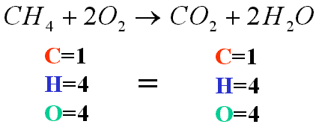
Balanced Chemical Equation

Slide 11
It is balanced?
Oxidation of glycerin (1,2,3-propanetriol) by potassium permanganate is ... Equation. 14KMnO4 + 4C3H5(OH)3 --> 7K2CO3 + 7Mn2O3 + 5CO2 + 16H2O.
Potassium Permanganate + Glycerin + Oxygen →
Potassium Carbonate + Carbon Dioxide + Water
14KMnO₄ + 4C₃H₅(OH) ₃ → 7K₂CO₃ + CO₂ + 16H₂O
Notes:
Potassium Permanganate Demo

Slide 12
Balancing Chemical Equations
Write and balance (coefficients) the following:
__ H₂ + __O₂ → __H₂O
__Fe + __Cl₂ → __FeCl₃
__Li + __H₂O → __LiOH + __H₂
__Al + __S₈ → __Al₂S₃
__Al(OH)₃ → __Al₂O₃ + __H₂O

Slide 13
__Fe + __Cl₂ → __FeCl₃

Slide 14
__Li + __H₂O → __LiOH + __H₂

Slide 15
__Al + __S₈ → __Al₂S₃

Slide 16
__Al(OH)₃ → __Al₂O₃ + __H₂O

Slide 17
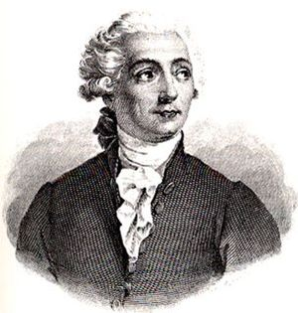
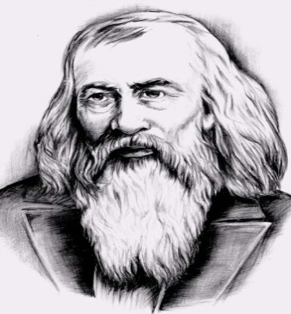
Atomic Structure
Periodic Table
List and explain all three sub atomic particles.
Explain how those particles are arranged in an atom.
Estimate how many atoms there are in the following: A penny, an apple, a bottle of
water, and your body. (Try and use
x10^{x} exponents.)
Name three different ways the periodic table is organized.
Explain why Hydrogen is on the left side of the Periodic Table and Helium is on the far right.
Atomic #
Complete the box on the left for the element Gold.
Chemical
Symbol
Draw an atom of Boron, Chlorine, or Sodium. Label each part including the nucleus and the electron cloud.
Chemical Name
Atomic Mass
Sodium
Compounds and Molecules
Chemical and Physical
Explain the difference between a
molecule and a compound.
Write the chemical formula for the following and label them as a compound, molecule, or both: water, carbon dioxide,
oxygen (in the air), and
sugar (if you know it).
Give 5 physical properties of a nail.
Give 2 chemical properties of a nail.
Explain the difference between
a physical change and a
chemical change.
Give an example of each.
Draw Lavoisier
Draw Mendeleev
Notes:
Use Chromebooks for the last 20 minutes of class if necessary.

Slide 18
Elephant Toothpaste
Write and balance (coefficients) the following:
2 H₂O₂ → 2 H₂O + O₂
Why is there only 1 reactor when there are four ingredients?
Notes:
Elephant Toothpaste

